Slide 1

SFY 2026-27 MN Youthbuild Program Competitive Grants Interested Parties Webinar
DEED Office of Youth Development
June 2025

Slide 2
Agenda
Grant Coordinator Introduction and Correspondence with DEED
Important Dates
Funding and Match Requirements
MN Youthbuild Program Overview
Statutory language requirements
Program design and MN Youthbuild program model
MN Youthbuild RFP and Application Packet Overview
Proposal components
Evaluation criteria
Additional forms and grant requirements
Wrap-Up and Reminders

Slide 3
MN Youthbuild Grant Coordinator and Correspondence with DEED
Nancy Waisanen – Program Coordinator, Office of Youth Development. Nancy.Waisanen@state.mn.us
During the RFP process, all questions, concerns, and comments must be written in an email and sent to Youth.Team.DEED@state.mn.us. Answers will be posted at: https://mn.gov/deed/about/contracts/open-rfp.jsp under “Minnesota Youthbuild Competitive Grants / Q&A file”
Note: All information in this webinar will also be listed in the RFP and Application Packet.

Slide 4
Important Dates
June 24, 2025: Notice of the Request For Proposals (RFP) is published on DEED’s website. The full RFP notice is found at: https://mn.gov/deed/about/contracts/open-rfp.jsp
Proposals and Application Packet are due: August 15, 2025; by 11:59pm
August 2025: Review and Selection Period
September 2025: Anticipated Notification to Applicants
Anticipated Contract Period: October 1, 2025 - June 30, 2027. Second Year (SFY 23) funds will not be available until July 1, 2026.

Slide 5
Funds Available and Match Requirements
Funding is authorized in Minnesota Session Law – 2025.
A total of $950,000 in funding is available in each state fiscal year (SFY) 2026 and 2027.
The maximum amount of funding that can be requested by any single applicant is $100,000 per year under this solicitation.
Applicants are required to provide a non-state Match in cash funds or in-kind resources which is equal to or greater than the requested grant amount. Examples include: the material cost of the house or building project, federal funds/resources, local government funds/resources, partner non-state funds/resources.

Slide 6
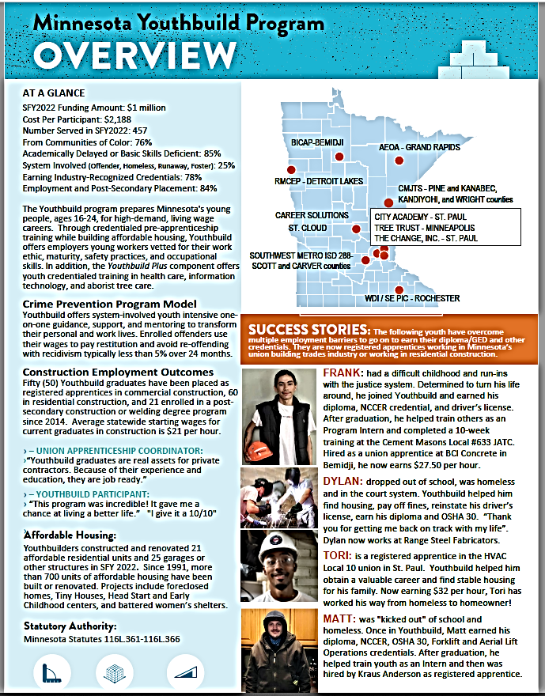
///////
MN Youthbuild Statute
MN Youthbuild is a codified state-funded program. Statutory authority, 116L.361 to 116L.366, lays out detailed and precise program requirements including eligible applicants, eligible participants, eligible building projects, program design, and reporting requirements.

Slide 7
///////
MN Youthbuild Statute 116L.361 and 116L.366:
Eligibility and Priority for Targeted Youth
“Eligible organizations” are public agency or nonprofit organizations that can demonstrate an ability to implement a program for education and training services provided to targeted youth. Organizations may include local jurisdictions, public school districts, private nonsectarian schools, postsecondary educational institutes, alternative schools, community groups, and labor organizations.
Eligible or "Targeted youth“, are at-risk individuals, between the ages of 16 years and 24, and are eligible for the high school graduation incentive program under section 124D.68, subdivision 2, or are economically disadvantaged as defined in United States Code, title 29, section 1503. Eligible youth must not be attending any school and have not received a diploma or its equivalent; or currently enrolled in a secondary education setting and who, in the opinion of an official of the school, are in danger of dropping out of the school.
Targeted youth priority groups include, per statute: (i) pregnant or parenting youth; (ii) youth who are or have been subject to any stage of the criminal justice system; (iii) youth receiving income maintenance services and social services; (iv) homeless youth; (v) minors who are not financially dependent on a parent or guardian; (vi) youth residing on a farm whose family income is substantially from farming, lack nonfarm work skills, or have limited access to vocational education or work experience opportunities.

Slide 8
MN Youthbuild Statute 116L.361 cont. Targeted Youth Definitions
Eligible for the High School Graduation Incentives Program: A pupil under the age of 21, if the pupil: (1) performs substantially below the performance level for pupils of the same age in a locally determined achievement test; (2) is behind in satisfactorily completing coursework or obtaining credits for graduation; (3) is pregnant or is a parent; (4) has been assessed as chemically dependent; (5) has been excluded or expelled according to sections 121A.40 to 121A.56; (6) has been referred by a school district for enrollment in an eligible program or a program pursuant to section 124D.69; (7) is a victim of physical or sexual abuse; (8) has experienced mental health problems; (9) has experienced homelessness sometime within six months before requesting a transfer to an eligible program; (10) speaks English as a second language or has limited English proficiency; or (11) has withdrawn from school or has been chronically truant; or (12) is being treated in a hospital in the seven-county metropolitan area for cancer or other life threatening illness or is the sibling of an eligible pupil who is being currently treated, and resides with the pupil's family at least 60 miles beyond the outside boundary of the seven-county metropolitan area.
Economically Disadvantaged: An individual who (A) receives, or is a member of a family which receives, cash welfare payments under a Federal, State, or local welfare program; (B) has, or is a member of a family which has, received a total family income for the six-month period prior to application for the program involved (exclusive of unemployment compensation, child support payments, and welfare payments) which, in relation to family size, was not in excess of the higher of (i) the official poverty line (as defined by the Office of Management and Budget, and revised annually in accordance with section 9902(2) of title 42,² or (ii) 70 percent of the lower living standard income level; (C) is receiving (or has been determined within the 6-month period prior to the application for the program involved to be eligible to receive) food stamps pursuant to the Food Stamp Act of 1977 [7 U.S.C. 2011 et seq.]; (D) qualifies as a homeless individual under subsections (a) and (c) of section 103 of the Stewart B. McKinney Homeless Assistance Act [42 U.S.C. 11302(a), (c)];

Slide 9
MN Youthbuild Statute 116L.362 and 116L.365: Eligible Housing and Building Projects
The programs are to include a work experience and construction training component that result in the rehabilitation, improvement, or construction of:
(1) Residential units for the homeless and low-income families and individuals;
(2) Improvements to the energy efficiency and environmental health of residential units and other green jobs purposes;
(3) Community garden facilities;
(4) Education, social service, or health facilities which are owned by a public agency or a private nonprofit organization.
Eligible facilities must principally provide services to homeless or low-income individuals and families and may include (a) Head Start or day care centers; b) playhouses or similar incidental structures; c) homeless, battered women, or other shelters; d) transitional housing and tiny houses; e) community health centers; youth center, and senior citizen centers, and f) community garden facilities.
Please email the Youth Team at Youth.Team.DEED@state.mn.us if you have an idea for a building project but are not sure if your proposed project is eligible.
Any residential or transitional housing units that become available through a work project that is part of the program described in section 116L.364 must be allocated in the following order of priority: (1) homeless targeted youth who have participated in constructing, rehabilitating, or improving the unit; (2) homeless families with at least one dependent; (3) other homeless individuals; (4) other families and individuals that are low-income or receive public assistance and that do not qualify in any other priority group.
Eligible organizations receiving a grant under section 116L.362 shall acquire property or buildings for the construction or rehabilitation of residential units at the lowest possible cost.
The program must address how to manage these residential units, including the source of financing for the maintenance costs of the buildings. Any management plan must include the participation of the residents and local established neighborhood groups.
Note: Low income is defined as 80% of the area median income.

Slide 10
MN Youthbuild Statute 116L.363: Program Design
Each program must include the following six components:
Orientation, Goal Planning, and Assessment, at enrollment, to understand the Youthbuild model and program policies, develop an individualized education and employment goal plan or career plan, and assess academic and work skills and career interests of each participant. Evidence or data of past success in recruiting and retaining youth is encouraged.
Education component requires participants to be progressing towards their diploma or GED, or literacy advancement. PSEO, CIS, or dual-college course credit are encouraged.
Work experience, Construction Training, and Housing component must provide meaningful vocational skills training in construction and result in the expansion of affordable residential housing or other eligible building structures targeted to low-income families and individuals. Projects must be directly supervised by individuals skilled in construction and must emphasize participant worksite and tool use safety. Note, a training wage or stipend may be provided to participants, but must not reduce their public assistance benefits, where applicable. Participants may also earn high school credits from their work experience and training participation. An explanation of why this training is best for youth and evidence or data of past success are encouraged.
Job Readiness, Career Exploration, Leadership, and Mentoring component must comprise at least 20 percent of the program, providing skills such as work readiness/soft skills (especially on-time, everyday attendance), financial literacy, interviewing skills, navigating on-line resources, job search skills, and an understanding of the building trades, unions, self-employment, and other employment opportunities. It is highly recommended that career exploration includes workshops and online resources, and field trips or tours of colleges, construction contractors, businesses, and apprenticeship training centers. Leadership, mentoring, and peer support activities must provide participants with meaningful opportunities to develop leadership skills such as decision making, problem solving, and negotiating, offer opportunities to mentor and be mentored by peers and adults, and encourage strong peer group ties that support their pursuit of work skills and values.

Slide 11
Program Design cont.
Case Management, Guidance Counseling and Support Services must be provided to participants to identify and overcome barriers (as needed) that might interfere with successful program completion. Career guidance, planning, and development of individualized education and employment goal plans and Driver’s License support for construction-bound youth are also highly recommended.
Placement Assistance and Follow Up Services must be provided to participants during enrollment or the 12-month follow-up period (after exit), as needed. Priority for placement in registered apprenticeship, career pathways employment, or post-secondary education is encouraged. Follow-up also allows for more complete diploma and placement data. Incentives may be provided to past participants to report performance outcomes.
The following components (or services/activities) align with the Department of Labor YouthBuild program, add value to the program, and are recommended and encouraged:
Other occupational training and work experience in one or more higher-wage occupations or in-demand, high growth career pathways (such as healthcare, welding, arborist tree care, law enforcement, auto mechanics, manufacturing).
Support to obtain industry-recognized safety and occupational credentials, certificates, or post-secondary credit (under occupational training and work experience component)
Stipends and incentives to participants to increase attendance, accomplish milestones, and/or performance outcomes (under applicable component).
Community Service activities and/or service projects.

Slide 12
Partnerships and Additional Program Resources
Collaboration with local partners is very important. Key partners typically include local workforce and education agencies and local non-profits or agencies that develop, build, and/or renovate affordable housing. Partner staff may also assist in education instruction, construction or other occupational training, certification or credentials, provision of support and social services and/or specific services.
Partners also provide non-state matching funds or resources to the requested grant amount for each program. Examples include: the material cost of the portion of a building project in which participants are involved, federal funds/resources, local government funds/resources, a partner’s non-state funds/resources.
Applicants are encouraged to leverage any additional funds or resources beyond the match amount and must report all funding sources and amounts used to support the program.

Slide 13
Proposal and Application Packet Requirements

Slide 14
Request for Proposals Overview
Grant funds cover SFY26 and SFY27 under one contract.
SFY26-27 grant period: October 1, 2025 (est.) through June 30, 2027.
SFY27 grant funds will not be available until July 1, 2026.

Slide 15
Application Packet
New for SFY26-27 MN Youthbuild RFP is the application packet.
The application packet must be fully complete and submitted to Youth.Team.DEED@state.mn.us by August 15, 2025, 11:59pm.
All 15 forms must be submitted in order to be considered for funding.

Slide 16
Required Proposal and Application Forms
There are 15 forms that are included in the Application Packet:
Form 1. Cover Sheet
Form 2a. Executive Summary
Form 2b. Narrative Responses
Form 3. Work Plan
Form 4a. Budget – SFY26
Form 4b. Budget – SFY27
Form 4c. Budget Detail – SFY26 and SFY27
Form 4d. Evidence of Match
Form 5. Partnership Chart

Slide 17
Required Proposal and Application Forms cont.
Form 6. Unemployment Insurance Account Consent
Form 7. Applicant Conflict of Interest Disclosure Form
Form 8. Performance Capacity
Form 9. No Conviction of Felony Financial Crime by Principal
Form 10. Evidence of Good Standing
Form 11. Required Nonprofit Grantee Documents

Slide 18
Overview of Evaluation Methodology
The review committee will evaluate all eligible applications received by the deadline.
Past performance will be taken into account in proposal evaluation.
Proposals are evaluated on a 100-point scale.
Applicants should thoroughly address each of the questions and/or items in the space provided, while being aware of each section’s 400-word limit.
The Commissioner of DEED will review all committee recommendations and is responsible for award decisions. The Commissioner of DEED reserves the right to prioritize resources to proposals that address racial equity and geographical location, and to increase or decrease the amount of the funding requested. The award decisions of DEED are final and not subject to appeal.

Slide 19
Evaluation Criteria and Scoring
The scoring factors and weight that applications will be judged on are:
1. Executive Summary: 2 points
2. Project Design: 30 points
3. Project Goals, Activities, and Timetables: 20 points
4. Partnership: 10 points
5. Evaluation and Reporting: 10 points
6. Capacity, Relevant Experience, and Equity: 10 points
7. Budget and Budget Narrative: 8 points
8. Work Plan: 10 points
Total points – 100 points.

Slide 20
2a. and 2b. Narrative Responses Limitations
Each section in the Executive Summary and Narrative Response portion (Forms 2a. and 2b.) of the application packet has a set word limit of 400 words per response. You will not be able to exceed those word limits when writing your proposal.
Do not provide additional narrative responses to the RFP beyond the 400-word limitations set in the application packet. Additional information will not be reviewed or scored.
If a particular response appears too lengthy, you may use partial sentences and/or omit needless words to remain within the 400-word limit. Reviewer Guidelines will make note of this so reviewers will be aware.

Slide 21
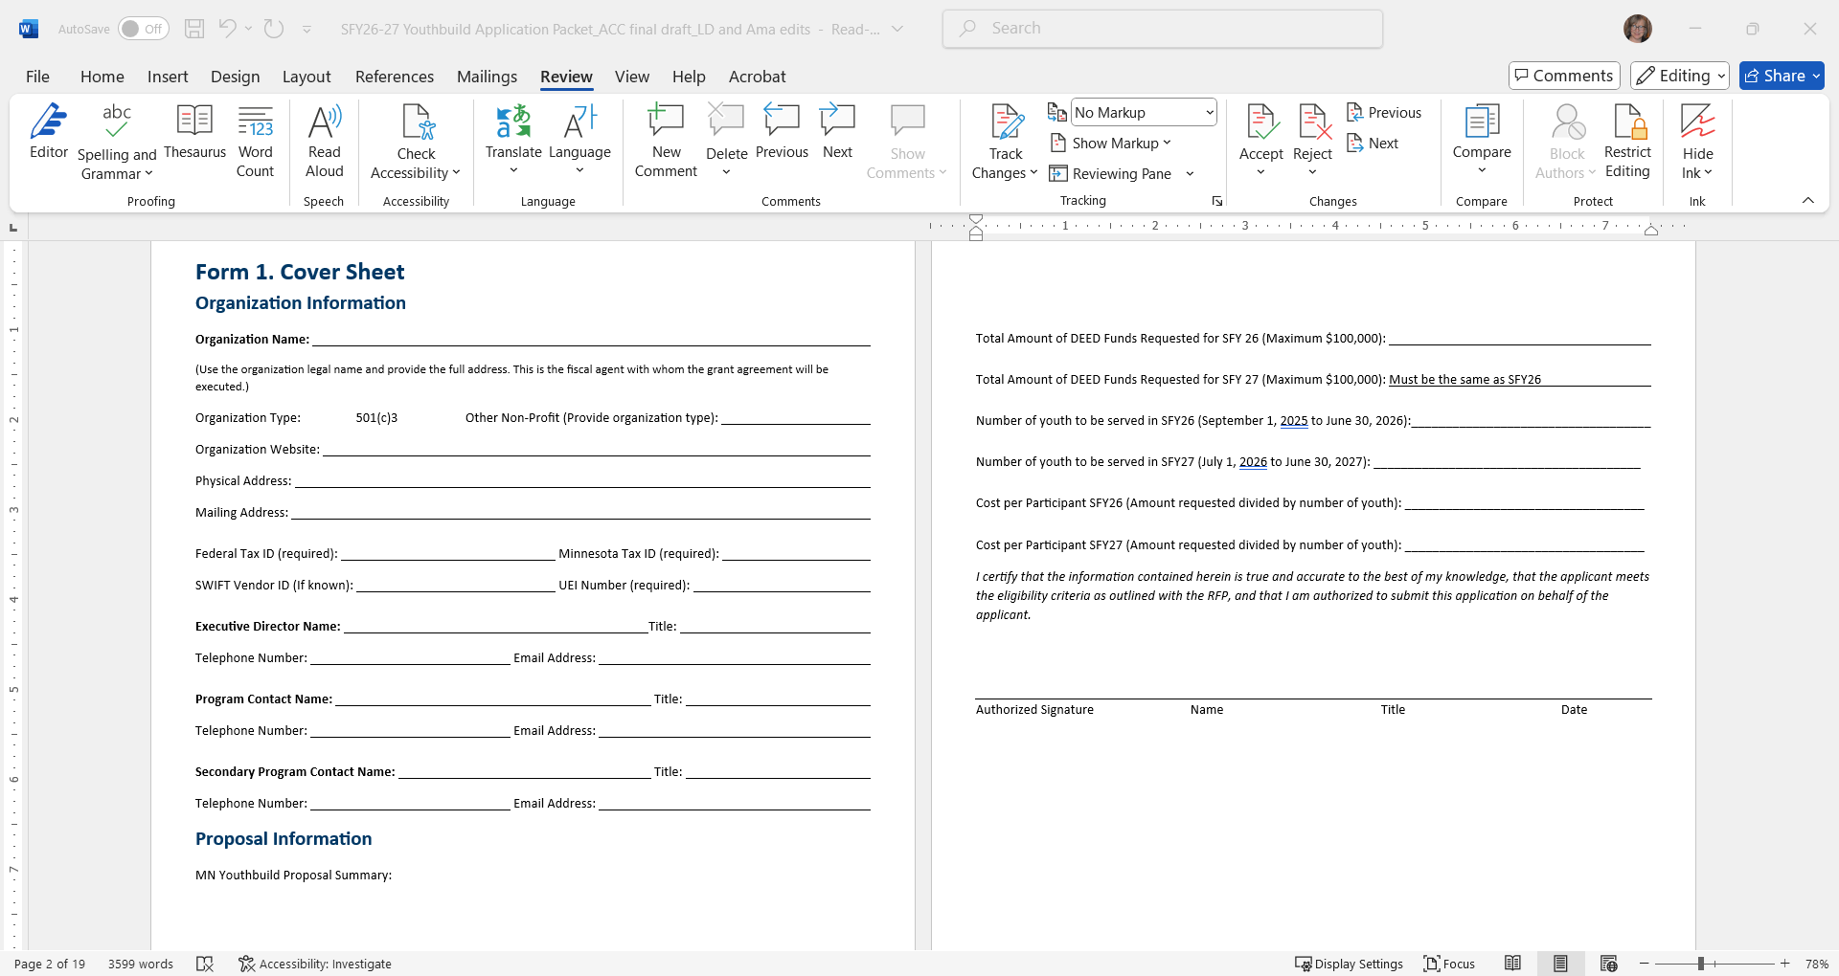
Form 1: Cover Sheet
Agency Name: Use the legal name and provide the full address. This is the fiscal agent with whom the grant agreement will be executed.
Electronic signatures are allowed

Slide 22
Form 2a. And 2b. Executive Summary and Narrative Responses NOTE: each response is limited to 400 words in total
Executive Summary (2 points)
Project Design (30 points)
Needs Statement and Target Population; Recruitment, Orientation, Assessment, and Retention; Occupational Skills Training, Safety Training and Work Experience; Housing and Building Projects.
Project Goals, Activities and Timetables (20 points)
Case Management and Support Services; Work Readiness, Career Exploration, Leadership, Education Support and Mentoring; Occupational Skills Training and Safety Instruction; Placement, Exit, and Follow up.
Partnerships (10 points)
Form 5. Partnership Chart and Narrative (key partners providing matching and leveraged funds and partners receiving grant funds for program activities and/or services). No letters of commitment required with application submittal.
Evaluation and Reporting (10 points)
Capacity, Relevant Experience, and Equity (10 points)
Past experience and reporting of youth diploma or GED attainment and placement in construction and other employment and/or registered apprenticeship is a plus. Also, number of affordable housing units, garages, and other/innovative building projects, serving homeless and low-income families and individuals.
Budget and Budget Narrative (8 points)
Forms 4a. And 4b. Budget and Budget Detail, and Budget Narrative over a two-year period (both SFy26 and SFY27)
Work Plan (10 points)

Slide 23
Form 3: Work Plan
In chronological order, under each component, list the specific activities and services to be provided to youth over an approximate two-year timeline. List integrated activities and services, as applicable.
List the specific goals and measurable outcomes for each activity or service, expressed as the number of youth and percentage of youth, which are realistic, clear, and measurable.
List the expected start date(s) and end date(s) of each activity or service, using a reasonable timeframe for performing and reporting on each project service or activity.

Slide 24
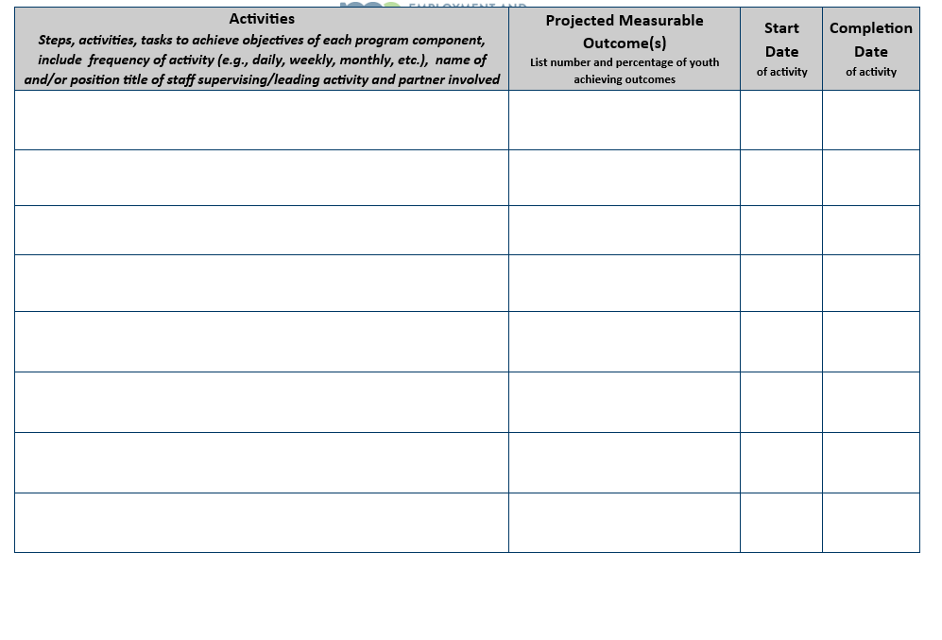
Form 3: Work Plan

Slide 25
Form 4a. And 4b. Budget Information Summary
Budget:
The total budget request over the two-year period SFY26-27, cannot exceed $200,000. The budget amounts should be cumulative over both fiscal years (total amount in each cost category and grant total are listed in the final quarter ending June 30, 2027).
Amounts should be entered cumulative by quarter (total amounts in each cost category and grand total are listed in the final quarter ending June 30th, 2027).
No more than 6% is allocated for administrative costs.
Grant funds cannot be used to purchase real property.
Housing and Building Materials (including power tools and equipment) are limited to 25% of total request. Note, equipment purchases greater than $5,000.00 must be pre-approved by DEED.
Note, two-year expenses in the Budget Summary must correspond accurately to the planned expenditures in the Budget Narrative and Budget Detail forms, describing line-item expenditures in more detail and listing the FTEs and wage rates (or monthly or annual salary) of key staff. Equipment and/or materials and supply expenses should list the approximate unit cost. The Budget Narrative should also describe matching and leveraged resources from other sources, the organization or source providing funds/resources, and amount or estimated value.

Slide 26
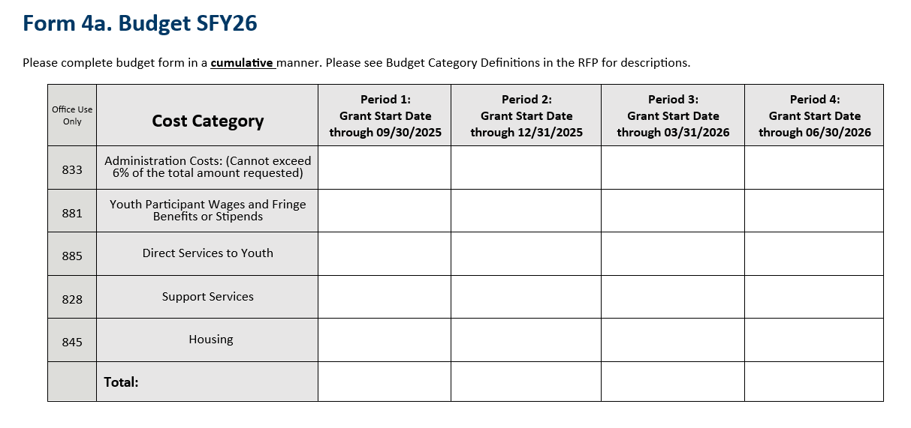
Form 4a: Budget Summary

Slide 27
Form 4c. Budget Detail
State Youthbuild Funds Request (left column):
The total budget request for SFY 2026-27 cannot exceed $200,000
No more than 6% is allocated under administrative costs (category 833).
Grant funds cannot be used to purchase real property.
Housing and Building Materials (including power tools and equipment) are limited to 25% of total request. Note, equipment purchases greater than $5,000.00 must be pre-approved by DEED.
Matching Funds (middle column):
The total matching funds listed much be equal to or greater than the total amount of grant funds requested. Any additional funding sources must be listed under leveraged funds. Matching funds may include cash or in-kind resources, such as partner staff time and resources (non-state sources) providing services to youth or the material cost of an affordable housing or facility project being built or renovated by Youthbuild participants.
Leveraged Funds (right column):
List all funding sources other than state appropriations that are used to support the program. Any other sources of funding in an amount greater than the required match amount should be listed under leveraged funds.

Slide 28
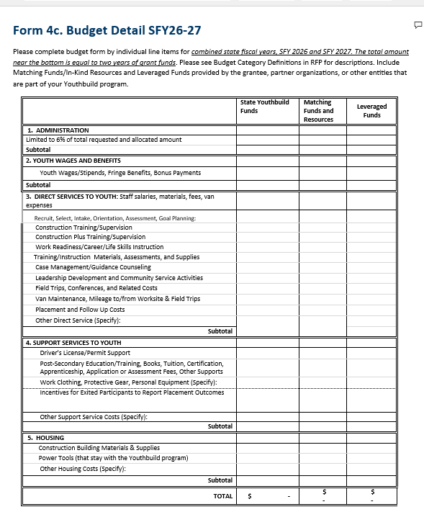
Form 4c. Budget Detail

Slide 29
Form 4d. Evidence of Matching Funds
Applicants must certify that their organization and any partner organization or entity providing non-state matching funds or resources has provided reasonably accurate information on the match amount in question.
Letters of Commitment will be requested and reviewed upon notification of grant awards.
Letters of commitment may be in the form of a letterhead memorandum or a partner organization’s director/official email describing their commitment. The letter should describe the organization’s planned role in the program, their commitment of activities, services, cash or resources, and its estimated value.

Slide 30
Form 5: Partnership Chart
Partnership Chart: List organizations which have or plan to commit cash, in-kind resources, staff and/or time to the project and those who will be receiving payment from the Youthbuild grant.
Upon notification of a grant award, you will be required to provide a letter or email from partners that provide matching funds/resources. The letter or email should include:
Type of Organization, Name, and Address
Type of Commitment (time, staff, resources, space, referrals etc.)
Key Contact Person
Estimated In-Kind Value or Amount of Commitment
Partnership Narrative: Describe any collaborative relationships you have with other organizations serving the target populations and how partners will be engaged to support the proposed project and how your project and services align or build off each other to comprehensively meet youth, employer and community needs.

Slide 31
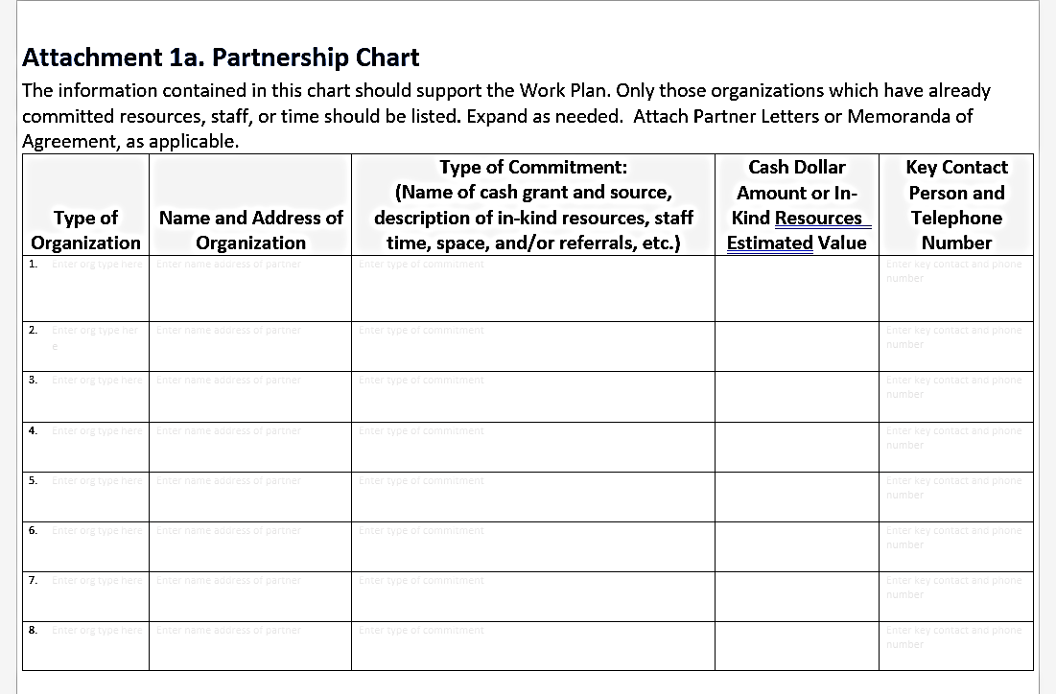
Form 5: Partnership Chart

Slide 32
Other Application Packet Components
Each of the following forms must be completed, signed, and included with your proposal.
Form 6. Unemployment Insurance Account Consent
Form 7. Applicant Conflict of Interest Disclosure Form the Office of Grants Management Policy_08-01, Conflict of Interest Policy for State Grant-Making Effective Date 1/1/21 discusses actual or perceived conflict-of-interest in greater detail.
Form 8. Performance Capacity
Form 9. No Conviction of Felony Financial Crime by Principal
Form 10. Evidence of Good Standing
Form 11. Required Nonprofit Grantee Documents

Slide 33
Grant Requirements
Applicants selected for funding must comply with all state and federal requirements including, but not limited to:
Workers’ compensation
Affirmative Action/Nondiscrimination/EO Assurances
Data Privacy
Evaluation if any unemployment insurance debt is owed
Americans with Disabilities Act
Other
Awarded grantees must be registered as a vendor with the State of Minnesota in order to receive payments. (Link available in the RFP).

Slide 34
Grant Requirements cont.
All Non-Governmental Organizations (NGOs) applying for grants in the state of Minnesota must undergo a pre-award risk assessment and financial review prior to being offered a grant award of $25,000 and higher.
To comply with State Policy on the Financial Review of Nongovernmental Organizations please submit one of the following documents based on the following criteria:
NGOs with annual income of under $50,000, or who have not been in existence long enough to have a completed IRS Form 990 or audit should submit their most recent board-reviewed financial statements.
NGOs with total annual revenue of $50,000 or more and less than $750,000 should submit their most recent IRS Form 990.
NGOs with total annual revenue of over $750,000 should submit their most recent certified financial audit.

Slide 35
Grant Requirements cont.
Tasks and Deliverables
Successful applicants will be required to:
Submit monthly Reimbursement Payment Request Forms (RPRs) or Financial Status Reports (FSRs) by the 20th of the month.
Submit a quarterly narrative that describes progress of the grant as described in your proposal and specific to each program component.
Provide a quarterly data summary which reports current/active participants and a cumulative total participants in each requested data items.
Provide a twice-a-year Excel participant data report to capture more detailed performance outcomes in relation to each youth’s demographics and at-risk characteristics or barriers.
Submit, in September of each year, a comprehensive narrative, updated data, photos, quotes, and success stories for the Youthbuild Annual Report.

Slide 36
Wrap-up and Reminders
Questions about the RFP must be asked via email:
Email: Youth.Team.DEED@state.mn.us
Answers will only be provided in writing and will be found on the Q&A document at: https://mn.gov/deed/about/contracts/open-rfp.jsp under “Minnesota Youthbuild Program Competitive Grants”
An emailed proposal, consisting of ONE Adobe Acrobat (.PDF) file containing the required components must be received via email by 11:59 p.m. CDT on Friday, August 15, 2025.
This document needs to be emailed to Youth.Team.DEED@state.mn.us and include your organization’s name in the filename

Slide 37
Thank you!

