Slide 1
Performance Based Agreements
VRS Community Partners + VRS/SSB-WDU Staff PBA Training June 29, 2021

Slide 2

Focus for Today
This training is about PBAs
General PBA and E1 PBA
This training is not:
In-depth training on how to provide placement services
About Supported Employment
About the E1MN/MoU process
Questions – use this form:
https://forms.microsoft.com/Pages/ResponsePage.aspx?id=RrAU68QkGUWPJricIVmCjPZziNO3vctElqxVZCB47BNUM1I5OE5VS0VPVU9YMFA3T0ZJQjI5Nkc2Ny4u

Slide 3

Training Objectives
Review Placement and Follow Up Services
Understand how PBA Milestone Payments fit into the Placement and Follow Up process
Know the difference between General PBA and the E1 PBA and when VR will refer for each one
Differentiate between Follow Up and Job Coaching

Slide 4

Placement and Follow Up Forms
VRS is updating many of the forms used in Placement and Follow Up Services
Updated forms will be used starting July 1, 2021
New versions will be sent to you

Slide 5

Placement and Follow Up Services Overview
This Photo by Unknown Author is licensed under CC BY

Slide 6

Placement Services
May include, but are not limited to:
Identify and develop job opportunities
Assist with creating and updating resumes
Complete job applications
Prepare for job interviews
Complete cover and thank you letters
Provide on site job analysis
Assist employers to identify and eliminate barriers

Slide 7

Follow Up Services
May include, but are not limited to:
Orientation and paperwork assistance
Assist adjustment to employment
Getting feedback from the employer on work performance
Identify and coordinate services needed
To maximize skill development
Or advance in employment

Slide 8
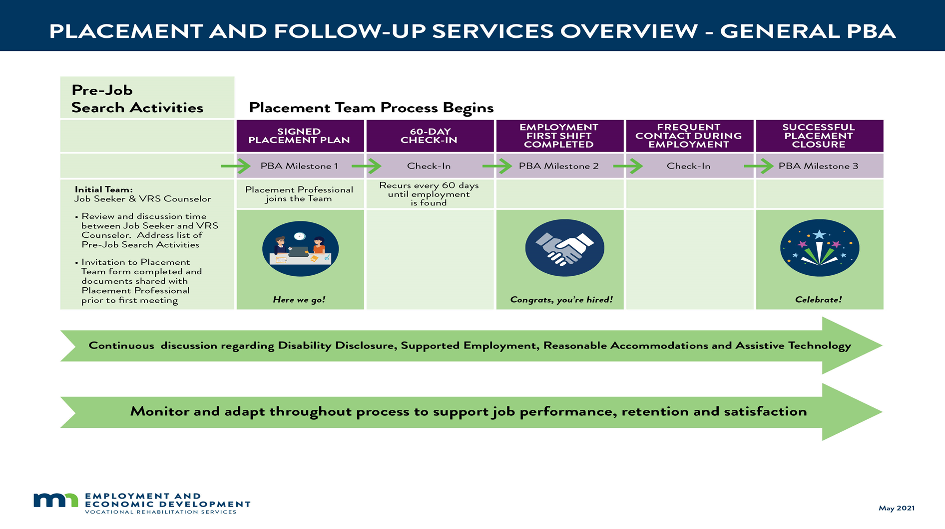
Placement and Follow Up Services

Slide 9
Pre-Job Search Activities Prior to Signed Placement Plan Meeting
Interests and goals
Employment related skills and abilities
Labor market information
Criminal background
Credit report & bankruptcy as they relate to job goal
Impact of wages on benefits
Transportation
Housing
Care arrangements (child, spouse, parents)
Medical insurance
Cultural or religious considerations
Disability disclosure
Support systems available
Verify employment authorization documents

Slide 10

Choosing a Placement Professional
Informed Choice
VRS uses a Performance Based Agreement (PBA) to pay our partners for placement services
VRS Placement Coordinators and Partner Placement Professional follow the same process and paperwork

Slide 11

General PBA

Slide 12
Genera PBA Milestones
Milestone | Description | Amount
1 | Signed Placement Plan | $1,330
2 | First Paid Day of Employment | $1,200
3 | Successful Placement Closure | $1,270
 | TOTAL: | $3,800
*Occupational Communication Specialist Services (OCSS) Differential of $400 may be added to the PBA
if on the Community Partners P/T Contract

Slide 13

Prior to Signed Placement Plan Meeting
Ensure the following documents are available to the Placement Professional with reasonable time to review:
Invitation to Placement Team
Completed Sample Employment Application
Relevant Information from the Assessment of VR Needs regarding job goals, work experience, skills and relevant disability will be sent

Slide 14

At the Placement Plan Meeting
Start of Placement and Follow Up Services
Placement Professional come prepared
Review roles and responsibilities of Job Seeker, Placement Professional and VRS Counselor
Complete a Placement Plan
Placement Plan is signed by all three core team members
Community Partner can use the VRS Placement Plan or create their own; only do one Placement Plan
60-day meeting is scheduled

Slide 15
Signed Placement Plan PBA Milestone 1
Payment for Milestone 1:
Community Partner must provide VRS a signed copy of Placement Plan with an invoice for Milestone 1
VR Counselor will case note a summary of the Placement Plan meeting
Community Partners will no longer submit Placement Plan Meeting Summary

Slide 16
Communication Expectations
Communicate Early, Communicate Often
Change from bi-weekly Communication Updates to Monthly Progress Reports
Monthly Progress Report – Job Placement and Follow-up services must be received to pay PBA milestones
Partners will submit last bi-weekly Communication Update through June 30, 2021
July 1st, Monthly Progress Report will start to be used, the first report will be due August 10, 2021

Slide 17
Monthly Progress Report – Job Placement and Follow-up Services
Required - Placement Professional submits every month until the case closed​
This report will also be used for Milestone #2 First Paid Day of Employment details and Milestone #3, Successful Placement Closure details
This reports meets RSA required employment details
Everyone uses the same report – for uniform/consistent information
Submitted within 10 days following the end of each month​
This is not intended to stop “communication” we want to stay in touch

Slide 18
60-Day Check-In
All core team members come together at a “live” meeting every 60 days until job seeker has obtained employment and worked their first shift to:
Review job search progress
Identify and address barriers
Amend Employment or Placement Plan as needed
Implement new strategies
Agreement that Placement and Follow Up services will continue
If yes, before meeting concludes, schedule the next 60-day meeting

Slide 19

Job offer

Slide 20

Post-Job Offer, Pre-Job Start
Things to think of just prior to job start:
Supports on the job
Work clothes
Accommodations
Assistive Technology
Transportation specific to job location
Scheduling conflicts
Potential job coaching needs

Slide 21

Two 90-Day Clocks
Employed for 90 Days
Achieved 90 Days of Employment Stability

Slide 22
The 90-Day Clocks
Employed for 90 Days
Community Partner tracks this clock
Day one of the Employed for 90-day clock is the first paid day of work completed
This tracks the 90 days to reach a PBA Milestone 3 (90 days after first day of work)
Tracks Placement and Follow Up Services closure
Achieved 90 Days of Employment Stability
VRS tracks this clock (in WF1)
Once Employment Stability is reached, the participant is moved to “In Employment” and this starts the “Achieved 90 days of employment stability”
This could be Day one of first day worked or this could start later
This clock may or may not align with the “employed for 90 days” clock
Tracks VR outcome closure

Slide 23
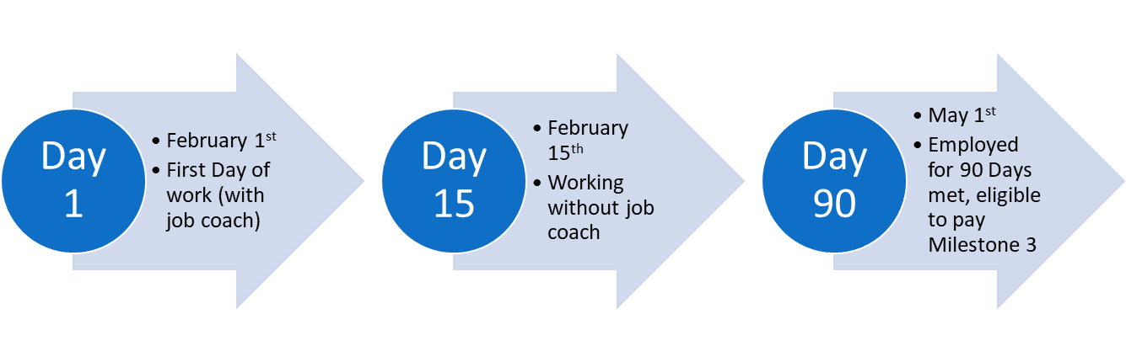
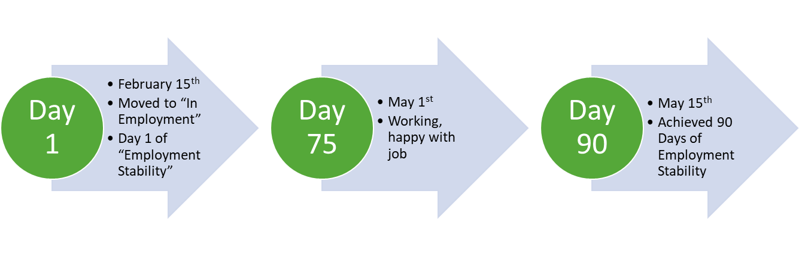
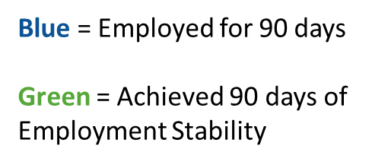
90-Day Clock Example

Slide 24
First Paid Day of Employment PBA Milestone 2
Placement Professional provides VRS Counselor with job offer information as soon as possible and the Monthly Progress Report no later than 7 days after employment start date.
Must collect and record employer name and address, wage, job title, hours, start date, level of benefits, name of person giving you the information and the date the information was received
This starts Day 1 of the “Employed for 90 days” clock
VR enters information into WF1
For Milestone 2 Payment:
Community Partner Placement Professional submits Monthly Progress Report with the job hire details with an invoice for the 2nd PBA milestone
All Monthly Progress Reports have been received by VR since the last milestone was paid

Slide 25
Job Coaching Changes
Starting July 1, 2021:
The 20 hours of job coaching are no longer part of the PBA, this will become a separate service
VRS staff have been asked to review caseloads and identify the individuals you are currently working with who are in a PBA
If you think a participant will need job coaching discuss this with the VRS counselor and request an authorization starting July 1, 2021

Slide 26
Follow Up
Part of all PBAs
After job placement the Placement Professional provides follow up services to the individual from the first day of employment until Placement and Follow Up Services close
Require regular check-ins with the individual to assist the person’s adjustment to competitive integrated employment (at minimum bi-weekly)
Could include communicating with the employer to ensure that essential performance standards are being met and offer assistance and resources to facilitate adjustment to the new position
Monthly Progress Reports are submitted

Slide 27
Job Coaching
Time limited service
Authorized separately, prior to start of service
Involves providing support, training and consultation to the individual and the employer to facilitate successful competitive integrated employment
Provided to individuals needing more intensive services than Placement Follow Up Services and is provided up to the point that “employment stability” is achieved and not beyond
Performed on or off the job site
Job coach provides required regular updates to VRS (weekly is best practice)
The Coaching Report is submitted at the time of billing/invoice
Travel time can be authorized as agreed upon

Slide 28
Follow Up vs. Job Coaching
Follow Up is:
Provided to all new employees
Assistance with new employee orientation, initial paperwork
Assist adjustment to employment
Getting feedback from the employer on work performance
Identifies services needed to maintain or advance in employment Orientation and paperwork assistance
Job Coaching is:
Specific to the individual and the job
Considered the individuals intensive training and supports specific to learning needs
Coordinate with employer - gain approval, explain role, open line of communication, education, accommodations etc.
May include assistance with:
Visuals
Checklists
Hand over hand instruction
Apps

Slide 29

Breakout Groups

Slide 30
Small Group Discussion
During your small group discussion:
Is the distinction between Follow Up verses Job Coaching clear?
What do you look for in the job search process that might indicate Job Coaching might be needed?
Submit answer/feedback using this Microsoft form:
https://forms.microsoft.com/Pages/ResponsePage.aspx?id=RrAU68QkGUWPJricIVmCjPZziNO3vctElqxVZCB47BNUM1I5OE5VS0VPVU9YMFA3T0ZJQjI5Nkc2Ny4u

Slide 31

Time for a Break

Slide 32

Reflections
Enter your groups discussion on the MS Form:
https://forms.microsoft.com/Pages/ResponsePage.aspx?id=RrAU68QkGUWPJricIVmCjPZziNO3vctElqxVZCB47BNUM1I5OE5VS0VPVU9YMFA3T0ZJQjI5Nkc2Ny4u

Slide 33

Follow Up Check-Ins
VRS Counselor and Placement Professional should have frequent contact with the individual while they are employed to ensure there are no changes or needed employment supports that have not been addressed or that arise like:
Supervisor changes
Natural supports/Work Culture
Job satisfaction
Transportation/hours
Housing
Childcare
Wage reporting to Social Security

Slide 34
Closure from Placement and Follow-Up Services
Conditions for Successful Closure from Placement and Follow-Up Services:
Matches job goal
Paid at least minimum wage and customary rate/benefit level
Number of hours / week is adequate
Competitive integrated setting
Ongoing supports match needs
90 days of employment with same employer/position unless individual made informed decision for successive temporary assignments
VRS record of service need not be closed before Community Partner can receive the final PBA milestone payment as VRS may still be providing other services

Slide 35

Successful Placement Closure PBA Milestone 3
Job Seeker has been working for 90 days since Milestone 2 (First Paid Day of Employment Completed)
PBA Milestone 3 Payment:
Final Monthly Progress Report submitted with the Details on Accepted Job Offer and Employment Verification at Closure completed
Invoice for final milestone submitted
All Monthly Progress reports received since Milestone 2 payment

Slide 36

Special Circumstances

Slide 37

12 Months of a PBA
CONSIDERATIONS FOR CONTINUATION OF PLACEMENT AND FOLLOW-UP SERVICES:
If progress in job search is continuing and the person is making good progress toward a job = new PBA to the existing or new provider
If the placement progress has stalled out or stopped. The team agree that job search should be discontinued and look at other options = PBA is closed
A person has received VRS job search services for 12 months and VRS determines the person can no longer benefit from continued placement services at this time. Team agrees placement services have been exhausted and the remaining PBA is canceled, the person is referred to another agency, if appropriate, and the VRS case closed.

Slide 38
Holds During a PBA
When there is an interruption in job search for more than two weeks, a hold will be discussed with the placement team.
When placement services are on Hold:
Communication is important
Minimally at 30 days, VRS will check in with job seeker
At 60 days, a meeting is held with the placement team and a decision is made about next steps
Next steps:
Scheduling date to resume job placement services
Closing job placement services

Slide 39

Break Time

Slide 40

E1 PBA

Slide 41
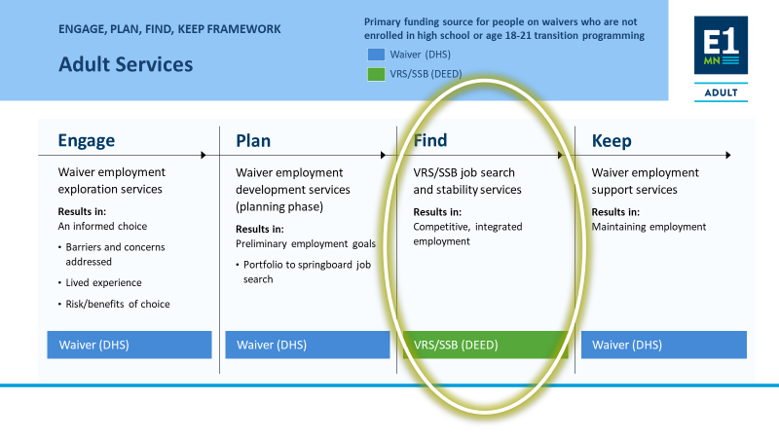
E1MN

Slide 42
E1 PBA Milestones
Milestone | Description | Amount
1 | Signed Placement Plan | $1,330
E1 | 120-Days of Service | $1,200
2 | First Paid Day of Employment | $1,200
3 | Successful Placement Closure | $1,270
 | TOTAL: | $5,000
*Occupational Communication Specialist Services (OCSS) Differential of $400 may be added to the PBA
if on the Community Partners P/T Contract

Slide 43
What’s Different with the E1 PBA
The E1 PBA payment option will become available on July 1, 2021
The E1 PBA is for Job Seekers on these Medicaid Waivers:
CADI The Community Access for Disability Inclusion Waiver ​
BI The Brain Injury Waiver​
CAC The Community Alternate Care Waiver​
DD The Developmental Disabilities Waiver
The Waiver Case Manager is a team member
There is an extra milestone payment called E1 (in addition to Milestones 1, 2 & 3) at 120 days of service
Any partner with PBA on their PT Contract could provide an E1 PBA
E1 PBA will be a new service type in WF1 for Employment Plans starting July 1, 2021

Slide 44
Before the Signed Placement Plan Meeting
Ensure the following documents are available to the Placement Professional with reasonable time to review:
Invitation to Placement Team
Completed Sample Employment Application
Relevant Information from the Assessment of VR Needs
VRS communicates with Waiver Case Manager

Slide 45
Signed Placement Plan E1 PBA Milestone 1
At the Placement Plan Meeting:
Discuss roles and responsibilities of Job Seeker, Placement Professional, VRS Counselor and Waiver Case Manager
Placement Plan is signed by all three core team members
Community Partner can use the VRS Placement Plan or create their own; only do one Placement Plan
60-day meeting is scheduled
The Placement Plan form has been updated
VR Counselor will case note a summary of the Placement Plan meeting
Community Partners will no longer submit Placement Plan Meeting Summary
Milestone 1 Payment:
Signed Placement Plan and Invoice

Slide 46

Communication Early, Communicate Often
Placement Professional expectations:
At least weekly communication attempts with Job Seeker
Send completed resume to VRS
Monthly Progress Report
VRS expectations:
Keeps Waiver Case Manager updated
All team members:
Assist the Job Seeker to upload documents into their Vault account

Slide 47

Monthly Progress Reports for E1 PBA
Required - Placement Professional submits every month until the case closed​
This report will also be used for Milestone #2 Employment First Shift details and Milestone #3, Successful Placement Closure details
This reports meets RSA required employment details
Everyone uses the same report – for uniform/consistent information
Submitted within 10 days following the end of each month​
This is not intended to stop “communication” we want to stay in touch

Slide 48


What does Job Search look like with an E1 PBA?

Slide 49

E1 PBA 60-Day Check-In
All core team members meet “live” every 60 days until job seeker has obtained employment and worked their first shift to:
Review progress
Identify and address barriers
Amend Employment or Placement Plan as needed
Implement new strategies
Agreement that Placement and Follow Up services will continue
If yes, before meeting concludes, schedule the next 60-day meeting
VRS counselor updates Waiver Case Manager

Slide 50

E1 Milestone 120 Days of Service
Milestone E1:​
Only for individuals with Medicaid waivers​
Paid at 120-days of service​
This could be during active job/search placement services OR​
Could be follow up services once a competitive integrated job is secured​
For Milestone E1 Payment: ​
All four (4) Monthly Progress reports (since Placement Plan)​
A record of the 60-day meetings AND ​
Invoice from provider​

Slide 51

A Job Offer!

Slide 52

Post-Job Offer, Pre-Job Start E1 PBA
Things to think of just prior to job start:
Supports on the job
Work clothes
Accommodations
Assistive Technology
Transportation specific to job location
Scheduling conflicts
Potential job coaching needs
VRS updates Waiver Case Manager to initiate long- term support funded by the waiver

Slide 53
90-Day Clocks
Employed for 90 Days
Community Partner tracks this clock
Day one of the Employed for 90-day clock is the first day of work completed
This tracks the 90 days to reach a PBA Milestone 3 (90 days after first day of work)
Tracks Placement and Follow Up Services closure
Achieved 90 Days of Employment Stability
VRS tracks this clock (in WF1)
Once Employment Stability is reached, the participant is moved to “In Employment” and this starts the “Achieved 90 days of employment stability”
This could be Day one of first day worked or this could start later
This clock may or may not align with the “employed for 90 days” clock
Tracks VR outcome closure

Slide 54
First Paid Day of Employment E1 PBA Milestone 2
Placement Professional provides VRS Counselor with job offer information as soon as possible:
Must collect and record employer name and address, wage, job title, hours, start date, level of benefits, name of person giving you the information and the date the information was received
Monthly Progress Report completed and submitted no more than 7 days after employment start date
This starts Day 1 of the “Employed for 90 days” clock
VR enters information into WF1
For Milestone 2 Payment:
Community Partner Placement Professional submits Monthly Progress Report with the job hire details with an invoice for the 2nd PBA milestone
All Monthly Progress Reports have been received by VR since the last milestone was paid

Slide 55
Follow Up verses Job Coaching
Follow Up is:
Provided to all new employees
Assistance with new employee orientation, initial paperwork
Assist adjustment to employment
Getting feedback from the employer on work performance
Identifies services needed to maintain or advance in employment Orientation and paperwork assistance
Job Coaching is:
Considered intensive training and supports specific to the individuals learning needs
Coordinate Job Coaching services with employer - gain approval, explain role, open line of communication
Educating the employer about individual needs and accommodations
May include assistance with:
Visuals
Checklists
Timers
Hand over hand instruction
Apps

Slide 56

Follow Up Check-In Recommendations
VRS Counselor and Placement Professional should have frequent contact with the individual while they are employed to ensure there are no changes or needed employment supports that have not been addressed or that arise like:
Supervisor changes
Natural supports/Work Culture
Job satisfaction
Transportation/hours
Housing
Childcare
Wage reporting to Social Security

Slide 57

Conditions for Successful Closure from Placement and Follow-Up Services E1 PBA
Position Matches job goal
Paid at least minimum wage and customary rate/benefit level
Number of hours / week is adequate
Competitive integrated setting
Ongoing supports match needs
Employed for 90 days with same employer/position, unless the individual made informed decision for successive temporary assignments
VRS record of service need not be closed before Community Partner can receive the PBA Milestone 3 payment as VRS may still be providing other services

Slide 58

Successful Placement Closure E1 PBA Milestone 3
Job Seeker has been working for 90 days since Milestone 2 (First Paid Day of Employment)
PBA Milestone 3 Payment:
Final Monthly Progress Report submitted with the Details on Accepted Job Offer and Employment Verification at Closure completed
Invoice for final milestone submitted
All Monthly Progress reports received since last milestone payment

Slide 59
12 Months of an E1 PBA
CONSIDERATIONS FOR CONTINUATION OF PLACEMENT AND FOLLOW-UP SERVICES:
If progress in job search is continuing and the person is making good progress toward a job = new PBA to the existing or new provider
If the placement progress has stalled out or stopped. The team agree that job search should be discontinued and look at other options = PBA is closed
A person has received VRS job search services for 12 months and VRS determines the person can no longer benefit from continued placement services at this time. Team agrees placement services have been exhausted and the remaining PBA is canceled, the person is referred to another agency, if appropriate, and the VRS case closed.

Slide 60

Holds
When there is an interruption in job search for more than two weeks, a hold will be discussed with the placement team.
When placement services are on Hold:
Communication is important
Minimally at 30 days, VRS will check in with job seeker
At 60 days, a meeting is held with the placement team and a decision is made about next steps
Next steps could be:
Scheduling date to resume job placement services
Closing job placement services

Slide 61
E1 PBA Scenario #1 Partner paid $5,000 | Milestone sequence 1, E1, 2, 3
Milestone #1
Abdi starts job placement and has their Initial Placement Plan meeting on February 1, 2022
60 day meeting
Abdi continues in job search and has a 60-day meeting on April 1, 2022 – agreement to continue with job search
Partner has submitted Monthly Progress Report (2 reports since Milestone 1)
E1 Milestone
Abdi continues in job search and has reached 120-days of service on June 1, 2022
Partner has submitted Monthly Progress Report (4 since Milestone 1) and invoices for the E1 Milestone, $1,200
Milestone #2
Abdi accepts a competitive integrated job and works his first shift on August 16, 2022
Partner has submitted Monthly Progress Report with Employment and Follow Up information and invoices for Milestone 2, $1,200
Milestone #3
Abdi successfully maintains and is happy with their job on November 16, 2022
Partner has submitted Monthly Progress Report with Employment and Follow Up information AND Job Placement and Follow Up Service Closure and invoices Milestone 3, $1,270
Partner submits Placement Plan and invoices for Milestone 1, $1330

Slide 62
E1 PBA Scenario #2 Partner paid $5,000 | Milestone sequence 1, 2, E1, 3
Milestone #1
Dillon start job placement, has their Initial Placement Plan meeting on February 1, 2022
60 day meeting
Dillon continues in job search and has a 60-day meeting on April 1, 2022 – agreement to continue with job search
Partner has submitted Monthly Progress Report (2 reports since Milestone 1)
Milestone #2
Dillon accepts a competitive integrated job and works first shift on March 15, 2022
E1 Milestone
Dillon continues working and is still “in service” at 120-days on June 1, 2022 *no meeting required
Milestone #3
Dillon is stable, working, and happy with their job on June 15, 2022
Partner submits Placement Plan and invoices for Milestone 1, $1330
Partner has submitted Monthly Progress Report with Details on Accepted Job Offer information and invoices for Milestone 2, $1,200
Partner has submitted Monthly Progress Report (4 since Milestone 1) and invoices for Milestone E1, $1,200
Partner has submitted Monthly Progress Report with Employment Verification at Closure information and invoices for Milestone 3, $1,270

Slide 63
E1 PBA Scenario #3 Partner paid $5,000 | Milestone sequence 1, 2, E1, 3
Milestone #1
Jane start job placement, has their Initial Placement Plan meeting on February 1, 2022
60 day meeting
Jane continues in job search and has a 60-day meeting on April 1, 2022 – agreement to continue with job search
Partner has submitted Monthly Progress Report (2 reports since Milestone 1)
Milestone #2
Jane accepts a competitive integrated job and works first shift on April 5, 2022
Jane quits their job on April 15, 2022
Partner updates team
Agreement to resume job search.
Partner submits Placement Plan and invoices for Milestone 1, $1330
Partner has submitted Monthly Progress Report with Details on Accepted Job Offer information and invoices for Milestone 2, $1,200
A 60 meeting should be held around June 15, 2022

Slide 64
E1 PBA Scenario #3 continued Partner paid $5,000 | Milestone sequence 1, 2, E1, 3
E1 Milestone
Jane continues job search and is still “in service” at 120-days on June 15, 2022 *no meeting required
60 day meeting
Jane continues in job search and has a 60-day meeting on August 15, 2022 – agreement to continue with job search
Partner has submitted Monthly Progress Report (4 reports since Milestone 2)
No Payment
Jane accepts a competitive integrated job and works his first shift on September 15, 2022
Partner has submitted Monthly Progress Report with Employment and Follow Up information no invoice, Milestone 2 has already been paid
Milestone #3
Jane successfully maintains and is happy with their job on December 15, 2022
Partner has submitted Monthly Progress Report with Employment and Follow Up information AND Job Placement and Follow Up Service Closure and invoices for Milestone 3, $1,270
Partner has submitted Monthly Progress Report (4 since Milestone 1) and invoices for Milestone E1, $1,200

Slide 65
E1 PBA Scenario #4 Partner paid $2,530 | Milestone sequence 1, E1
Milestone #1
Sam starts job placement and has their Initial Placement Plan meeting on February 1, 2022
60 day Meeting
Sam continues in job search and has a 60-day meeting on April 1, 2022 – agreement to continue with job search
Partner has submitted Monthly Progress Report (2 reports since Milestone 1)
E1 Milestone
Sam continues in job search and has reached 120-days of service on June 1, 2022
Partner has submitted Monthly Progress Report (4 since Milestone 1) and invoices for the E1 Milestone, $1,200
60 day Meeting
Sam continues in job search and has a (3rd) 60-day meeting on August 1, 2022 – agreement to stop job placement services
Partner submits Placement Plan and invoices for Milestone 1, $1330
Partner has submitted Monthly Progress Report (6 reports since Milestone 1 was paid)
Close file

Slide 66

No Retroactive E1 PBAs
Starting July 1, 2021: E1 PBA will become a placement payment option with a rolling implementation for new PBAs
Individuals currently in a VRS General PBA will continue in the General PBA for the remainder of their job placement and follow-up. VRS will not change the authorization to E1 PBA
Individuals who are in a VRS General PBA and attain a waiver while in the General PBA will continue in the General PBA for the remainder of their job placement and follow-up

Slide 67

New PBAs Start July 1, 2021

Slide 68

Questions
Please submit questions using this MS Form:
https://forms.microsoft.com/Pages/ResponsePage.aspx?id=RrAU68QkGUWPJricIVmCjPZziNO3vctElqxVZCB47BNUM1I5OE5VS0VPVU9YMFA3T0ZJQjI5Nkc2Ny4u

Slide 69
The VR program receives 74.05 percent of its funding through a grant from the U.S. Department of Education. For federal fiscal year 2019, the total amount of grant funds awarded were $41,796,129. The remaining 25.5 percent of the costs ($14,300,000) were funded by Minnesota state appropriations.

