Slide 1


Welcome!
Annual Winter Meeting
Governor’s Workforce Development Board (GWDB) Minnesota Association of Workforce Boards (MAWB)
December 12, 2024
WIFI Information:
Network: D’Amico Events
Pass: *Birdie!

Slide 2
Call to Order
Surya Iyer
GWDB Chair
Comm. Scott Schulte
MAWB Chair

Slide 3
GWDB Business Meeting
Surya Iyer| Governor’s Workforce Development Board Chair
DeLinda Washington | Governor's Workforce Development Board Vice Chair

Slide 4
GWDB Business Meeting
GWDB Chair, Vice Chair and Staff Introductions
GWDB Meeting Goals
September Minutes*
Chair’s Report*
GWDB 2025 Meeting Schedule*
* Indicate Voting Items

Slide 5
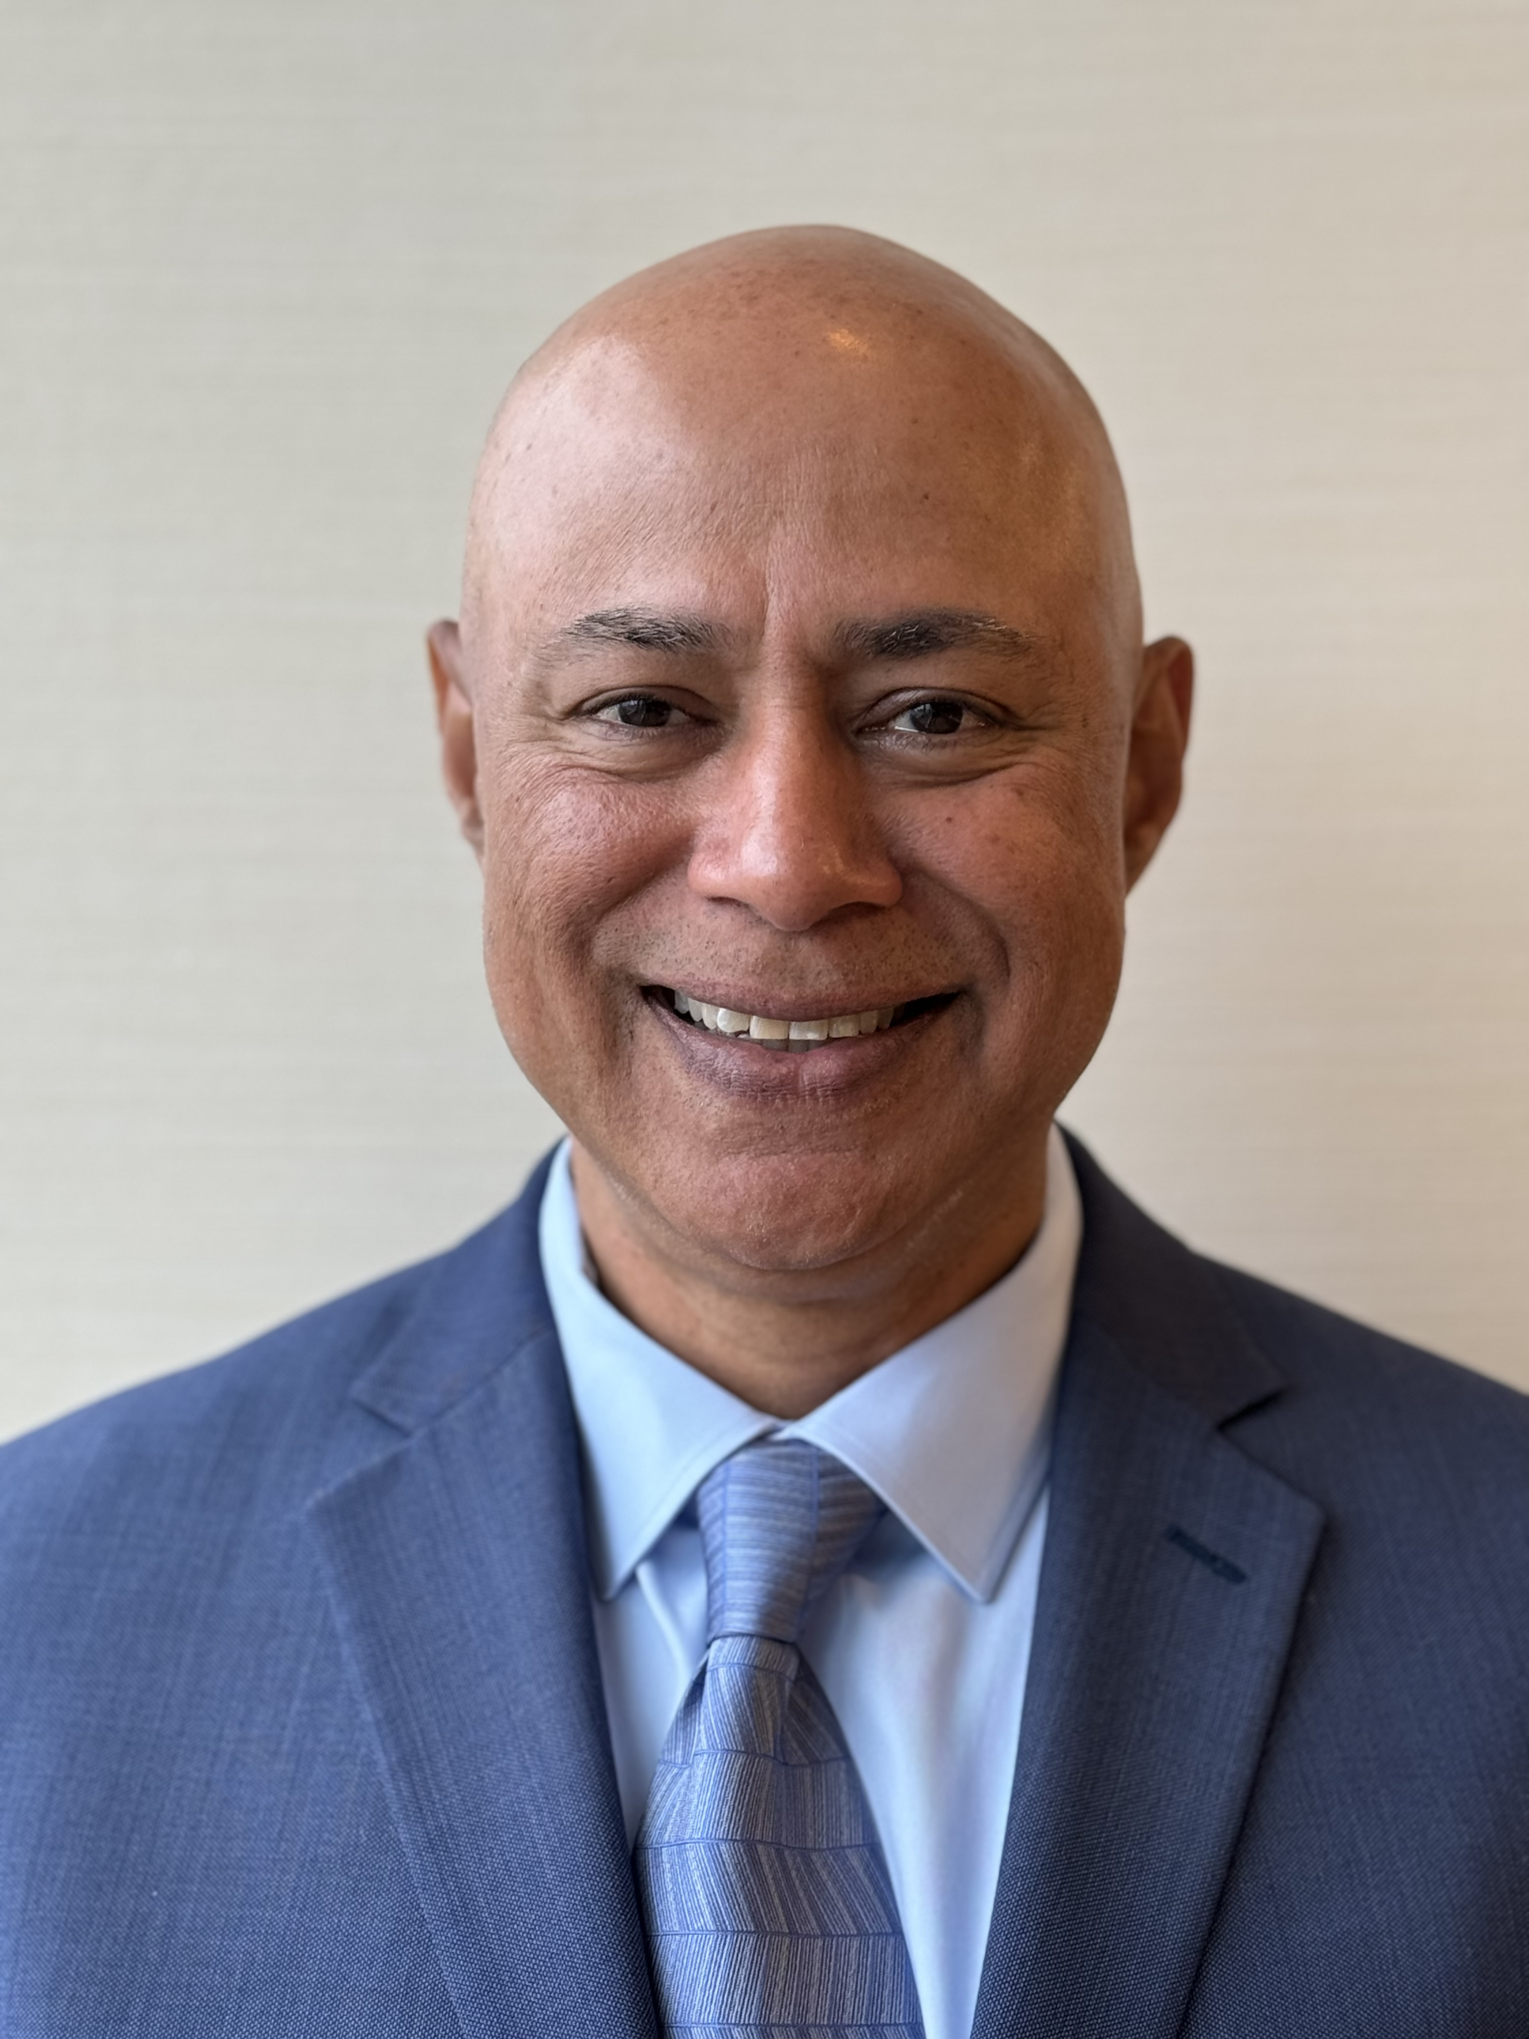
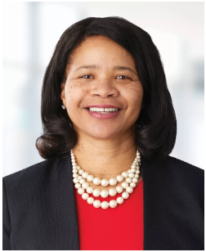
New GWDB Leadership
Surya Iyer
Chair, Governor's Workforce Development Board
President & COO, Polar Semiconductor
DeLinda Washington
Vice Chair, Governor's Workforce Development Board
Senior Vice President,
Chief People Officer,
HealthPartners

Slide 6
GWDB Staff
Katie McClelland, GWDB Director
katie.mclelland@state.mn.us
Sonji Davis, Workforce Policy Coordinator
sonji.davis@state.mn.us
Kay Kammen, Senior Policy Analyst
kay.kammen@state.mn.us
Patti Balacek, Workforce Development System Coordinator
patti.balacek@state.mn.us
Nolan Thomas, PROWD-GWDB Employer Engagement Specialist
nolan.thomas@state.mn.us

Slide 7
2025 – 2026 GWDB Meeting Schedule
2025 Full Board Meetings:
Wednesday, February 12 from 9 a.m. to 4 p.m. – In-person Member Retreat at DEED
Wednesday, May 14 from 10 a.m. to 3 p.m. – In-person Meeting
Wednesday, August 13 from 10 a.m. to 3 p.m. – In-person Meeting
Wednesday, November 12 Joint GWDB/MAWB Meeting from 10 a.m. to 3 p.m. – In-person Meeting
2026 Full Board Meetings:
Wednesday, February 11 from 10 a.m. to 3 p.m. – In-person Meeting
Wednesday, May 13 from 10 a.m. to 3 p.m. – In-person Meeting
Wednesday, August 12 from 10 a.m. to 3 p.m. – In-person Meeting
Wednesday, November 4 Joint GWDB/MAWB Meeting from 10 a.m. to 3 p.m. – In-person Meeting

Slide 8
MAWB Business Meeting
Commissioner Scott Schulte

Slide 9

MAWB Business Meeting
2025 Legislative State Platform and Federal Priorities*
* Indicates Voting Items

Slide 10

State and Federal
Legislative Update

Slide 11
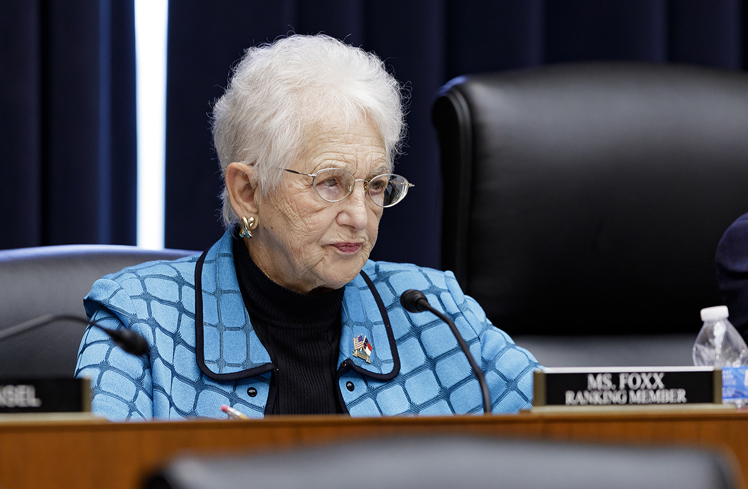
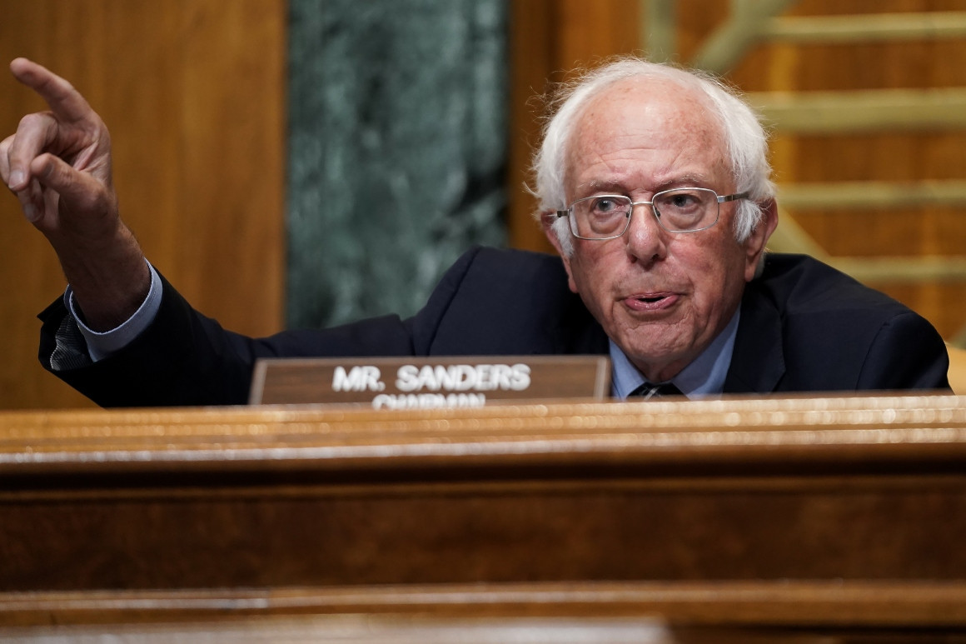
WIOA Reauthorization Process
Bill is similar to the bill passed by the House in the spring.
Committee leaders are continuing to work on ways to get to passage (hot line procedure, attaching to another bill).
  Continuing Resolution needed prior to Dec 20.
Notes:
d

Slide 12
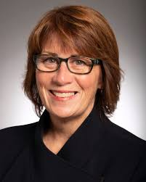
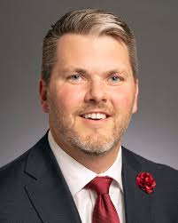
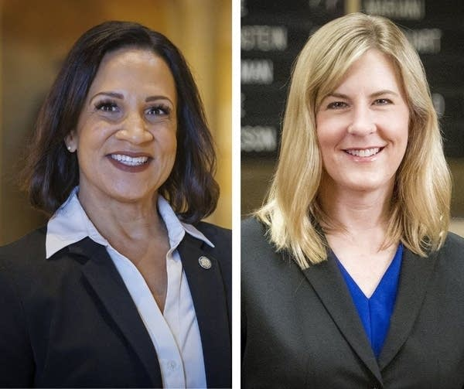
2025 Legislative Session
Governor Walz continues in the 3rd year of his term.
Senate continues to be held by Democrats in one vote margin.
House is in a 67-67 pure tie.
Budget Forecast
  $616 million surplus in 2026-27
  $5.1 billion structural imbalance/deficit in 2028-29

Slide 13
Legislative
Platform and Priorities

Slide 14
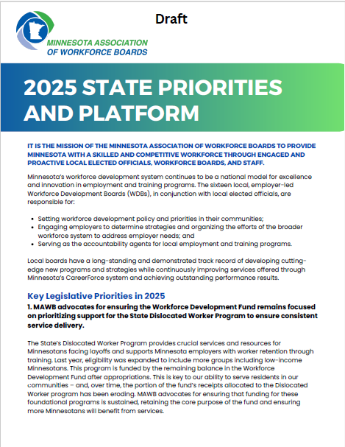
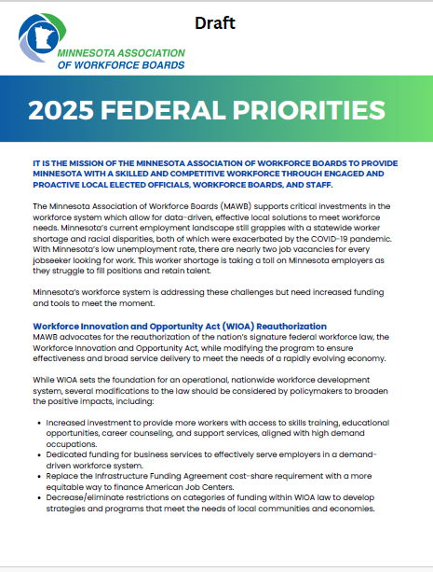
2025 Platform and Priorities
Notes:
d

Slide 15
Federal Platform and Priorities
WIOA Reauthorization
WIOA Investment
Notes:
d

Slide 16
State Platform and Priorities
MAWB advocates for ensuring the Workforce Development Fund remains focused on prioritizing support for the State Dislocated Worker Program to ensure consistent service delivery.
MAWB advocates for making the FY24-25 supplemental funding increase to the Minnesota Youth Program permanent and ongoing.
Notes:
d

Slide 17
2025 Platform and Priorities
Notes:
d

Slide 18
Interagency Workforce Alignment Quarterly Update
DEED Commissioner Matt Varilek

Slide 19
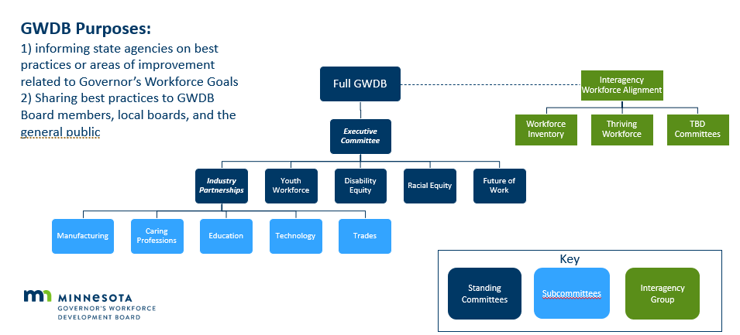
Governor’s Workforce Development Board Partnership with IWA

Slide 20
Building Enterprise Workforce Development Alignment
Overarching Aim of Using the IWA as the Space for Interagency Alignment: Enable thoughtful, strategic, aligned, and proactive interagency decision-making and collaboration, and hold ourselves accountable for reaching a 4.4% vacancy rate overall and in the Drive for Five sectors.
Aim 1: Ensure Enterprise-wide alignment and defined agency ownership of workforce efforts across the Drive for 5 Sectors.
Aim 2: Define metrics and measurable goals to track progress on stated outcomes and timelines.
Aim 3: Ensure effective internal and external communication about statewide talent attraction and retention strategies.

Slide 21
Interagency Workforce Alignment Work to Come
Work To Be Completed:
  Roadmap for Aims implementation by 2027
  Quarterly updates to the Governor’s Office and Governor’s Workforce Development Board
December Planning Meeting:
  Establish prioritization of activities
  Identify timelines, goals and strategies for implementing Aims by 2027
  Plan quarterly check-in meetings through 2027

Slide 22
Ways to Accomplish Our Work
One Minnesota Plan
Interagency coordination required
Time intensive, near-term results focused
IWA Committees
Interagency coordination required
Less time intensive, near- or long-term outcomes
GWDB Committees
Interagency and external partners required
Example: GWDB Education Committee focused on educator pipeline
Example: Workforce Inventory Workgroup
Example: Thriving Workforce Budget Workgroup
Specific area of focus, coalition building importance

Slide 23
Workforce Inventory Pilot
    Purpose of inventory: To create visibility of workforce supports across agencies to enable more informed decision making and have a consistent source of information.
    Rollout: Began with 6 agencies (DEED, OHE, DHS, DLI, MDE, PELSB), over the coming year will socialize with stakeholders across existing agencies and incorporate additional agencies throughout 2025.
    Who the tool is for: Internal Enterprise staff for budget proposals, grant identification or outreach.

Slide 24
Recap of Key Milestones in Phase 1 of Inventory Development
Workgroup members met regularly to inform scoping, and development of categories and data collection tool.
June: 26 staff members from 6 agencies responded to survey to provide the data for the Inventory.
July: MMB Staff reviewed all survey responses for quality and followed up with individual survey respondents to get clarity on responses provide, as needed. Some responses were adjusted for accuracy and consistency. In open-ended questions asking for an overview of each support and its outcomes, some variability exists in the level of detail that was provided by different agencies and respondents.
August:
  MMB Executive Budget Officers reviewed funding information in tool for accuracy.
  The tool was shared with Goal Leads, the Governor’s Office and other Goal Review attendees.
Notes:
Important notes about inclusion in this phase of the Inventory:
Only the work of DHS’s Aging and Disability Services division is represented in the current data. Additional divisions of DHS will be added in the future.
Some new direct appropriations are included in the tool. Others are not because not enough information is available currently. These will be added at a future date
Outside of the three groups listed (Goal Leads, Workforce Goal Review attendees, including the Gov’s Office, and the Thriving Workforce budget group, there has been no intentional sharing of this tool with others.

Slide 25
Strengthening GWDB & MAWB Partnership
GWDB & MAWB Leadership

Slide 26
Work Accomplished Together This Year
State and Local Planning Process
  Local and regional plans submitted
  Special committee review and meetings
Partnership on federal funding opportunities
  CHIPS & Science Act
  Tech Hubs
  Infrastructure funding

Slide 27
State, Regional and Local Planning Process
A Year in Review

Slide 28
WIOA State Plan
Under the Workforce Innovation and Opportunity Act (WIOA), the Governor of each state must submit a workforce State Plan to the U.S. Departments of Labor and Education that outlines a four-year strategy for the State's workforce development system.
The State Plan serves as the state's strategic workforce development plan and provides analysis of the state's economic conditions, workforce characteristics, and workforce development activities. These analyses drive the required vision and goals for the state's workforce development system and alignment strategies for workforce development programs to support economic growth.
The Vision and Goals for Workforce Development and the Strategies for carrying them out can be found in the WIOA 2024-2027 Combined State Plan Legislative Summary.

Slide 29
MN’s WIOA PY 2023-2027 Vision & Goals
2024-2027 WIOA Strategic Vision The strategic vision of the One Minnesota Workforce Development Vision is a healthy economy where all Minnesotans have equitable access to a workforce development system in which partners across the state are working toward a collective goal of providing workforce development programs that are responsive to employer needs in in-demand occupations and lead to good jobs with family-sustaining wages.
2024-2027 WIOA State Plan Goals
Increase interagency and local area coordination and alignment around shared goals, maximizing efficiency and coordination of workforce funding and programs and improving system integration, and creating a “no wrong door” approach for individuals or employers engaging in the workforce system.
Build or expand employer-led industry-sector partnerships across the state to create or expand responsive and equitable workforce development programs and career pathways with embedded work-based learning or on-the-job training, including Registered Apprenticeships, focused on closing gaps in participation and representation based on race, ethnicity, disability, gender, veteran status, and age.
Create a more inclusive, equitable, accessible, and proactive workforce system to serve all Minnesotans, preparing employers and the current and emerging workforce for the changing nature of work including new and emerging technology, changing labor market demands, and for the state’s shifting demographics, including our new Minnesotans.

Slide 30
WIOA Local and Regional Plans
The GWDB and local and regional areas/boards worked collaboratively on their strategic plans. This work is only possible with the contributions of each of our local and regional partners.
GWDB provided guidance to aid in aligning their plans with the state plan. They are encouraged to ask questions and offer feedback. The planning guidance template also includes the states vision, goals, and strategic priorities.
After the local areas submitted their plans the GWDB Special Committee members were assigned to review the plans for alignment to the states plan.

Slide 31
Local and Regional Plans - Next Steps
DEEDs website Workforce Innovation and Opportunity Act (WIOA) / Minnesota Department of Employment and Economic Development
On this webpage there is a tab labeled Regional and Local Plans
  The Employment and Training Programs (Adult, DW, and Youth) share the WIOA PY 2024 – 2025 Negotiated Levels of Performance there.
  The Youth Program team has been extracting just the youth section of local plans and sharing the program topic specific report on the site by its geographical location.
  Adult and DW Program team plan to begin sharing in this way.
Local/Regional Plans Executive Summaries can also be shared here. Please contact Sonji Davis at sonji.davis@state.mn.us to share your executive summary.

Slide 32
Federal Funding Opportunities
Opportunity for More Collaboration

Slide 33
What Comes Next
Coming soon - Workforce Needs Dashboard!
Regional convenings for infrastructure & climate workforce planning with regional partners
  Will include Regional Labor Market Information Analysts, Local Workforce Boards, Union Partners, Employers, Community-Based Organizations, State Agency representatives
  More in-depth analysis for regional workforce needs and planning to equitably and inclusively grow our infrastructure & climate workforce and support employers in providing high-quality employment

Slide 34

CHIPS Coalition Workforce Partnership
Goal: Meet the workforce needs for Semiconductor today and in the future.
Focus:
  Operators
  Technicians
  Engineers
Objective: Recruit, Retain, Upskill
CHIPS Act is not the driver but provides the motivation and incentive to work together to uplift the industry and state.

Slide 35
CHIPS Workforce Workstreams
Pipeline Development
K-12 Partnerships
Career Changers
Workplace Development
Hiring Requirements, Benefits & Pay
Organizational Culture & DEIA
Job Security & Worker Voice
Postsecondary students
Targeted Demographics
Skill Development
Program Partnership Identification & Curriculum Review
Apprenticeships
On-the-job Training
Career Pathways
Internships
Near term opportunities: Significant activity underway
Leads Assigned
Longer term opportunities: Some activity underway
Proposed Lead Change
Skill Development and Pipeline to inform improvement recommendations
No lead assigned at this time

Slide 36
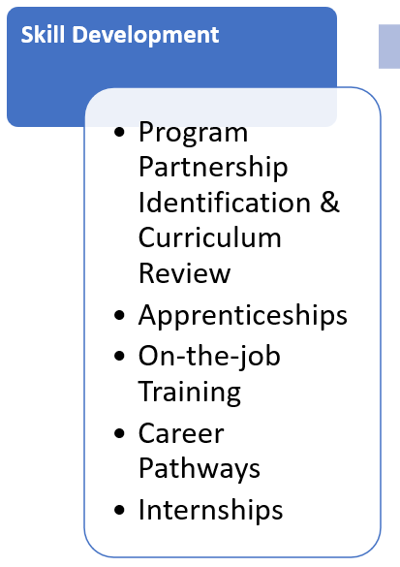
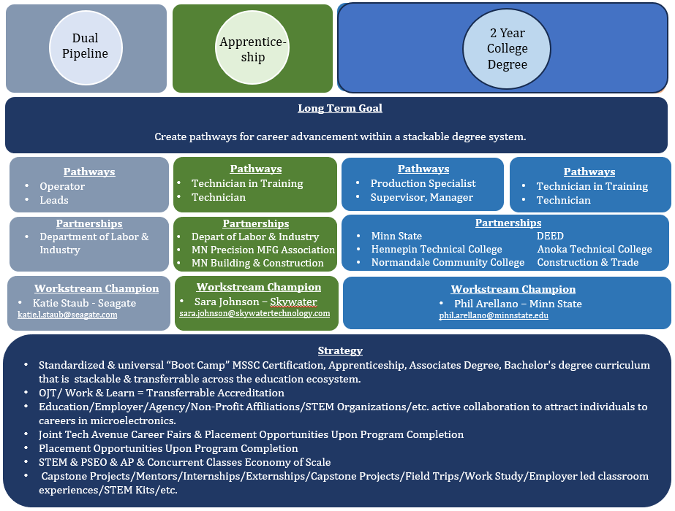
Strategies: Skills Development Workstream
Focus:
Operators
Technicians
Supervisors & Managers

Slide 37
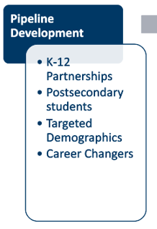
Talent Pipeline
Goal:
Through leveraging members of the CHIPS coalition to work collaboratively on resources and opportunities for outreach and engagement, connect 9-12 grades to CHIPS career pathways as well as find and encourage underrepresented populations and career changes to CHIPs career pathways
Strategies:
Outreach to high schools
Connect with community non-profits to outreach to underrepresented populations and career changers
Common Occupation Pitch Deck
Engagement Activities

Slide 38
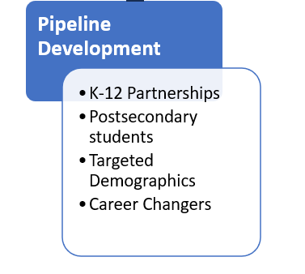
Activities & Successes: Pipeline Development
Industry
Non-Profits
Post Secondary
Secondary
Define Job/Skills need & outlook
Identify Populations
Remove Barriers
Identify Barriers
Respond to industry needs
Remove Barriers
Provide Supports
Provide Supports
Ongoing Outreach/Mentor/Marketing
Respond to Industry needs
Identify barriers
Provide supports
Inform Industry, Education
MSSC Certification
HS CTE
Technician
Pathways
Operator
Support Technician
Pathways
Technician in Training
Technician
Partnerships
HIRED
Normandale
DEED
Partnerships
Bloomington Public School District
Polar
Hennepin
Workstream Champion
Katie Staub - Seagate
katie.l.staub@seagate.com
Workstream Champion
Katie Staub - Seagate
katie.l.staub@seagate.com
Strategy
Partnerships with Employer & Non-profits to meet potential employees “where they are”
Define barriers per demographic
Industry stackable certificate or degree upon completion
Placement opportunities
Earn & Learn Focus

Slide 39

Tech Hubs: Minnesota MedTech 3.0

Slide 40

MN MedTech 3.0 Overview
Data and Information Sharing
Team
Ecosystem Growth and Investment
Innovation Hub
Leadership Council providing
executive governance functions
Equity Team providing coalition
wide DEI goals, metrics, strategies
MNcubation and Acceleration Team
Regional Innovation
Ofﬁcer & Staff
NextGen Talent
Building Team

Slide 41
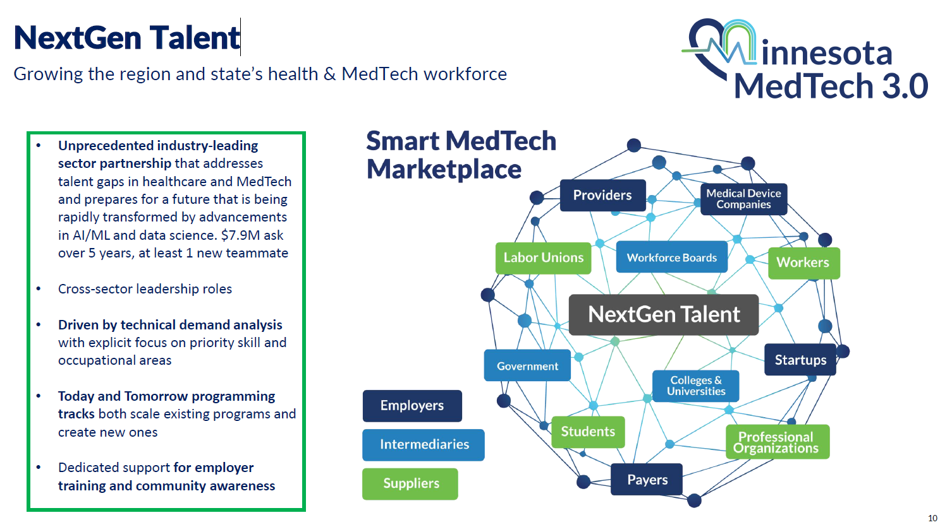
NextGen Talent Strategy

Slide 42

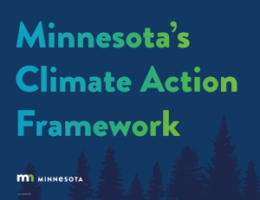
Workforce Development Overview
The Workforce Development vision for the M-SPIRE work is to create an inclusive and equitable pathway into the sustainable plastics sector.
This work will build off of of the One Minnesota Climate Action Framework and will leverage recent analysis carried out by the Minnesota Department of Employment and Economic Development (DEED) on workforce development opportunities in the waste sector to build career pathways with multiple on and off ramps for all Minnesotans, especially those underrepresented in this sector.
The GWDB plays a leading role in connecting workforce initiatives across state and local agencies and education & workforce partners and will support the linkage of the M-SPIRE work to existing and future workforce initiatives across the state to leverage resources and support for the years to come.

Slide 43
New PROWD Partnership
Partnership Goals:
  Address workforce gaps through targeted pathways for justice-involved individuals.
  Providing fair chance hiring guidance to employers.
  Convening workforce development programs, wrap around support, employers, and justice-impacted individuals.
  Nolan Thomas will coordinate this partnership through PROWD and GWDB.
High growth vacancies
Federal and state releases
Relevant training and support
Fair chance
best practices and guidance
Notes:
This partnership between PROWD and the Governor’s Workforce Development Board is designed to create new opportunities for justice-involved individuals, helping to fill the labor shortages we see across key industries in Minnesota.
A central focus is aligning the large untapped talent pool coming out of correctional facilities with vacancies in high-demand sectors like manufacturing, construction, and semiconductors. By doing this, we not only address industry needs but also provide life-changing career pathways for these individuals.
We are addressing the issue from both ends—by providing participants with the necessary training, skills, and support, while also engaging employers with education on best practices and incentives for fair chance hiring. This ensures businesses are equipped to adopt inclusive hiring strategies, ultimately creating more opportunities for justice-involved individuals to secure meaningful employment.
Nolan Thomas will play a critical role in coordinating this relationship. As a member of both the PROWD and GWDB teams, he will help convene the relevant workforce programs, employers, and justice-impacted individuals into the statewide efforts of the GWDB.

Slide 44
New PROWD Partnership
Current Tasks:
Creating Pathways & Sectoral Partnerships:
Identifying and filling high-demand, low-skill positions through partnerships in manufacturing, construction, and semiconductors under the IIJA, IRA, and CHIPS Act.
Employer Group with DOC:
Formalizing a group with the Department of Corrections to engage employers in fair chance hiring.
Comprehensive Employer Support Plan:
Developing an industry-specific plan to offer employers best practices, incentives, and guidance for fair chance hiring.
CHIPS Coalition & DoD Background Checks:
Engaging with the CHIPS Coalition and exploring how Department of Defense criminal background check requirements impact justice-involved individuals in semiconductor manufacturing roles.
Notes:
Creating Pathways & Sectoral Partnerships:
One of our primary tasks is identifying high-demand, low-skill positions that align with the skills and training of justice-involved individuals.
We’re partnering with businesses in industries like manufacturing, construction, and semiconductors to create accessible job pathways under workforce programs from the IIJA, IRA, and CHIPS Act. This will help meet growing labor demands while providing fair opportunities for individuals re-entering the workforce.
Employer Group with DOC:
We are working with the Department of Corrections (DOC) to establish a formalized employer group. This group will consist of businesses committed to fair chance hiring—giving justice-involved individuals a real shot at sustainable employment.
This group allows us to engage with employers who understand the importance of inclusive hiring practices and help them align their hiring needs with our program goals.
Comprehensive Employer Support Plan:
We're also in the process of developing a comprehensive support plan to offer employers best practices, incentives, and guidance on fair chance hiring.
We are working closely with resources like the Twin Cities RISE Fair Chance Hiring Guide, the Racial Equity GWDB Board Committee, and the Chamber Foundation to ensure the support is industry-specific and effective.
CHIPS Coalition & DoD Background Checks:
We are actively involved with the CHIPS Coalition, exploring the intersection of justice-involved individuals and careers in semiconductor manufacturing.
One specific focus is on the Department of Defense (DoD) criminal background checks, where we’re assessing how these checks may impact job eligibility for individuals re-entering the workforce, especially for roles that require security clearance or other federal contracts.

Slide 45
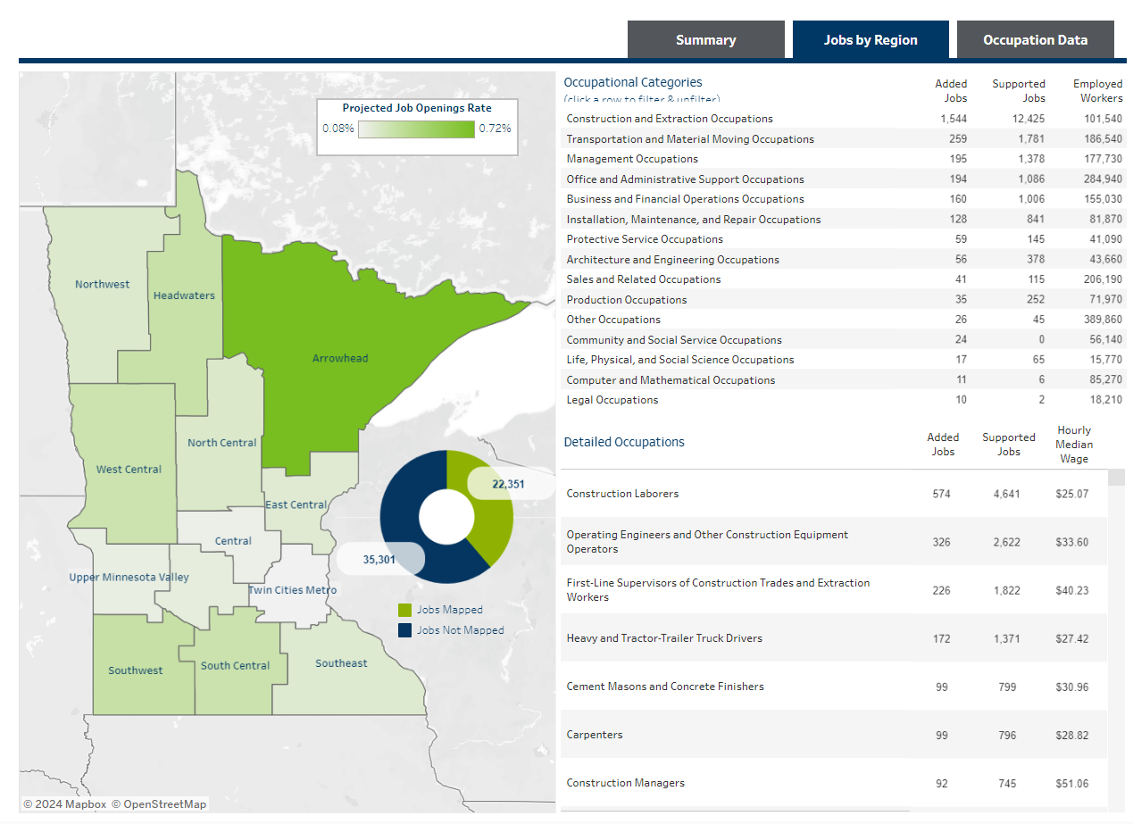
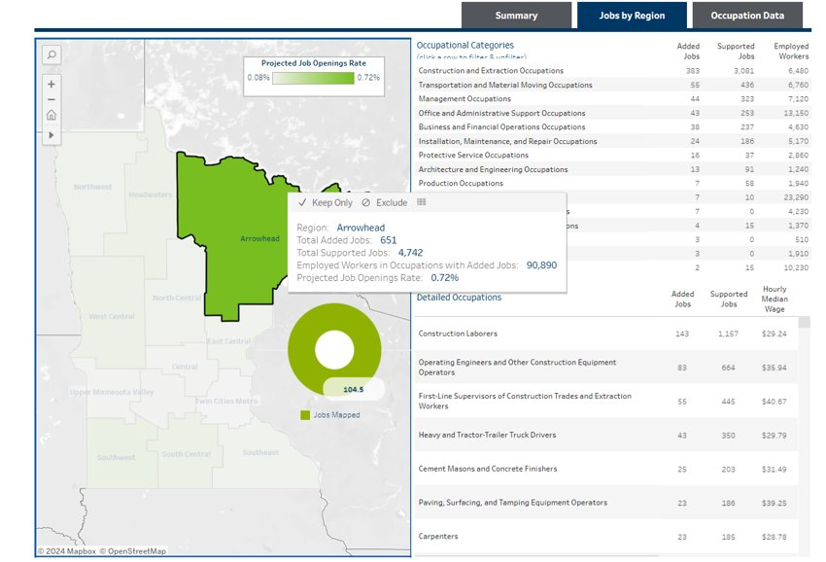
Jobs By Region Draft
Dashboard will show statewide forecasts and regionally specific forecasts as seen below

Slide 46
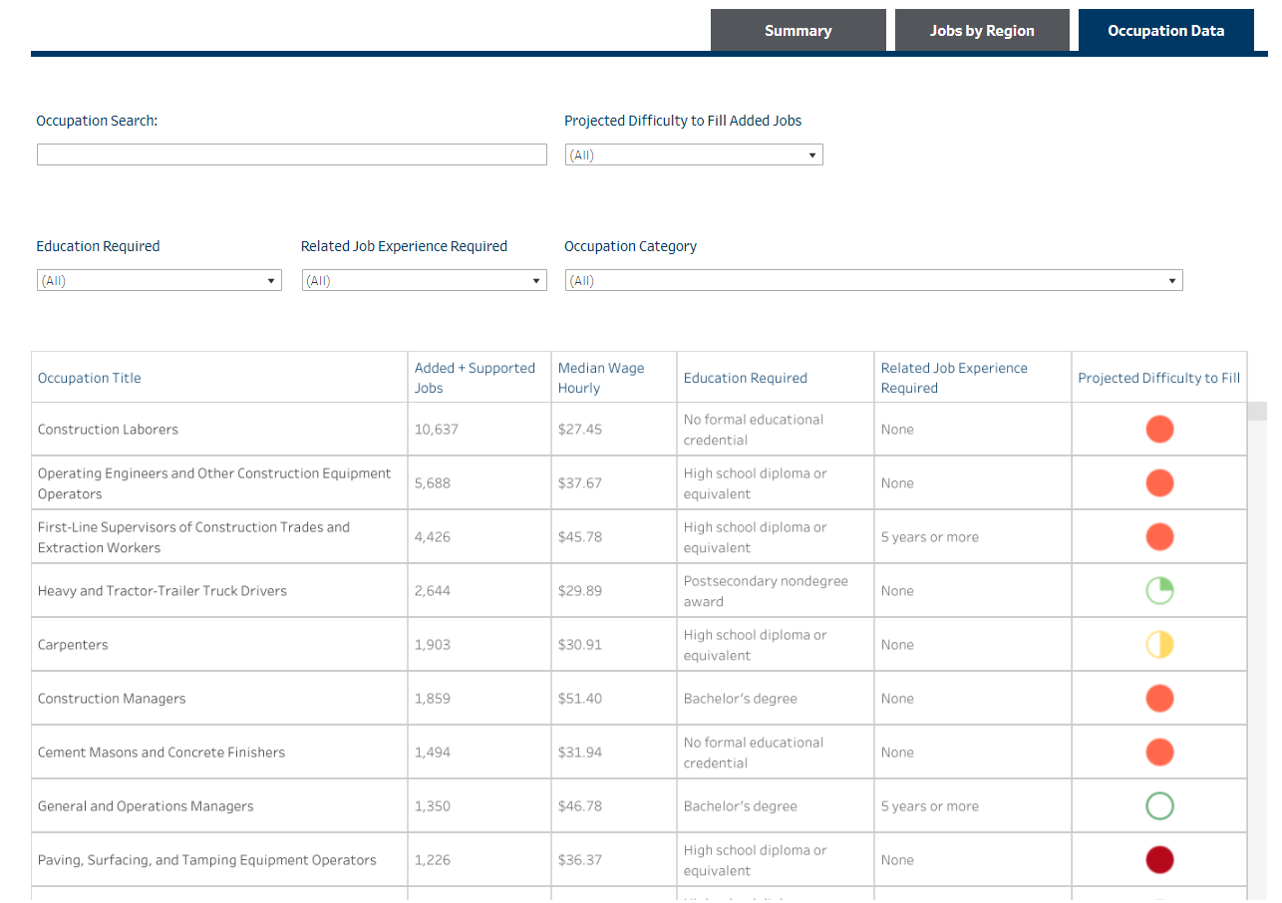
Draft Occupation Data
Occupation Data will demonstrate demand for all relevant occupations impacted by federal funding.

Slide 47
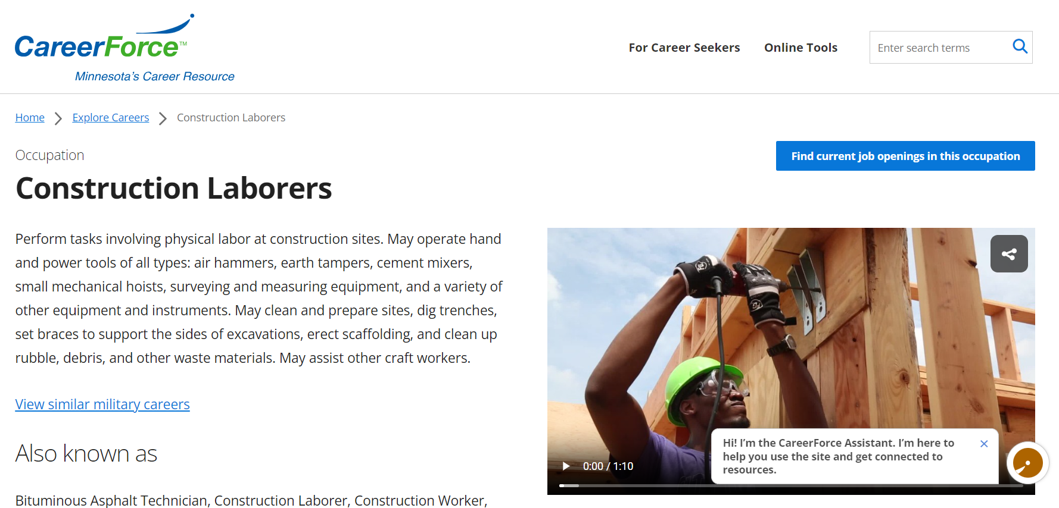
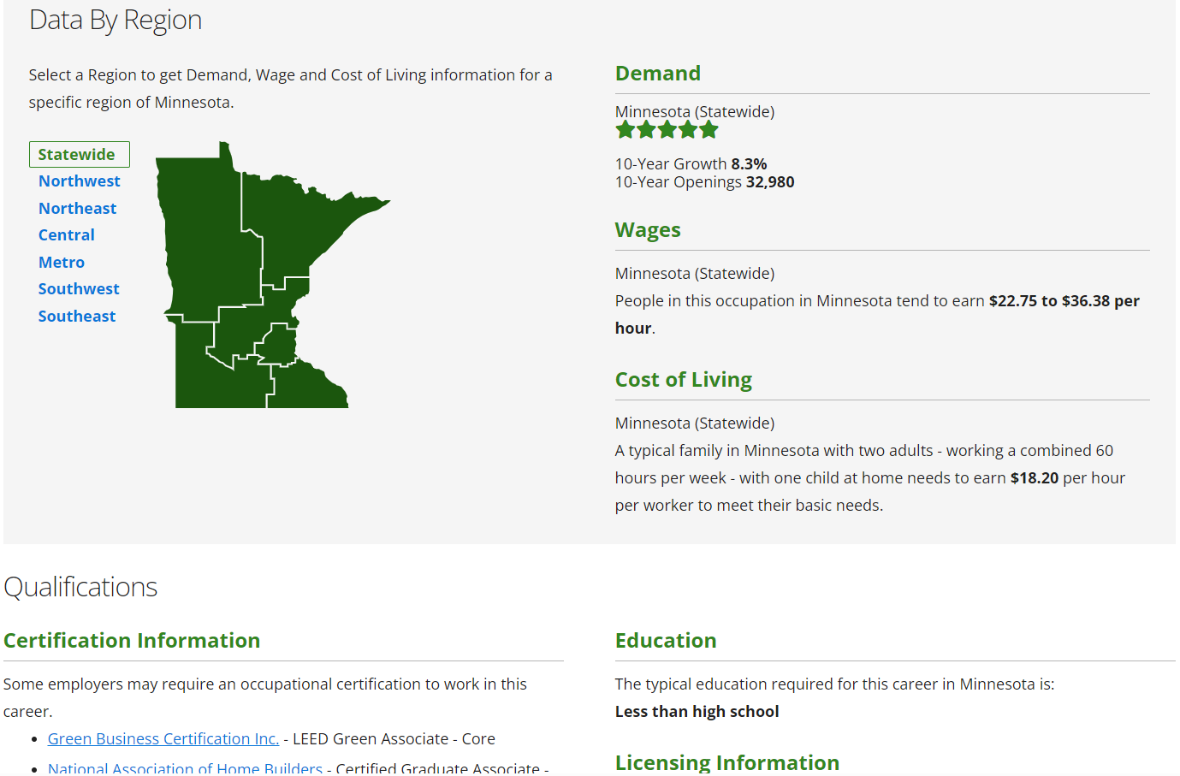

Slide 48
Discussion

Slide 49
What Comes Next?
Bringing the State Plan to Life
WIOA Reauthorization Implementation
Federal Funding Planning
State Sector Strategy

Slide 50
GWDB & MAWB Partnership
How can we better tell our story and the story of the workforce system?
What partnerships with MAWB and GWDB have worked well, either recently or in the past?
What are opportunities to work better together?
How can we increase collaboration on the three state plan goals?
  Interagency & Local Coordination
  Sector Partnerships
  Innovative Service Delivery

Slide 51
WIOA Reauthorization
Potential Opportunities:
  Alignment of workforce and economic development areas and regions
  Strengthened Eligible Training Provider List
  Expanded ability to serve Opportunity Youth
  Stronger coordination with state and local boards on implementation

Slide 52
State and Local Implementation Discussion
For those who were part of the 2014 WIOA Reauthorization, what worked well for state and local implementation?
What opportunities does a change in legislation provide for stronger coordination?
How should we be using national groups like National Association of Workforce Boards (NAWB), National Association of Workforce Agencies (NASWA), National Governor's Association (NGA), etc. as a resource?
What are our biggest areas of opportunity or concern?

Slide 53
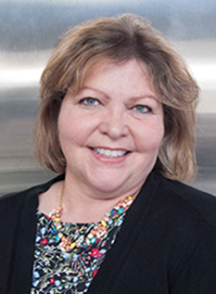
Thank you for your service, Kay!
Kay Kammen
GWDB Senior Policy Analyst

Slide 54
Lunch
WIFI Information:
Network: D’Amico Events
Pass: *Birdie!

Slide 55
State Sector Partnership Strategy Discussion
Katie McClelland, GWDB Director

Slide 56
GWDB Sector Partnership Strategy from 2024-2027 WIOA State Plan
GWDB Committees: Five sector partnership committees aligned to Drive for 5 sectors.
Defined Sector Partnerships & Mapping: Guidance on what constitutes and industry or sector partnership, how to register a partnership with the state to be part of the sector partnership communities of practice, and create a comprehensive database and mapping tool of the geographic and sector diversity of partnerships.
Best Practice Sharing: Quarterly meetings led by the GWDB Sector Partnership Chairs will bring together representatives from sector partnerships across the state to share best practices, discuss common needs across the partners within the industries or occupations of focus, and inform the GWDB of additional resources or guidance needed from the state.
Sector Partnership Convening: The GWDB will host convenings on each of the 3 State plan goals as part of achieving these goals over the next four years and gaining broader statewide awareness and adoption of the goals.
Career Pathway Development: The GWDB will work in partnership with the P-20 Partnership to develop statewide career pathways for each of the Drive for 5 sectors, building from existing best practices from across the state’s local and regional partners.

Slide 57
Step 1: Defining Sector Partnerships
Common Definition: Convene statewide partners to come to a common definition of sector partnerships
Define who should be part of a partnership (multiple employers, backbone org, etc.)
Identify Activities: Have partnerships identify key occupations and activities to find commonality across the state
Identify activities like OJT/WBL, career pathway development, training, recruitment, retention, etc.
Identify Scope: Each partnership may have different areas of focus. Scope identification will help with mapping to find gaps, overlaps, etc. as compared to where industry is in the state.
Identify sector/occupation of focus, geography, target populations, where on the talent pipeline focus (entry-level, upskilling, etc.)
Demonstration of Quality: Each partnership should demonstrate how they are carrying out and measuring quality of their partnership for:
Engaged partnerships, data informed decisions, worker voice and job quality

Slide 58
Step 2: Sector Partnership Convenings
Planning Convening
Bring partners together to confirm plan, come to agreement on terms and scope
Preview the plan at the GWDB/MAWB Quarterly Meeting
Partners to include representatives of: GWDB Leadership, Local Boards, State and Local Chambers, Education & Training Partners, Local Economic Development Organizations, Foundations, Employer Associations, Labor
Launch Convening
Host a larger convening of stakeholders engaged in sector partnerships to launch the new effort and encourage participation in the statewide initiative
Define role of DEED in supporting existing or creating new sector partnerships
  Provide opportunities for stakeholders to have leadership in the statewide strategy

Slide 59
Step 3: Partnership Mapping
Create site for partnership mapping and best practice sharing on GWDB’s site
GWDB and DEED staff to provide support for registration and new partnership creation
  Is this a role local boards and LWDAs could play too?
Identify gaps or overlaps in geographic areas as compared to labor market needs
  Work with local workforce board to build new partnerships

Slide 60
Step 4: Best Practice Sharing and Career Pathway Development
Host best practices on the GWDB site
  Create standardized template for best practice documentation, identified by sectors, demographics and activities
  Work with Career One Stop, MAWB, Minnesota State Centers of Excellence, MDE CTE Partners, etc. to collect or build best practices
Work with partners across the state to document best practices and develop/document career pathways
  Role of MAWB Regional Career Pathways Committees?
Identify where additional resources are needed

Slide 61
Discussion
What excites you about the proposal?
What are opportunities to improve the proposal?
How should we be leveraging the GWDB Committees to support this new initiative?
How can MAWB and MAWB Committees play a role in implementing this strategy?
What else is needed to strengthen this strategy/approach?

Slide 62
Drive for 5 Grants Panel: Sharing Best Practices & Lessons Learned

Slide 63
Drive for 5 Grants: Sharing Best Practices & Lessons Learned
Moderator: Nicole Swanson, Anoka County Job Training Center
Manufacturing: Steve Kalina, MN Precision Manufacturing Association
Tech: Jo Foust, Scott County Community Development Agency
Trades: Arlyce Cucich, MN Rural CEP
Caring Professions: Jennifer Eccles, Minnesota State HealthForce Center of Excellence, University of Minnesota
Education: Elena Foshay, City of Duluth Workforce Development

Slide 64
State of Child Care &
Best Practices
Jessica Beyer and Suzanne Pearl
Minnesota First Children’s Finance

Slide 66

Meet your Presenter from First Children’s Finance
Jessica Beyer
Business Development Manager - Minnesota
320-288-2652 Direct
320-808-7066 Cell
Jessica@firstchildrensfinance.org
Jessica is the Business Development Manager for the western side of Minnesota. Prior to joining First Children’s Finance, Jessica spent 12 years as a Community Program Manager at the Center for Small Towns at the University of Minnesota Morris. She was a programmatic staff that provided assistance to rural communities and oversaw the student involvement component of the Center. She also has an extensive background in leadership, community organizing, and publicity. Jessica also has vast experience with project management, training and facilitation. She received her BA from the University of Minnesota Morris in Speech Communication in 2002.

Slide 67
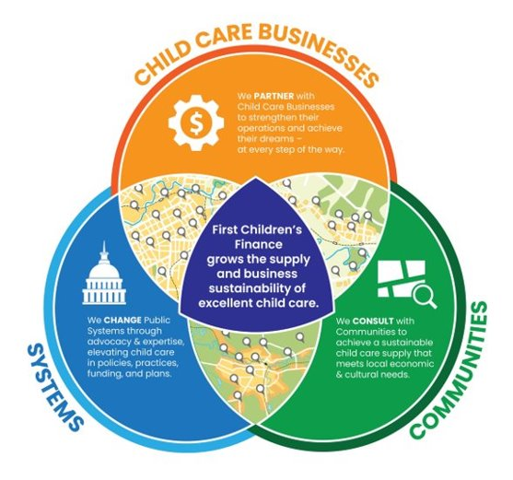



What does First Children’s Finance do?
Loans • Technical Assistance • Assessments • Start Up & Expansion Planning • Training • Business Consulting • Grants • Business & Leadership Development
Supply Building Initiatives • Needs Analysis • Community Engagement • Feasibility Studies • Custom Solutions • Technical Assistance • Workshops
Policy & Practice Review • Needs Assessments • Resource Alignment • Cost of Care Studies • National & Cross-Sector Collaboration
Notes:
First Children’s Finance work is conducted at three basic levels – the individual business level, the community level, and the system level.
The business level is we partner with individual child care providers to strengthen their operations and help them to achieve their dreams We work hard to ensure that child care business owners and programs are equipped with what they need to see long term success and sustainability. We provide loans, technical assistance, assessments, start-up and expansion planning, training, business consulting, grants, and business and leadership development.
The community level is where we are here today. We consult and work alongside with communities to help them you achieve a sustainable child care supply that meets your local economic and cultural needs. This work includes the facilitation of capacity building initiatives, the analysis of your local child care need, community engagement processes, Technical assistance and feasibility studies.
The systems level is where we change public systems through advocacy and expertise. We elevate child care in policies, practices, funding and plans. Some of our systems level work includes policy and practice review, needs assessments, cost of care studies, and national and cross-sector collaboration.

Slide 68
About First Children’s Finance
The mission of First Children’s Finance is to increase the supply and business sustainability of excellent child care.
Founded as a Community Development Financial Institution (CDFI)
Expanded to Oregon
and 13 Tribal Nations
Became a national
non-profit organization
Expanded to Vermont
Expanded to Michigan & Iowa
We continue to grow!
2008
1991
2006
2008
2022
2024
Today!

Slide 69
Navigating the Business Side of
Child Care

Slide 70
The Cost of Child Care Tuition for Families
Average annual cost of infant care is $16,087 ($1,341/month)
  21.2% of Median Family Income in MN
  Costs 30.8% more than average rent
Average annual cost of preschool care is $12,252 ($1,021/month)
A median-income family with an infant and a 4-year old would pay 37.4% of income on child care
Economic Policy Institute: Child Care Costs in the United States: Minnesota
Notes:
This is based on what parents are paying in tuition – updated in 2023
Most families who access child care are young, at the beginning of their earning potential. They have one of the largest expenses they’ll ever have when they are least able to afford it.

Slide 71
Child Care: Broken Business Model
The disconnect
  Families can’t afford child care
  Child care businesses have narrow profit margins
  Child care workers are among the lowest paid of Minnesota’s workforce
The actual cost of providing child care is more than families alone can afford
Notes:
Coming slides will illustrate the cost of providing child care in both licensed family child care and child care centers and hopefully show the disconnect; data comes from newly released 2023 MN Cost Modeling Report
FCF was awarded the project, funded by DHS; DHS does this every 3 years
Surveyed nearly 1100 child care providers in late 2022 (855 FCC/243 CCC); completed business interviews w/31 child care providers, including in-depth financial analysis of business documents
70 page report released today (Monday); includes analysis by geography using USDA’s “Rural Urban Communing Areas”; different from previous reports to better reflect the variation in greater Minnesota; and broadens the definition of “urban” beyond Mpls/St Paul

Slide 72
Family Child Care: Expense Breakdown
Expense Category | Total Annual Cost
Personnel Expenses | $6,605
Occupancy Costs | $9,576
Program Expenses | $14,382
Administration Expenses | $7,211
Total Annual Expenses | $37,774
2023 Minnesota Child Care Cost Modeling Report
Notes:
This reflects statewide average expense data for a licensed family child care program
Personnel Expense: Health Insurance
Occupancy Costs (Time-Space Percentage applied):
Mortgage interest, property taxes, & depreciation or rent/lease
Homeowners/Renters Insurance
Utilities
Cleaning Supplies, etc.
Repairs & Maintenance
Program Expenses:
Repairs and maintenance for child care
Supplies
Food and food-related supplies
Training/Professional Development
Professional membership dues
License and permits
Administration Expenses:
Telephone & Internet
Advertising
Vehicle Expenses
Depreciation of equipment
Insurance
Interest
Professional Fees
Office Supplies

Slide 73
Family Child Care: Expenses/Revenue
2023 Minnesota Child Care Cost Modeling Report
Notes:
Note that labor was not in pie chart on previous slide – that’s because it’s fairly rare of for Family Child Care providers to cut themselves a paycheck every 2 weeks/15 days.. The revenue here serves as their pay. We’ll take a closer look at revenue in the next slide, but first I’d like to note that expenses are fairly consistent across different size communities. While there may be variation in different expense areas across geographies, ultimately the total expenses are fairly uniform statewide.

Slide 74
Family Child Care: Revenue/Hourly Wage
 | Rural | Small Town | Large Town | Urban
Net Revenue | $28,789 | $33,956 | $33,749 | $56,796
Hourly Wage | $8.65 | $10.20 | $10.14 | $17.07
2023 Minnesota Child Care Cost Modeling Report
Notes:
While the revenue on the previous slide may have looked fairly impressive, Licensed Family Child Care providers worked on average about 65 hours/week. Think about a parent’s work day, that’s probably 8.5-9 hours, plus commuting time, with different drop-off/pick-up times for different families, that’s easily a 10, 11 or more hour work day, plus time to manage the business side, take required trainings, deal with any required licensing/compliance issues, etc.
So with that in mind, this is how the revenue breaks down into an hourly wage for family child care providers, across different geographic areas.

Slide 75
Child Care Centers: Expense Breakdown
Expense Category | Total Annual Cost
Personnel Expenses | $660,712
Occupancy Costs | $132,034
Other Costs | $164,434
Total Annual Expenses | $957,180
2023 Minnesota Child Care Cost Modeling Report
Notes:
This information is based on a model of an 80-seat center using statewide average expenses including average wages
Personnel includes wages/benefits – by far the largest expense
Occupancy includes rent, building insurance, utilities, mainentance/repair and cleaning
Other costs includes food (largest expense); classroom equipment; educational/program supplies; payroll processing and banking fees; liability insurance; audits/legal fees; licensing/permit costs; etc
Talk about ratios and classroom coverage here

Slide 76
Child Care Centers: Wages
Staff Role | Rural | Small Town | Large Town | Urban
Director | $23.38 | $20.31 | $21.07 | $26.31
Administrative Assistant | $17.35 | $17.35 | $17.35 | $19.62
Cook | $16.40 | $15.89 | $15.89 | $17.31
Accountant | $20.32 | $17.01 | $17.01 | $22.45
Lead Teacher | $17.20 | $16.65 | $16.81 | $19.61
Teacher Assistant | $13.98 | $13.86 | $13.70 | $16.73
Teacher Aide | $13.54 | $11.95 | $12.69 | $15.09
Substitute | $17.40 | $17.44 | $17.48 | $20.73
2023 Minnesota Child Care Cost Modeling Report
Notes:
These are average wages, shown by geography.
Not all centers have all of these positions, and many may be part-time positions (accountant, in particular).

Slide 77
Child Care Centers: Annual Per-Child Cost
Geography | Rural | Small Town | Large Town | Urban
Infant | $20,821 | $19,836 | $20,099 | $23,858
Toddler | $12,775 | $12,211 | $12,361 | $14,509
Preschool | $9,555 | $9,161 | $9,267 | $10,770
2023 Minnesota Child Care Cost Modeling Report
Notes:
This table shows the annual per-child cost of providing center-based child care for each age group/geographic type. We do not have a similar table for FCC (methodology was based on “classrooms” and FCC are all in one “classroom” – that analysis may be done at a later date)
Compare with first slide, where parents were paying an average of $16,000/year for infant care. This table shows even that doesn’t cover the true cost. That slide also shows infant cost at about $12,000/year
Note difference in cost by age – particularly the high cost to provide care for infants. Largely relates to the staffing ratio of 1 adult: 4 infants.
“Lose money on infants, break even with toddlers, must subsidize costs with preschool/school age”
We see that play out with the first slide of this presentation, which showed that parents were paying an average of $16,000/year for infant care. This table shows even that doesn’t cover the true cost. That slide also shows infant cost at about $12,000/year

Slide 78
Identifying the Need for
Child Care

Slide 79
Why This Matters
Community Vitality
Working Parents
Tomorrow’s Workforce
Return on Investment
Access to quality child care and early education is vital to individual productivity and regional economic growth.
Notes:
Working parents cannot access and maintain productive employment today without affordable, quality care and education for their children.
Tomorrow’s workforce will not be prepared to succeed in the global economy unless all children receive quality care and education today.
The return on investment in quality care and education today reduces long-term costs to the public and private sectors.

Slide 80
Data & Potential Need Analysis
Economic Development Region:
-9,701
Southeast
-4,570
Southwest
-16,065
Central
Region 9 & 10
Region 6E, 6W, & 8
Region 5, 7E, & 7W
-4,537
West Central
-2,797
Northwest
-4,098
Northeast
Region 4
Region 1 & 2
Region 3
-47,732
Metro
-41,796
Greater MN
-89,528
Entire MN
Region 11
Notes:
Data was pulled June 2024. This happens every year
Operating capacity vs licensed capacity
Omit programs that do not offer full year wrap around care
All parents in the work force – link to economic development
Under the age of 5

Slide 81
Impact on Family Planning
“I would consider having kids if child care wasn't such a huge issue. As it stands, I will probably never have them unless I decide to quit my job.”
- Local Employee
RCCIP Communities 2022-2024
Notes:
Has the availability of your preferred child care option impacted your decision to have another child/limit the size of your family?
It is also important to note that 56% of respondents said that the lack of available child care is impacting their decision on their family planning
“It has made my husband and I put off having children because we cannot locate a childcare facility that is affordable. Therefore, my husband is trying to get onto a different shift, so we can try to only need part time childcare vs full time.”
–Local Parent

Slide 82
Local Level Economic Impact of Child Care
35% of parents withdrew from the workforce or declined employment due to child care issues
RCCIP Communities 2022-2023

Slide 83
Local Level Economic Impact of Child Care
Work issues occurred due to child care arrangements in the last 12 months
RCCIP Communities 2021-2023
Notes:
This is a local picture that aligns very similar to a Study done in Santa Barbara
Where the top 4 was
Tardiness – 45%
Inability to work overtime – 38%
Absent from work – 33%
Inability to work shifts and productivity tied at – 25%

Slide 84
Services and Resources for Communities

Slide 85
Local Resources
Right-Sized Solutions
+ Innovation
SUSTAINABLE SUPPLY
Notes:
The magic of this project happens when we harness the creativity and interconnectedness of rural communities. We bring together local resources (energy, relationships, and dollars) and innovation to develop sustainable and right-sized solutions.

Slide 86




For Communities
First Children’s Finance partners with communities to develop local solutions to address child care shortages.
^{Analyze supply of child care}
Innovate ideas to create new slots
Empower communities to implement solutions
Provide technical assistance to create incentives
An adequate supply of child care is a critical component to a healthy community and a vibrant regional economy.
Notes:
The Rural Child Care Innovation Program (RCCIP) is a regional approach linking child care to local economic development.
a community engagement process that addresses the shortage of child care in rural communities. The Rural Child care Innovation Program is based on the fundamental idea that rural communities are greater than their size in numbers and greater than their current challenges. After an application process, selected communities undertake a 18-24 month community engagement process to identify the local child care need and challenges (through surveys and data analysis), explore right-sized solutions which address the child care shortage, and implement goals that were created by each community during this process

Slide 87
Programs & Services for Communities
Programs
  Rural Child Care Innovation Program (RCCIP)
  Child Care Strategic Supply Plan (SSP)
Consulting Services
  Child Care Supply Demand and Gap Analysis
  Custom Survey and Analysis
  Child Care Business Models
  Community Presentation
  Guidance for Public-Private Partnerships to Build and Maintain Supply
  Technical Expertise on Local Policy and Financial Incentives
  Child Care Study
Notes:
The Rural Child Care Innovation Program (RCCIP) is a regional approach linking child care to local economic development.
a community engagement process that addresses the shortage of child care in rural communities. The Rural Child care Innovation Program is based on the fundamental idea that rural communities are greater than their size in numbers and greater than their current challenges. After an application process, selected communities undertake a 18-24 month community engagement process to identify the local child care need and challenges (through surveys and data analysis), explore right-sized solutions which address the child care shortage, and implement goals that were created by each community during this process

Slide 88
Connecting to FCF Resources

Slide 89

When to make a Referral to FCF
  Communities looking to assist in child care solutions
  Small and large businesses looking to support child care solutions
  Individuals interested in starting a child care business
  Child care business that may or may not be struggling
  Child care businesses interested in growing/expanding/change
  Other Business Needs
Notes:
Understanding the different business models
Before their business is in the licensing process
Child care business that are in the licensing process

Slide 90

A Special Acknowledgment …
© First Children's Finance
Notes:
would like to take this time to thank the MN DCYF and our regional funding partners for the funding to conduct rural community engagement work.

Slide 91
Thank You!
No one has yet realized the wealth of sympathy, the kindness and generosity hidden in
the soul of a child. The effort of every true education should be to unlock that treasure.
– Emma Goldman

Slide 92
Addressing the Aging Population in Greater MN
Cathy McLeer, State Director, AARP Minnesota

Slide 93
Older Workers:
Principles and Policies
Cathy McLeer
State Director AARP Minnesota
cmcleer@aarp.org
Notes:
Hello- I’m Cathy McLeer – state director for AARP Minnesota. With 625,000 members across Minnesota – we work to empower people 50 and older to choose how they live as they age. We do that through our advocacy – working to ensure health and financial security for older Minnesotans. We provide resources and information and we work to build stronger more livable communities for all ages.
I want to thank Bob Libal for the invitation to be with you all today to share some of AARP’s principles and policy priorities as they pertain to older workers.

Slide 94

Older Workers – An Untapped Resource
Preference or Necessity
Resilience
Deep Knowledge
Experience
Notes:
As we are living longer, older adults are putting off retirement out of preference or necessity. Older workers bring resilience, deep knowledge and experience to the workplace, and, they are valuable contributors to the multigenerational workforce that exists today. As many industries across Minnesota face workforce shortages- workers 50 and older are truly an untapped resource that has the potential to meet workforce needs across all sectors.

Slide 95
Labor Force Changes
Notes:
One of the more significant labor-force developments of the past quarter century has been the rising participation rate of older Americans. In 1985, less than two-fifths of people age 50 and older were either working or looking for work. By 2019, that figure had risen to nearly half of that age group or almost 55 million people. Subsequently, the COVID-19 pandemic reduced the size of the 50 and older workforce to 53.7 million. However, workers age 50 and older still made up over 33 percent of the total U.S. workforce age 16 and older in 2022.
Pandemic-related job losses hit older workers particularly hard. Yet many employment issues and trends involving older workers remain the same as before the pandemic. Most Baby Boomers have reached traditional retirement age, and many have left the labor force. Yet, the number of older workers is still projected to increase. That’s because the number of older adults is growing, and labor force participation rates among older workers are expected to rise. Minnesota touts more citizens over the age of 65, than younger than 18.
Some older workers opt to delay retirement because they want to continue working. Others keep working because they cannot afford to retire. The Bureau of Labor Statistics still projects that those age 65 and older—traditionally retirement age—will be the fastest-growing age group in the workforce in the decade ahead.

Slide 96

Barriers Facing Older Workers
Age Discrimination
  Excluding Older Applicants
  Refusing to Hire or
  Promote Older Workers
  Targeting Older
  Workers in Layoffs
  Curtailing Benefits
  Limiting Training &
  Responsibilities
Notes:
AARP believes it is important for older workers to have the option to work beyond the traditional retirement age. Longer work lives contribute not only to current financial well-being but also to economic security in retirement.
Yet, significant barriers to hiring and retaining older workers exist. Among them is the persistence of blatant or subtle age discrimination. What does age discrimination look like?
excluding older applicants from recruiting activities,
refusing to hire older applicants or promote older workers, AARP research finds it often takes job seekers over the age of 50 twice as long to get hired than younger workers.
targeting older workers in layoffs, curtailing their employee benefits, and limiting their training opportunities and job responsibilities.
Employment discrimination due to disability is a particular challenge for older workers. They are more likely than younger workers to live with disabilities or chronic medical conditions.

Slide 97
AARP Employment Principles
Protection from Discrimination
Expand Opportunities
Help Vulnerable Populations
Increase Job Availability & Quality
Improve Workforce Development
Job Search and Training
Notes:
I want to cover a few Employment Principles highlighted in AARP’s Policy Book - this is available to the public I’ll share how to access this later..
As I just mentioned, Protect people from discrimination—freedom from discrimination is a fundamental right. All workers deserve to be protected from arbitrary discrimination in all aspects of employment, including hiring, compensation, promotion, termination, and training.
Expand employment opportunities and economic security—employment policy should remove barriers to work opportunities. It should also expand employment opportunities for all who are willing and able to work. Those policies should minimize unemployment and underemployment and promote economic security.
Help vulnerable populations—vulnerable populations should receive special help in finding and keeping employment capable of sustaining a decent standard of living.
Increase job availability and quality—government and employers should promote job creation that accounts for the needs of older workers. Deteriorating job quality should be addressed. This includes wage levels that do not keep up with inflation, a decline in jobs with benefits, unpredictable schedules, unsafe working conditions, and the growth in contingent employment.
Improve workforce development—individuals, employers, and policymakers must each play a role in ensuring that workers of all ages can develop new and update existing skills as the economy and labor market change.
One way to do that is through Job Search and Training. We live in a rapidly changing work environment. Older workers need access to high-quality job search services and job training. Lifelong training and retraining opportunities can help to ensure that older workers remain competitive.
AARP encourages local and regional level collaboration of job training efforts among employers, workforce development centers, libraries and training providers.
One unique example of this, the Northland Foundation received and Age-Friendly Minnesota Grant in 2023 to support a project linking individuals who have the left the workforce, including for retirement and caregiving responsibilities to employers who will offer "returnships" to help them re-enter the workforce.

Slide 98

Flexible Work Arrangements
Alternative Work Schedules
Flextime
Telecommuting
Job Sharing
Phased Retirement
Notes:
Another way to support an age-friendly and diverse workforce is through Flexible work Arrangements: This includes alternative work schedules, flextime, telecommuting, job-sharing.
A lack of flexible work arrangements can be a hindrance to older workers’ continued employment. Many need to combine paid work with caregiving responsibilities and often face discrimination as a result of those responsibilities. I’ll talk more about that in just a moment.
Another example of flexible work arrangement for older workers is to offer phased-retirement programs and retiree reemployment programs that encourage employees to stay in the workforce beyond the time they would normally plan to retire. The programs should protect the adequacy of their pension and retirement benefits until they do fully retire.
Policymakers should eliminate barriers to the adoption and acceptance of phased-retirement programs. They should ensure that such programs protect worker rights and financial security.
Public and private agencies should educate employers about how to implement successful phased-retirement programs

Slide 99

Flexible Work Arrangements
1 in 6 Employees are Caregivers
Caregiver Supports:
  Maximize Productivity
  Improve Physical and Emotional Health
  Attract & Retain Quality Employees
Paid Family & Medical Leave Act
Notes:
I want to talk a bit more about supporting Caregivers in the workplace as it relates to workplace flexibility.
In Minnesota – we have 530,000 family caregivers. Nationally, One in six employees provide some sort of care for a family member or a friend. Those responsibilities range from taking time off or adjusting schedules to get their loved one to doctors appointments, manage medications, assist with daily task of living. 1 in ten caregivers say they had to give up work entirely, or retire early.
Often workers put their own financial security at risk – by taking unpaid leave, or dropping out of the workforce to care for a loved one, whether it’s a child, a parent, a spouse or someone with whom they have a significant.
Minnesota’s Paid Family Medical Leave Act – which will be implemented in 2026 as a critical way to support caregivers in the workplace - especially those caring for older loved ones.
Minnesota’s Paid Family and Medical leave act is one of the most progressive in the country and will ensure no one will have to choose between their paycheck and taking care of a loved one.
Paid Family Medical Leave, in conjunction with workplace policies to support caregivers can
Maximize Productivity​
Improve employees' Physical and Emotional Health​
And attract and retain quality employees by making it easier and less stressful to perform their caregiving responsibilities.
As Paid Family and Medical Leave rolls out in 2026 it will be important to inform and educate employers and help them understand their role in implementing PFML, and informing employees about their rights under the new law.

Slide 100

Work & Retirement Benefits
Workers 20X more like to save with auto-deductions
700,000 + MN workers lack access
to saving on the job
Secure Choice - Implementation 2025
  Private-Public Partnership
  No Cost to Employer
  Easy Administration
Notes:
Finally – I want to touch on another important aspect of the work force and that’s ensuring workers of every age can save for the future and build a secure financial future.
I want to highlight Secure Choice – which AARP Advocated for in 2023 and will roll out late in 2025.
People are 20 times more likely to save for retirement if they have a opportunity to save on the job, and their contributions are automatically deducted from their paychecks. Yet, more than 700,000 workers in Minnesota lack access to a traditional pension or retirement saving plan through their jobs. And, workers of color, and employees at small businesses are least likely to have a way to save on the job.
Minnesota’s Secure Choice Retirement Program is a new state-sponsored plan designed to help small businesses offer employees an easy way to save for their future.
Business with 5 employees or more that don’t already offer a retirement saving plan will be required to offer through a simple payroll deduction.
Secure Choice is:
Easy to administer
Zero employer fees
No fiduciary responsibility
Voluntary for employees

Slide 101
Thank You
Cathy McLeer, AARP Minnesota
cmcleer@aarp.org
www.aarp.org/policybook
Notes:
Thank you again for the opportunity to join you to day –
One final thought I want to leave you with… I encourage you all to in your work, and on your boards, to solicit input from representatives of organizations serving or advocating on behalf of older workers. If you have at-large representation from the community, include older workers on your boards. I would also encourage you to get engaged with the Age-Friendly Minnesota Council. As this group builds a Multi-Sector Blueprint on aging – on how to best address the needs of older Minnesotans – your input is essential. One of the key domains of an Age-friendly state is Economic Security and Vitality… and certainly the ability to remain in the work force is a critical aspect of Financial resilience for Minnesotans of all ages.
If you want to explore from AARP’s Policy Recommendations on older workers – our policy book is online and available to the public at aarp.org/policybook.
Thank you again for your time and attention.

Slide 102
Closing Remarks & Adjournment
Surya Iyer
GWDB Chair
Com. Scott Schulte
MAWB Chair

