Slide 1
2021 GWDB-MAWB Annual Winter Meeting
Welcome to the
Wednesday, December 15
9:00 a.m. – 12:00 p.m.
Virtual Meeting (via Zoom)

Slide 2
Today’s Agenda
Welcome/Call to Order
GWDB Business Meeting
MAWB Business Meeting
Updates from DEED Commissioner Steve Grove
Promising Practices for Workforce Recovery
Break (≈10:10-10:15)
Panel Discussion: Innovative Service Delivery
Breakout Discussions: Reflections & Ideas
Alabama: Strong Start, Strong Finish & Other Initiatives
Health Care Month: Updates & Opportunities
Adjourn (12pm)

Slide 3
Today’s Voting Procedure
Today votes will be taken using the Zoom chat function during the GWDB Business Meeting and the MAWB Business Meeting
To Vote Yes: Type “Yes” or “Yea” in the chat
To Vote No: Type “No” or “Nay” in the chat
GWDB Business Meeting: only VOTING MEMBERS of the GWDB are permitted to vote
MAWB Business Meeting: only VOTING MEMBERS of MAWB are permitted to vote

Slide 4
GWDB Business Meeting
Action Item: September GWDB Meeting Minutes
Action Item: GWDB Chair’s Report
Other Business (for information/no action needed):
GWDB By-Laws (revisions development underway)
2022 Meeting Schedule (TBD)

Slide 5
MAWB Business Meeting
Action Item: 2021 Legislative Priorities
WIOA Reauthorization Recommendations
Action Item: Bank Change Authorization

Slide 6
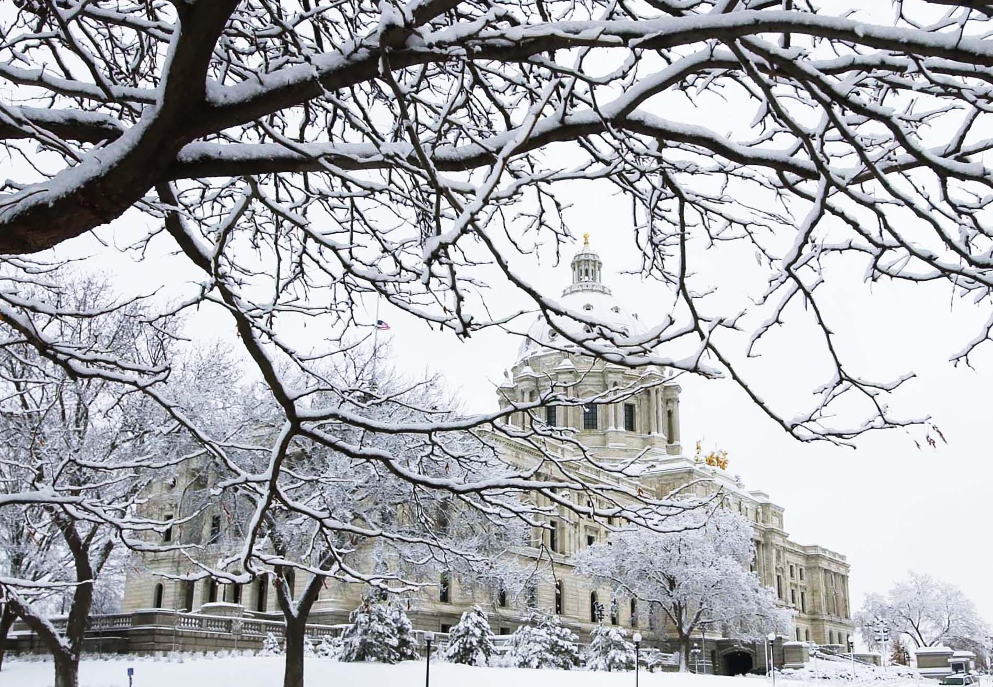
MAWB Business Meeting: 2021 Legislative Priorities – For Action
State of the Workforce section gets updated every year
Not a funding year, but supplemental budget expected due to forecasted surplus
Priorities – issues that we have direct influence or implementation responsibility
Other issues of Association Interest- adjacent issues that affect the success of our employers, jobseekers, program participants and local economies
Generally broader statements that allow flexibility for staff to pivot during session as needed.
Aligned with the Association of Minnesota Counties platform.

Slide 7
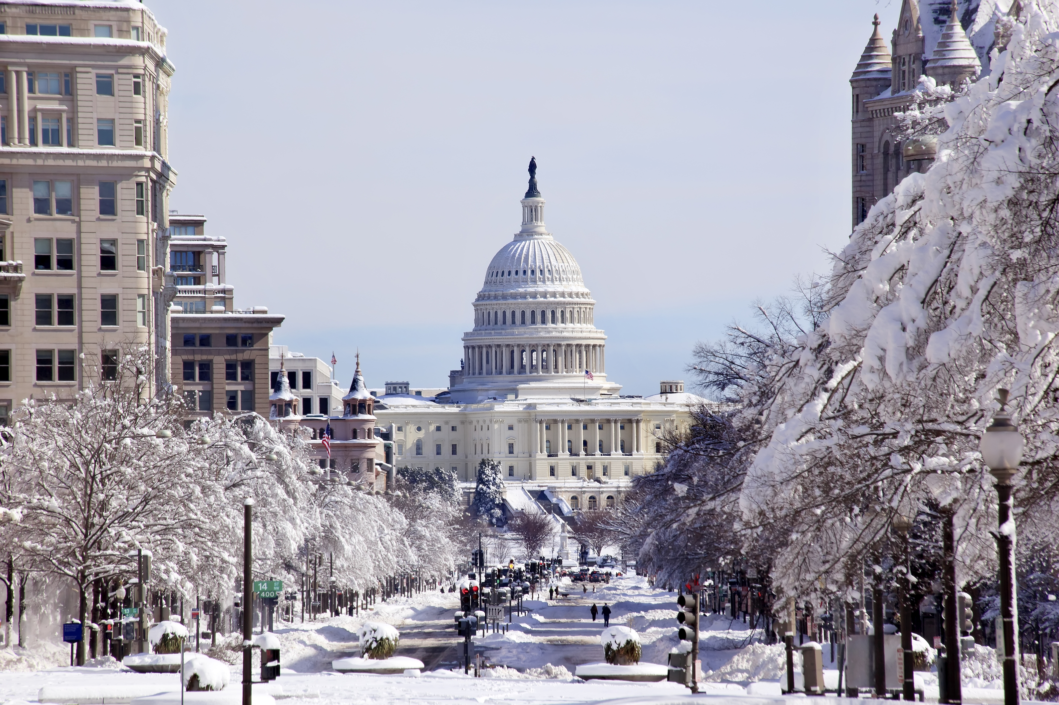
MAWB Business Meeting: Recommendations on WIOA Reauthorization
OVERARCHING THEMES:
Locally Driven, Flexible Solutions
Strengthen the One-Stop System
Program Integration/Alignment
Managing Performance
Full Funding

Slide 8
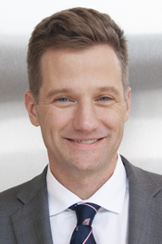
MN Department of Employment & Economic Development (DEED)
Next Up: Updates from DEED Commissioner Steve Grove

Slide 9
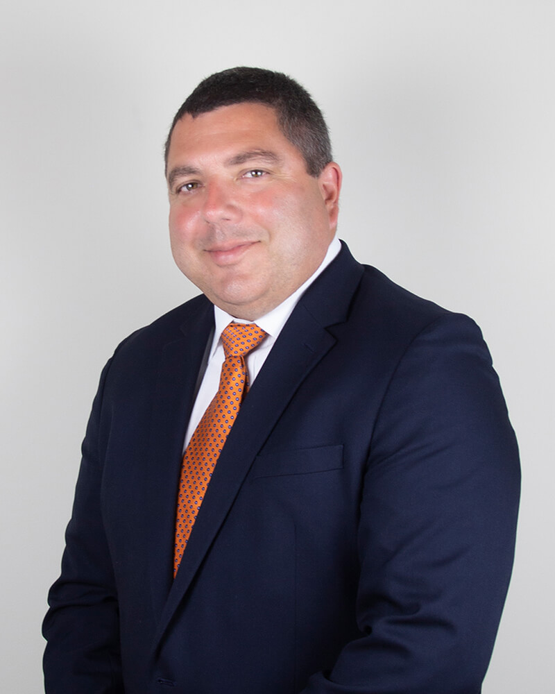
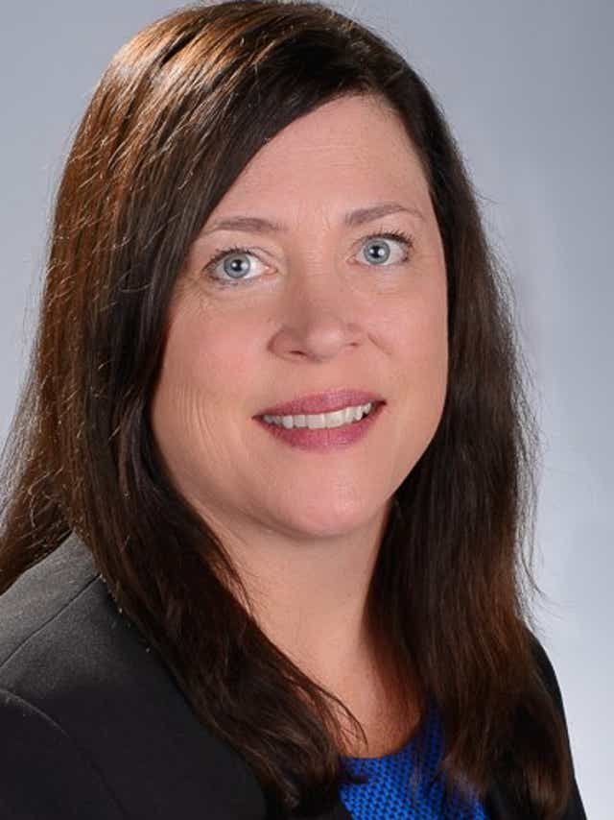
Promising Practices & State Initiatives during COVID-19: Innovative Approaches to Workforce Recovery
Mike Beene
Director of Employment Services,
Kansas Dept. of Commerce
Cheryl Bergman
CEO,
Michigan Women’s Commission
- First Guest Presenter -
- Second Guest Presenter -

Slide 10
Break!
5-minute break, we’ll begin again at 10:15!

Slide 11
Innovative Service Delivery: Panel Discussion
Panelists:
Megan Farry, New York Association of Training and Employment Professionals (NYATEP)
Ryan Hundt, MichiganWorks! Association
Bob Lanter, California Workforce Association
Walter Simmons, Employ Prince George’s, Inc. (Maryland)

Slide 12
Small-Group Breakout Discussions
Discussion Ideas:
What reactions or reflections do you have about today’s presentations from leaders in other states?
Do you think Minnesota could or should replicate any of the ideas you heard today in the presentations? Why or why not?
What would be some the obstacles to replicating these or similar ideas? Any opportunities, based on existing systems/infrastructure?
*Please select a “Reporter” amongst your group to share when we come back. Time-permitting, we’ll call on group reporters to share. Everyone is also welcome to share their thoughts (or group’s thoughts) in the chat.*

Slide 13
Strong Start, Strong Finish and other Alabama Workforce Initiatives
Presenter:
Nick Moore,
Director, Alabama Governor’s Office of Education & Workforce Transformation

Slide 14
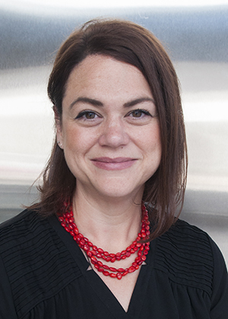
Health Care Month: January 2022
Jessica Miller,
DEED Workforce Strategy Consultant

Slide 15
Adjourn
Thank you
for attending!

