Slide 1

Registered Apprenticeship – Work Based Training
Ruth Taylor
Apprenticeship Minnesota
Minnesota DLI

Slide 2


| Minnesota Department of Labor and Industry
DLI’s MISSION is to ensure Minnesota’s work and living environments are equitable, healthy and safe.
DLI’s VISION is to be a trusted resource, service provider and impartial regulator.
DLI’S SERVICES:
Occupational Safety and Health (OSHA)
Construction Codes and Licensing
Workers’ Compensation
Labor Standards
Registered Apprenticeship
Dual-Training Pipeline
Youth Skills Training

Slide 3
Registered Apprenticeship…
Building Workforce through partnerships
MN WORKFORCE
Apprenticeship MN
MN WorkForce Strategy
MN Business
MN Educational Strategy

Slide 4
Registered Apprenticeship...
Building Workforce through Partnerships
Apprenticeship MN is the state’s Registered Apprenticeship Authority
Apprenticeship MN assist sponsors with:
Developing quality apprenticeship programs;
Providing service to sponsors and apprentices; and
Ensuring compliance of laws that protect both sponsors and apprentices.
Sponsors of Registered Apprentice are leaders in employee training
Sponsors work with Apprenticeship MN in:
Developing high caliber training for their employees;
Offering employees current, and on-going growth opportunity; and
Build a strong workforce for the future.

Slide 5
Registered vs Non-registered Apprenticeship Programs
Registered Programs
Always include employment, OJT, related instruction, progressive wage increases, and a national credential
Standardized across occupations
Programs are evaluated regularly by registration entity for quality and EEO requirements
Registration is often necessary for benefits programs (Veteran’s, WIOA, 529, etc.)
Non-registered Programs
May not include all five components of registered apprenticeship
E.g., only OJT and no related instruction, OJT may be less than 2000 hours, may not have progressive wage increases, may not have a portable credential
Variation between programs
Typically, not eligible for benefits programs
Apprenticeship Minnesota | apprenticeship.mn.gov

Slide 6


Registered Apprenticeship vs Traditional Model
EXPERTISE
(Education + Experience)
Time
(in years)

Slide 7

Benefits of Apprenticeship
Employers
Build and shape their own workforce
Creates new skilled worker pipeline
Workers produce as they train
Improve productivity
Reduced employee turnover
Retain/Transfer organizational knowledge
Employer Incentives to Hire Veterans
Workers
Employment
Comprehensive job training
Safety instruction
Wages increase with progress
Master in-demand skills
Nationally recognized credential
Registered Apprentices are G.I. Benefit Eligible
Minnesota
Pathway to the middle class
Quality training for workers
Safety for workers Vibrant economy

Slide 8


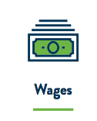
What is Registered Apprenticeship?
Components of a registered
apprenticeship program
NA
A time-tested model to:
recruit, train and retain a highly skilled and diverse workforce.

Slide 9
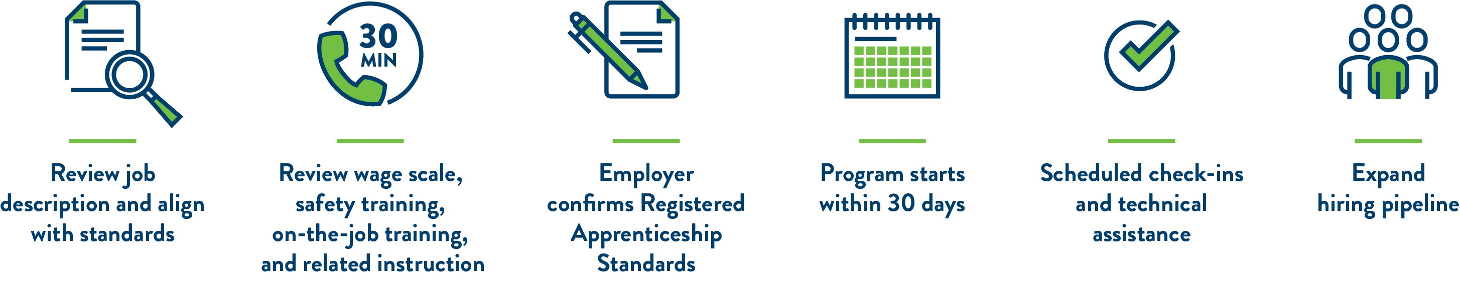
| How it Works
Development of a Registered
Apprenticeship Program

Slide 10
State of Registered Apprenticeship
In Minnesota

Slide 11

2023 Apprenticeship Program Snapshot
Active programs | 233
New programs | 9
Active Apprentices | 11,546
New Apprentice Registrations | 4,229
Apprentice Completions | 1,598
Notes:
2023 Calendar Year
Active programs (has at least one apprentice currently enrolled)
New programs (included early childhood educator, community health worker, digital marketer, quality control technician, ophthalmology technician)
Active apprentices: 11,546 (23% POC, 8% women, 6% veterans, 1% people with a disability)
New apprentice registrations: 4,229
Apprentice Completions: 1,598

Slide 12
Registered apprenticeship programs in Minnesota by industry

Slide 13
Percentage of total active apprentices by industry
Notes:
134 apprentices in manufacturing

Slide 14

Drive for Five Initiative
Intended to prepare more Minnesotans for high-demand jobs:
Caring professions
Educational Services
Manufacturing
Trades
Technology,
Prioritizes training for populations that face the largest disparities in employment
Notes:
Coordinated through DEED and the Governor’s WFDB

Slide 15

Additional Career Pathways
Registered apprenticeship creates an additional career pathway where postsecondary education has previously been preferred
Allows individuals facing barriers to employment to train for in-demand occupations that pays family- sustaining wages and provides opportunities for skills and career advancement.

Slide 16
| Engagement
High Schools:
List of what we do
Events
Presentations
Counselors
Bus tours
Construct Tomorrow
CBO’s:
Events
Bus Tours
Career Fairs
Businesses:
Events
Career Fairs
Sector Specific:
Navigator Position:

Slide 17
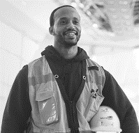




Apprenticeship.mn.com
THANK YOU
Ruth Taylor
Sr. Field Rep, Apprenticeship Minnesota DLI 443 Lafayette Road N., St. Paul, MN 55155 (651) 284-5467 | ruth.taylor@state.mn.us

