Slide 1






TRAINING
INCUMBENT WORKER
Presentation - 2024
Visit Our Websites
CareerSolutionsJobs.org
RMCEP.com

Slide 2

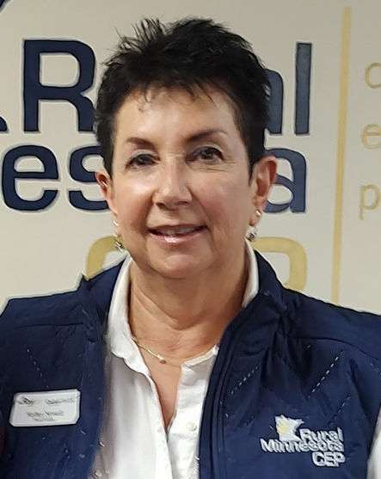



Intros
Kelley Nowell, Team Leader, Rural MN CEP
With for RMNCEP for 25 years.
Started as MFIP Job Counselor in the Detroit Lakes office working with direct client services for 12 years, and then promoted to a Team Leader managing multiple programs and staff for the past 15 years.
Oversee many WIOA programs, MYP, Youth at Work, Youthbuild, DW, P2P, Restoring Connections and MFIP/DWP Programs in Becker and Otter Tail counties.
First Team Leader to develop an Incumbent Worker Training at RMCEP and has led the charge in promoting IWT since 2020 writing over 8 IWT contracts, assisting businesses in gaining credentials and increase knowledge in highly sought after trainings in leadership development.
One of 8 Team Leaders for RMCEP, which covers 19 counties in 8 locations in NW MN.
Stacy Belen, Dislocated Worker Program Coordinator, Rural MN CEP
IWT Outreach for 8 RMCEP locations & 19 counties.
Previous MFIP/DWP Employment Counselor
Monthly HR Networking Group
FHPAP Homeless Committee Group
Perham Ambassador
Restorative Family Mediation Circles Training
Family Development Specialist Training
Outside of work, I enjoy working out, spending time with my family, volunteering, and being active outside camping, at the lakes, biking, sporting events, etc.
Angie Dahle, Business Services Manager, Career Solutions
Business Services Manager for Stearns & Benton Counties (St. Cloud area) Region 3
Incumbent Worker Training (since 2016)
Monthly HR Networking Group
Employer/High School Career Events
Diversity & Inclusion Resources/I-WE
Recruiting Resources
Marketing & Advertising
Region 3 Rural Career Counseling Coordinator (RC3)
Supervise Reception & Career Lab staff
Outside of work I enjoy hiking, camping, and attending sporting events with my family.

Slide 3


Agenda 11:15-12:15
Best practices with the Incumbent Worker Training (IWT) program.
Workforce development and outreach strategies.
Training program application process and requirements.
Training programs for businesses and employees.
Challenges in workforce training program, including trainee dropouts and employer payment issues.
Employer success testimonials.
Q & A

Slide 4



Outreach Strategies

Slide 5

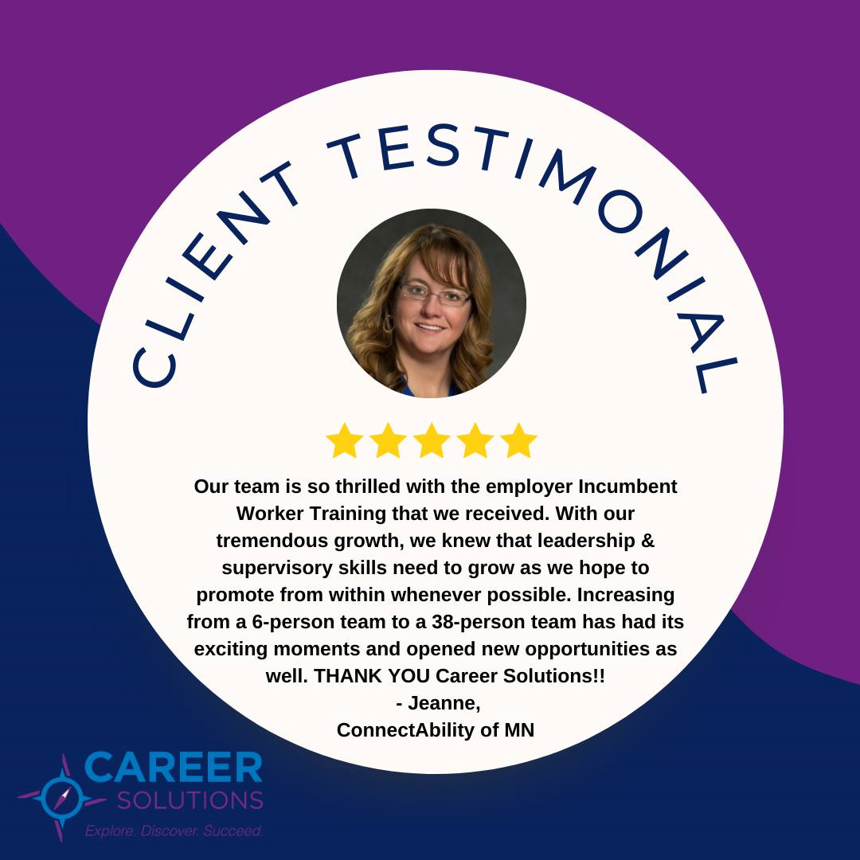

Outreach Strategies
IWT presentations:
HR Networking Group
Customized Training/other trainers
Individual Businesses
Community organizations
CMMA
All staff/Board meetings
IWT flyers to employers at job fairs
Employer testimonials on website, annual meetings
Social media posts - photos of employers

Slide 6


Outreach: Flyers

Slide 7


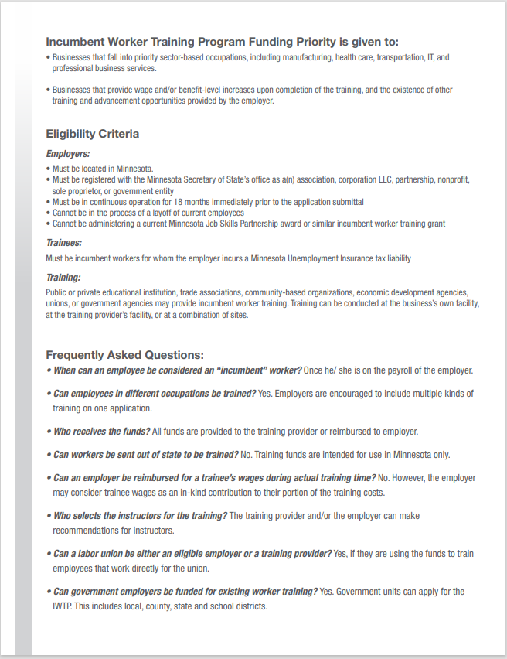
Outreach: Flyer

Slide 8


Outreach to Employers: Benefits of Upskilling & Investing in Employees
Increase employee retention
Fill skill gaps within the company
Ensure employee’s skillsets won’t become obsolete
Build a culture of learning
Boost moral
Enhance employee motivation, satisfaction, and productivity

Slide 9

Approval Process
1. Employer reviews IWT Guidelines & Email training idea to Business Service Manager or Team Leader
2. Submit IWT App.: 4-6 weeks or sooner before training starts. First come first served!
3. If approved, Award letter is emailed.
4. Trainees’ complete required Enrollment Paperwork with CS (BEFORE training starts): includes demographic info: family, wage, employment info, veteran status, I-9 form, Data Privacy Notice, Consent form for training vendor
5. WF1 case management
6. Submit Attendance Records & Certificates
7. Employer is reimbursed for training costs and provides wage follow-up the 2nd & 4th quarters after training is completed

Slide 10
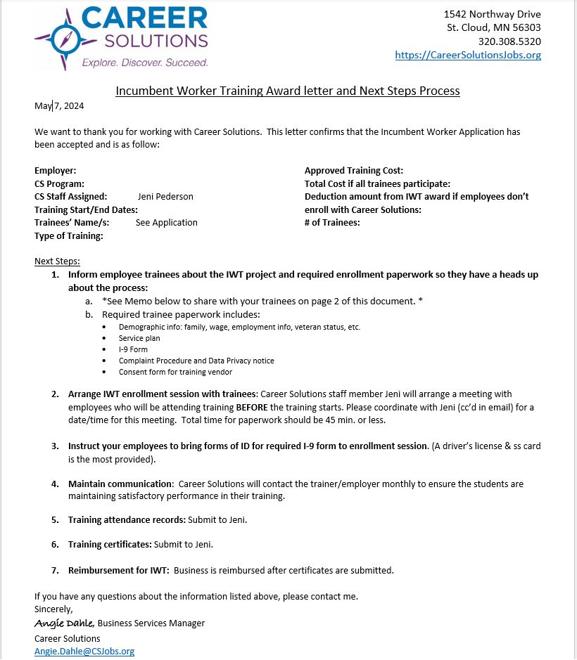
Approval Process: Award Letter

Slide 11
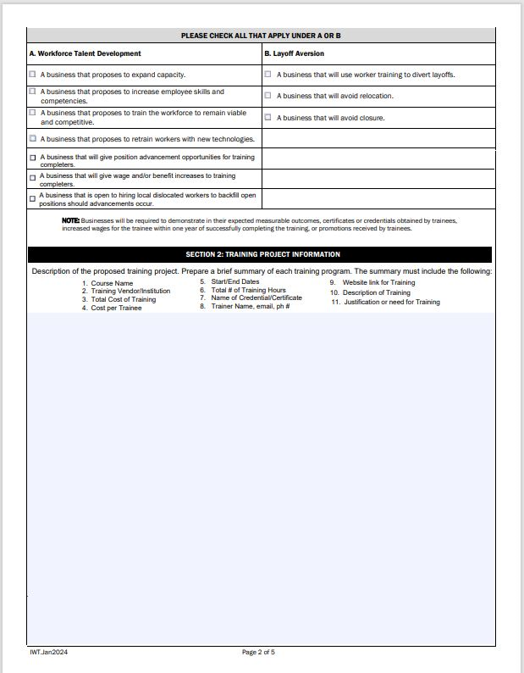
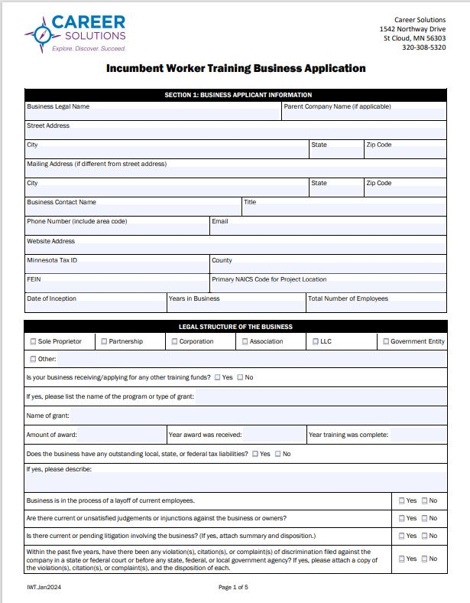
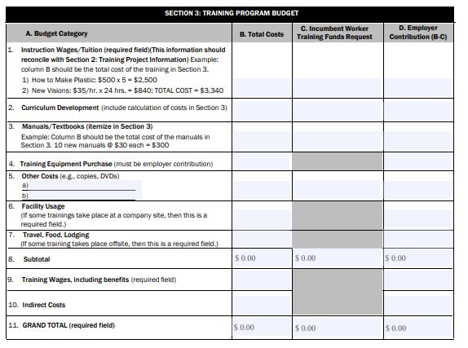
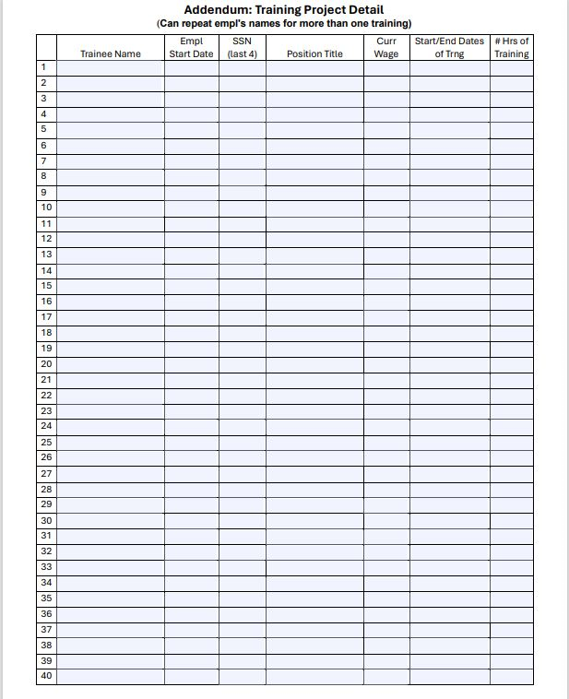
Application
Fillable application on website
Adopted this format from CMJTS

Slide 12
Case Management
Trainees’ complete required Enrollment Paperwork (BEFORE training starts): includes demographic info: family, wage, employment info, veteran status, I-9 form, Data Privacy Notice, etc.
WF1 data Entry: IWT activities, case notes & tracking
Employer Submits Attendance Records & Certificates
Employer is reimbursed for training costs and provides wage follow-up 2nd & 4th quarters after training is completed

Slide 13
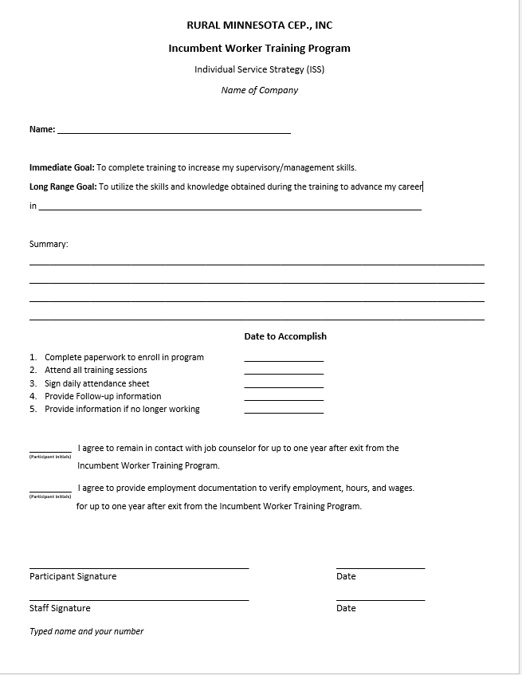
ISS/
Plan

Slide 14

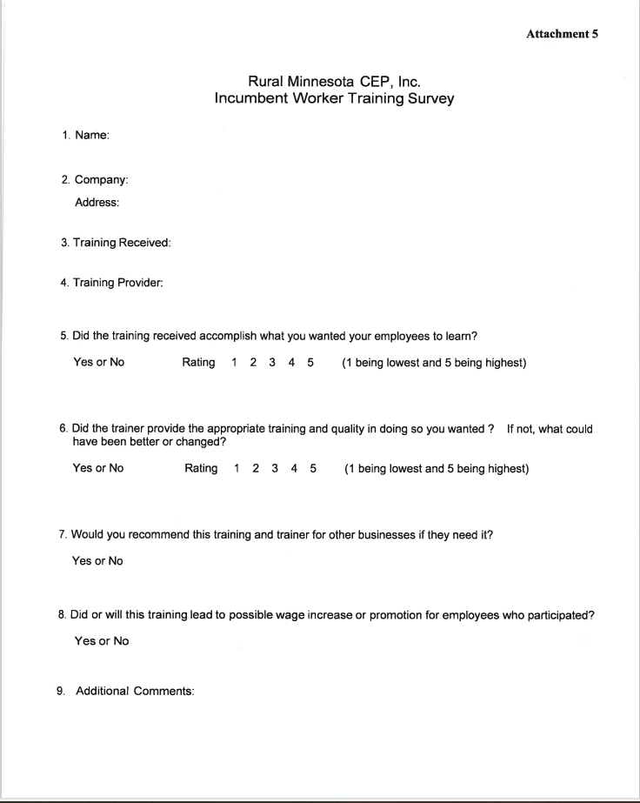
Survey

Slide 15

Approved Trainings
Examples of Approved Training
Leadership and Management Training
Supervisory Training
HR certification (e.g., PHR, SPHR, GPHR, or SHRM)
Training for improved process efficiency (e.g., “Lean” Training)
Training provided in conjunction with the purchase of new equipment
Training to upgrade computer skills (e.g., Microsoft Excel)
Other training that will make a trainee a better candidate for promotion
Welding, Maintenance, Crane Operator
W

Slide 16
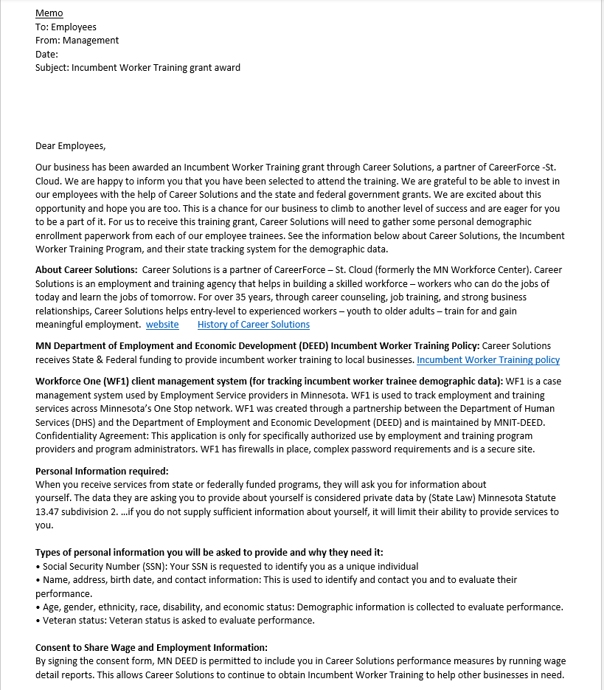
Challenges
Trainees’ not wanting to complete enrollment paperwork
Created a memo for employers to share with trainees
Not receiving attendance rosters or certificates in a timely manner
Reimburse the employer after certificates are submitted
Employers not giving applying in time to get enrollment paperwork completed in time.
Increased communication before application submittal
Trainees dropping out of training.
Increased clarification and communication up front.

Slide 17
Employer Success Testimonials
“The Incumbent Worker Training Grant was a real plus for us at KLN. It allowed us to bring more participants into a specialized training (welding) easily and seamlessly. The staff at RMCEP came onsite to fill out the registration process which was greatly appreciated. The follow up was efficient and smooth. I would highly recommend this grant and I definitely plan on using this grant again in the future.”
-Team at KLN
“The Incumbent Worker Training program was a wonderful resource for our business to explore. With a changing workforce we understand we need to develop our training materials. RMCEP provided us with the opportunity to hire a lean six sigma engineer to introduce our teams to organizing concepts as well as training documents and visuals. This individual helped us to work smarter not harder.”
-Team at Dynamic Homes
“Participating in the Incumbent Worker Training program has allowed our employees to receive the needed training to expand their job skills beyond typical on the job training. This also aligns our employees to be more promotable, which is one of our company core values.”
-Julia C., HR & Safety Manager at Louis Industries, Inc.
“As a small company, funding for training can be difficult to set aside, so the Incumbent Worker Training has provided us a way to train and grow our employees. It’s gratifying to watch employees grow, develop, and promote into new roles because of the training they have received.”
-Lisa P., HR Generalist, Pinnacle Climate Technologies
“Central McGowan has utilized Career Solutions Incumbent Worker Training program to advance the skillset of our office staff in both the accounting and HR functions. This has led to internal growth and promotional opportunities for our staff. The additional support of the Incumbent Worker Training provided us with an opportunity to fit the training into our annual plan sooner than we would have been able to given our budget.” -Brittany H., HR Director, Central McGowan

Slide 18











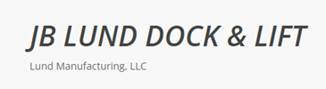





IWT Employers

Slide 19



Contact Us
Questions?
KelleyN@rmcep.com
StacyB@rmcep.com
Angie.Dahle@csjobs.org
CareerSolutionsJobs.org

Slide 20
THANK YOU
Visit Our Websites
CareerSolutionsJobs.org
RMCEP.com

