Slide 1
Minnesota Dual-Training Pipeline May 16, 2024

Slide 2
About the Department of Labor and Industry
DLI Programs:
Registered Apprenticeship
Minnesota Dual-Training Pipeline
Youth Skills Training Program
Child Labor Outreach and Compliance
Workplace Safety Consultation
Worker’s Compensation Administration
OSHA Compliance
Wage and Hour Compliance
Construction Codes and Licensing
Office of Combative Sports
DLI’s VISION is to be a trusted resource, service provider and impartial regulator.
DLI’s MISSION is to ensure Minnesota’s work and living environments are equitable, healthy and safe.

Slide 3
What is Minnesota Dual-Training Pipeline?
Source of support to employers to develop their own employment-based, dual-training programs
An innovative approach to address current and future workforce needs in the key industries of advanced manufacturing, agriculture, child care, health care services, information technology, legal cannabis industry and transportation
Private Investment, Public Education, Labor and Industry Experience

Slide 4
Employment-Based Training
Structured on-the-job training
Taking a variety of forms
Related Instruction
with a chosen training provider
Powerful learning
Engaged employee
Benefit
to all

Slide 5
Benefits of Employment-Based Training
Employers:
Build and shape their own workforce
Creates new skilled worker pipeline
Workers produce as they train
Improve productivity overall
Reduce employee turnover
Workers:
Employment
Job Training
Wages increase with progress
Master in-demand skills
Credentials

Slide 6
Minnesota Dual-Training Pipeline Strategies
Industry Forums: Inform and direct Minnesota Dual-Training Pipeline on industry trends and needs through discussion and strategic planning aimed to expand dual training.
Competency Councils: Define and identify specific occupational competencies for the seven key industries.
Dual-Training Consulting: Create and disseminate dual training resources for employers, employees and dual trainees: toolbox, grants, and expanding mentorship networks to set up dual training.

Slide 7
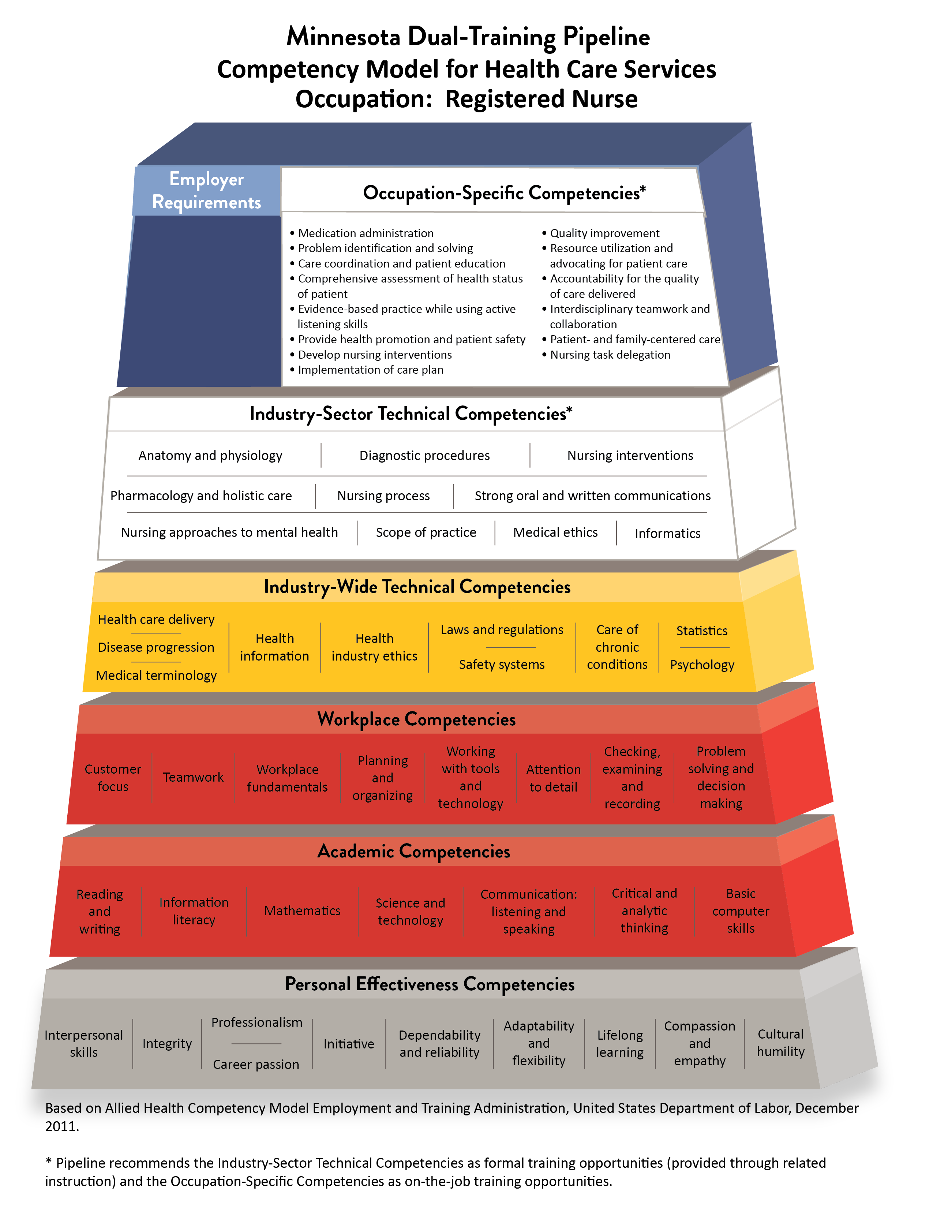
Minnesota Dual-Training Pipeline Competency Pyramid
https://www.dli.mn.gov/sites/default/files/pdf/Health-RN.pdf

Slide 8
Minnesota Dual-Training Pipeline Occupations
Two or more employers state need;
Must offer a pathway to a livable wage: $19.46/hour (based on a family with one child, one full-time and one part-time employed adult);
Must be in-demand (Labor Market Information and other research considered);
Must offer a career pathway; and
Must lend itself to the dual-training model.

Slide 9
Related Instruction Inventory
Starting point for employers to develop a dual-training program;
Includes education and training programs for approved occupations;
Employers are not required to partner with the training providers on the list, but these are options to be considered.
https://secure.doli.state.mn.us/pipeline/pipelinelookup.aspx
An education or training provider that would like to be included on the inventory should reach out to our team to be added to the list.

Slide 10
Related Instruction Inventory site

Slide 11
Resources
Tools to help employers develop dual-training programs;
Templates are available to track dual-trainees to ensure they are mastering necessary competencies;
Guidance for developing effective on-the-job training;
Information about skills based hiring practices.
https://www.dli.mn.gov/business/workforce/minnesota-dual-training-pipeline-tools

Slide 12
Consultation
Present to groups and individuals about dual-training programs and resources.
Facilitate employer to employer meetings and partnerships.
Lay out how to establish dual-training programs.
Investigate barriers and opportunities for dual-training programs.
Convene employer-led meetings with related instruction providers.
Support employers with applications for the Dual Training Grant.

Slide 13
Dual Training Grant
An eligible DTG applicant must meet all of the following:
Be an employer or organization of employers
Have or will have a dual-training program
Employ or will employ an eligible dual trainee
Have or will enter into agreement with an eligible related instruction training provider
If annual gross revenue exceeded $25,000,000 in the previous calendar year, pay for at least 25% of related instruction costs
If a current or prior DTG recipient, be in good standing on all grant requirements
If a current or prior recipient of other Minnesota State grant programs, be in good standing on all grant requirements.
Contact:
Jacquelynn.Mol.Sletten@state.mn.us

Slide 14
Dual Training Grant - New things for 2024
NEW for 2024
Dual Training Grant application was open from March 12 through April 22 (closes at 11:59pm). You can access the grant application here: Dual Training Grant Request for Proposal (state.mn.us)
Eligible industries added to include Child Care, Legal Cannabis & Transportation
Expenditures expanded to recommended books and supplies
Second funding category for trainee support costs, up to $15,000
Dual trainee maximum changed to $24,000 in a lifetime
$6,000 annual maximum remains
Organization of employers must identify employer partners at time of application
Online portal system for applying and administering grant
Financial and Capacity Review process during application for most applicants
Note: Industries, occupations, employers partnering with an applicant/organization, and related instruction training providers cannot be added after the application deadline.

Slide 15
Dual Training Grant continued
The maximum grant request amount is $165,000 and limited among the following budget categories:
Budget Category | Grantee Maximum Amount | Grantee Match Required | Expenditures | Dual Trainee Maximum Amount
Related Instruction Costs | $150,000 | 25% match required, up to $2,000, if annual gross revenue exceeded $25,000,000 | Tuition Fees Required & recommended books Required & recommended materials | $6,000
Trainee Support Costs *Connected to related instruction | 10% of grant request amount, up to $15,000 | None | Transportation and/or mileage Lodging Meals Tutoring services Translation and/or interpreter services | None

Slide 16
Upcoming Events
May 23, 2024, from 9 to 10 a.m. – Speaker Series featuring Lisa Tabor of CultureBrokers, LLC, and the presentation "The Inclusive Pipeline: Leveraging DEI for Enhanced Hiring, Retention and Organizational Growth." Learn more and register.
All Industry Forum – June 11, 2024 from 9am-10:30am at DLI
Notes:
Mady

Slide 17
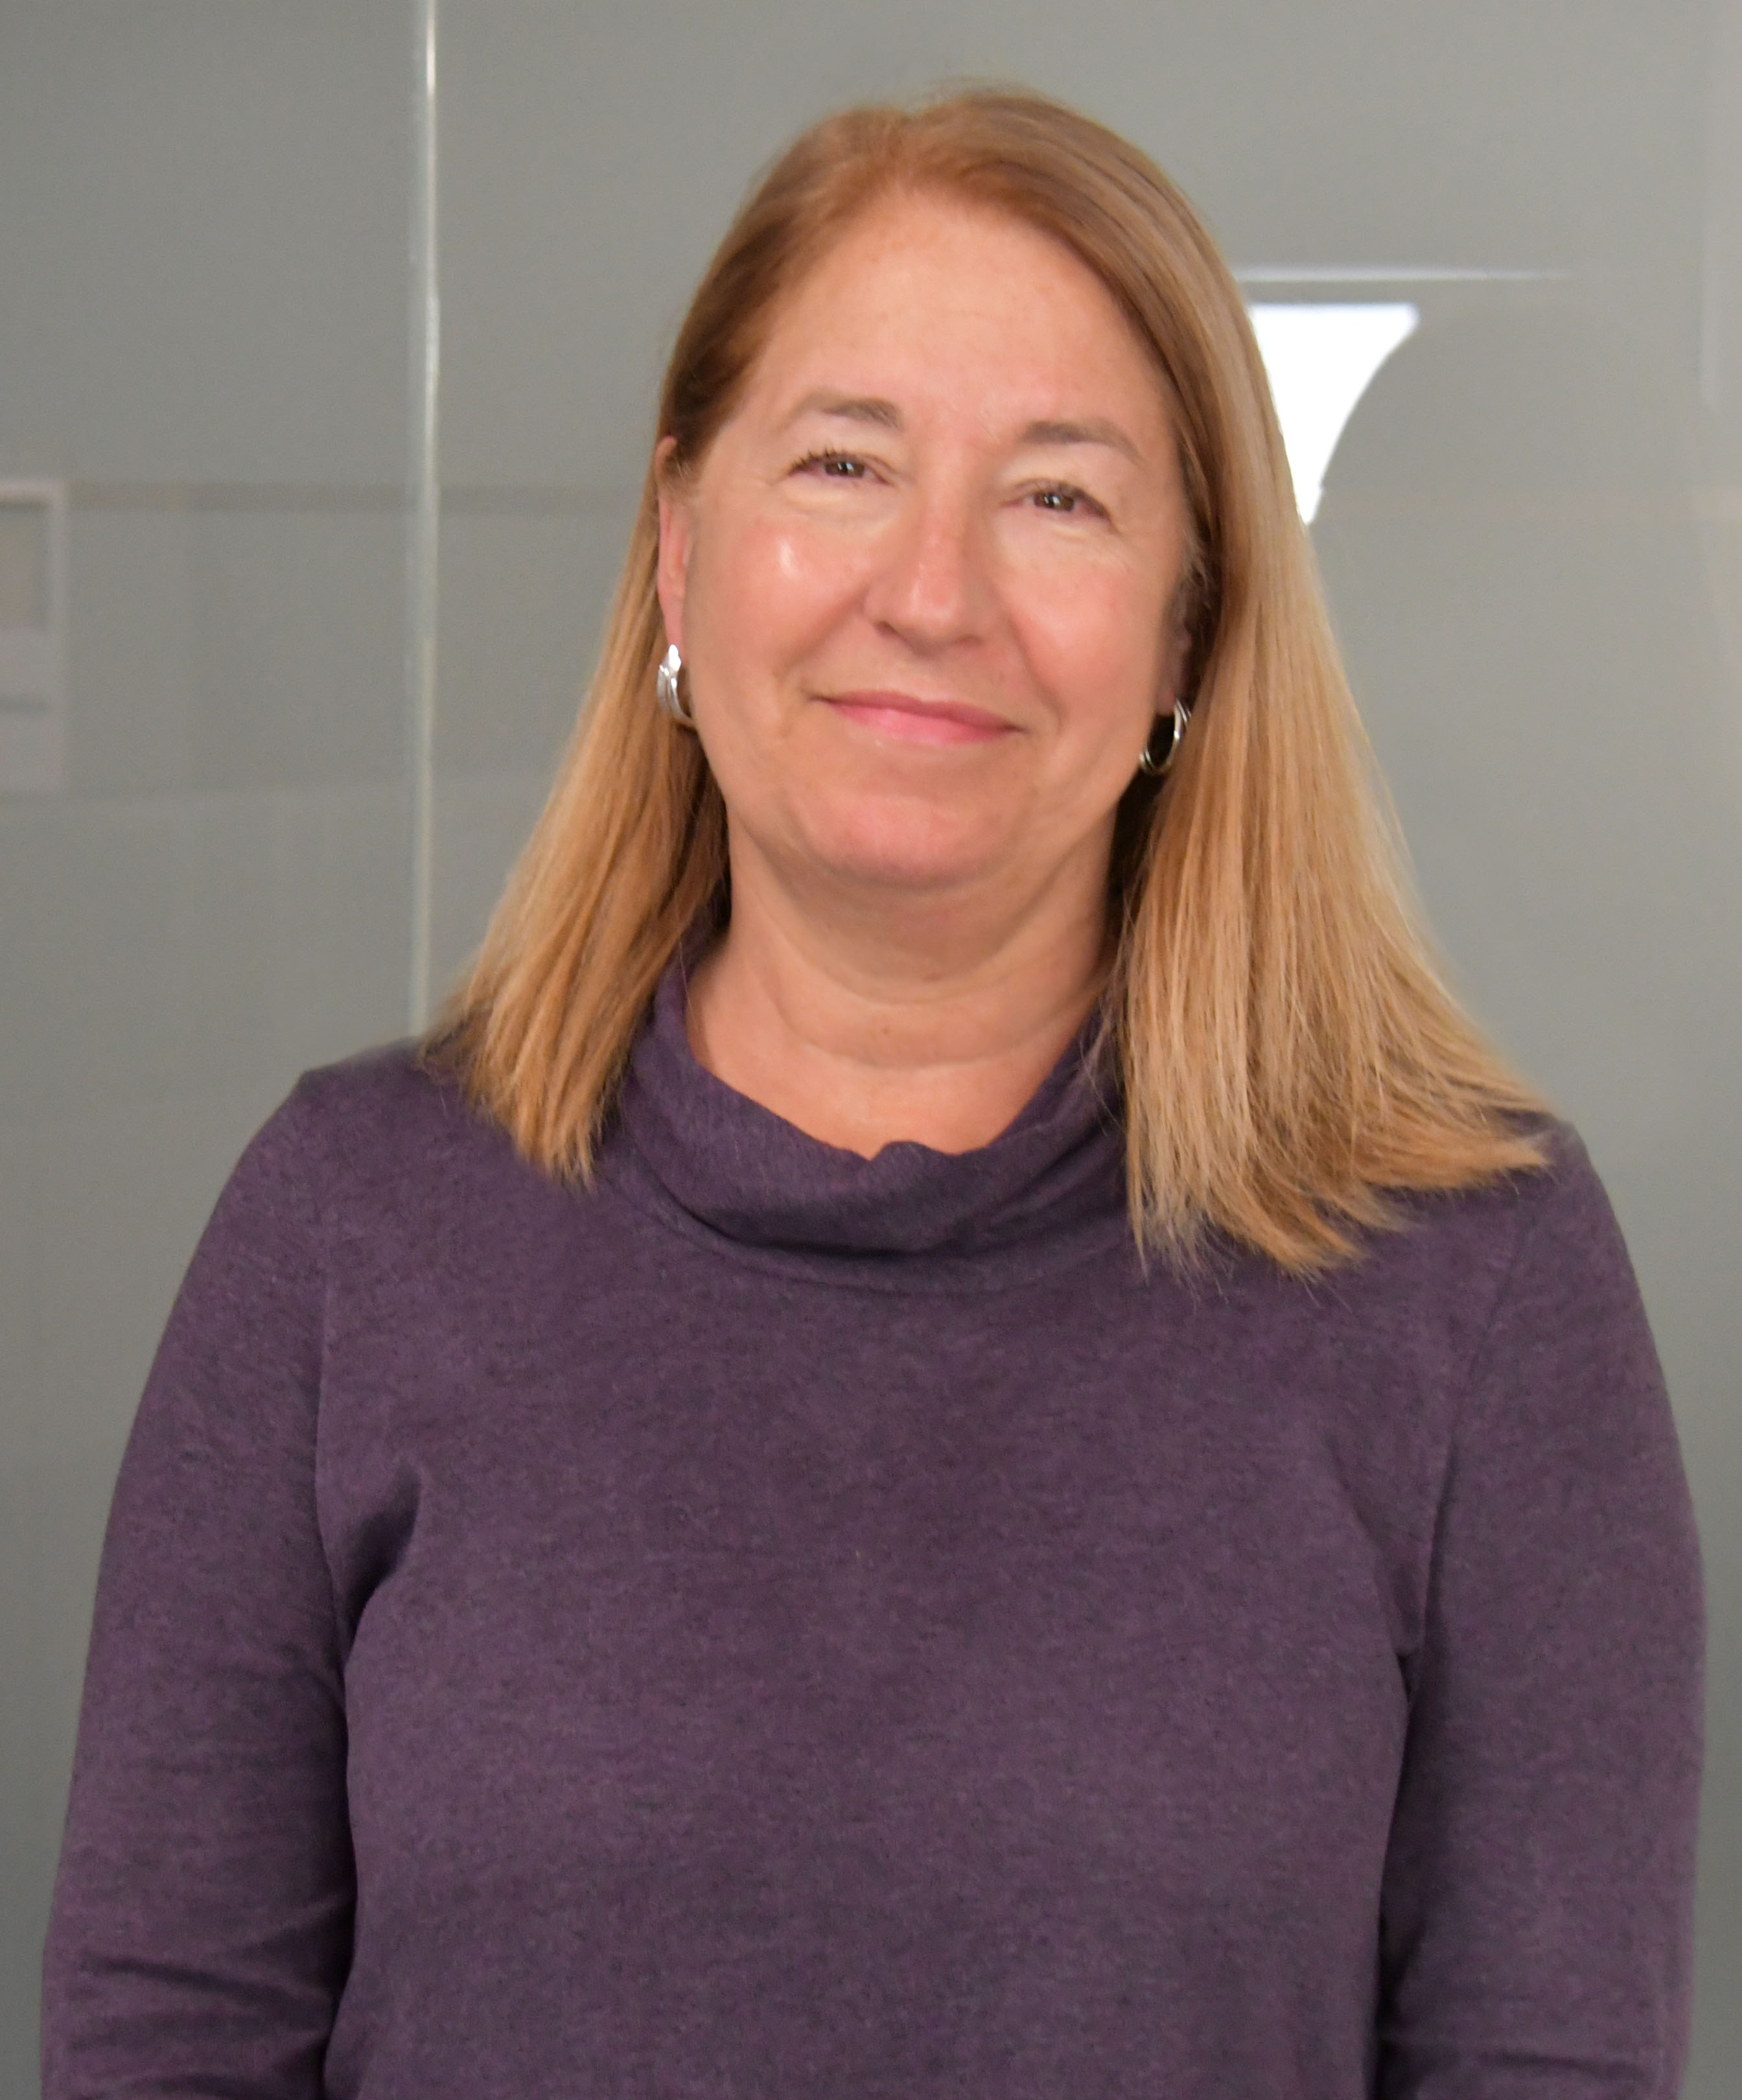
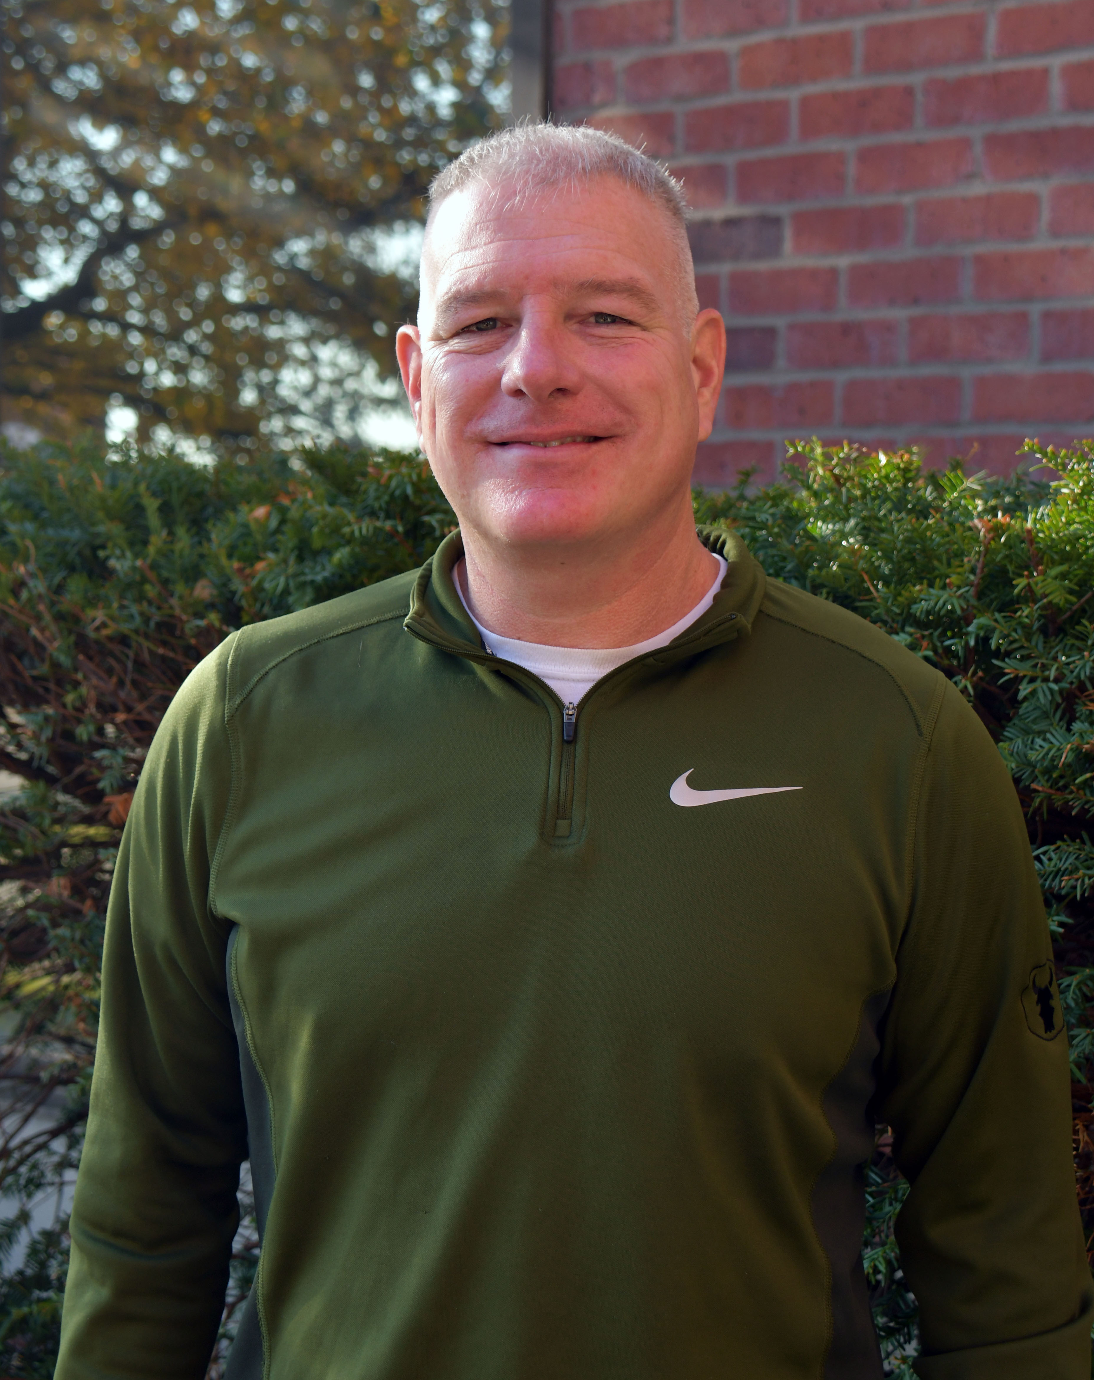
Thank You!
Dan Solomon
Program Manager
651-284-5355
dan.solomon@state.mn.us
Kathleen Gordon Program Consultant
651-284-5388
kathleen.gordon@state.mn.us
Erik Holtan
Program Consultant
651-284-5082
erik.holtan@state.mn.us
Madolyn Martini
Program Consultant
651-284-5088
madolyn.martini@state.mn.us

