Slide 1
Build What Matters
Notes:
Updated: October 2023; Accessible version Please customize this page with your information

Slide 2
Minnesota
Population – 5.7 million
Home to 15 Fortune 500 companies
22nd in population – with the 20th largest state economy in the U.S by GDP
Notes:
Other states can tout seeming advantages when it comes to one or two of the factors that are so crucial to business success.
They talk about tax rates alone … labor costs alone … incentives alone … or the strength of certain industry sectors or sub-sectors.
But isolated details can be misleading. It’s the full picture that counts when you’re making location decisions. END OF SPEAKER NOTES – Presenters: Sources listed at bottom of each slide are for reference
SOURCES:
1) Population: U.S. Census Bureau, July 2022 Estimate State Population Totals: 2020-2022 (census.gov)
2) Fortune 500s: Fortune, 2023 Minnesota now has 15 Fortune 500 companies, down from 16 last year | MinnPost
3) Population rank: U.S. Census Bureau, Population Estimates, State Population Totals: 2020-2022 (census.gov)
4) Bureau of Economic Analysis BEA Interactive Data Application (accessed June 2023)

Slide 3
Join Us
Notes:
This is the picture of Minnesota I’d like to show you today.
When you look at everything that it takes to help companies succeed and grow, few states can match Minnesota’s combination of exceptional human talent; remarkable business climate; extensive logistical advantages; first-rate infrastructure; and unrivaled quality of life.
Minnesota is truly a great place to do business, work and live.

Slide 4
A Robust and Diverse Economy
There’s room for everyone to succeed here
Notes:
Strong pro-business policies, favorable operating costs, streamlined regulatory requirements, and attractive incentives provide extremely fertile ground for your business investment to flourish and grow.

Slide 5
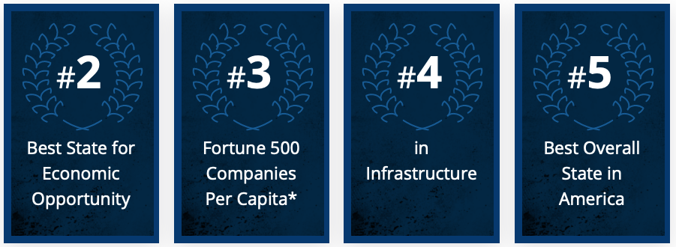
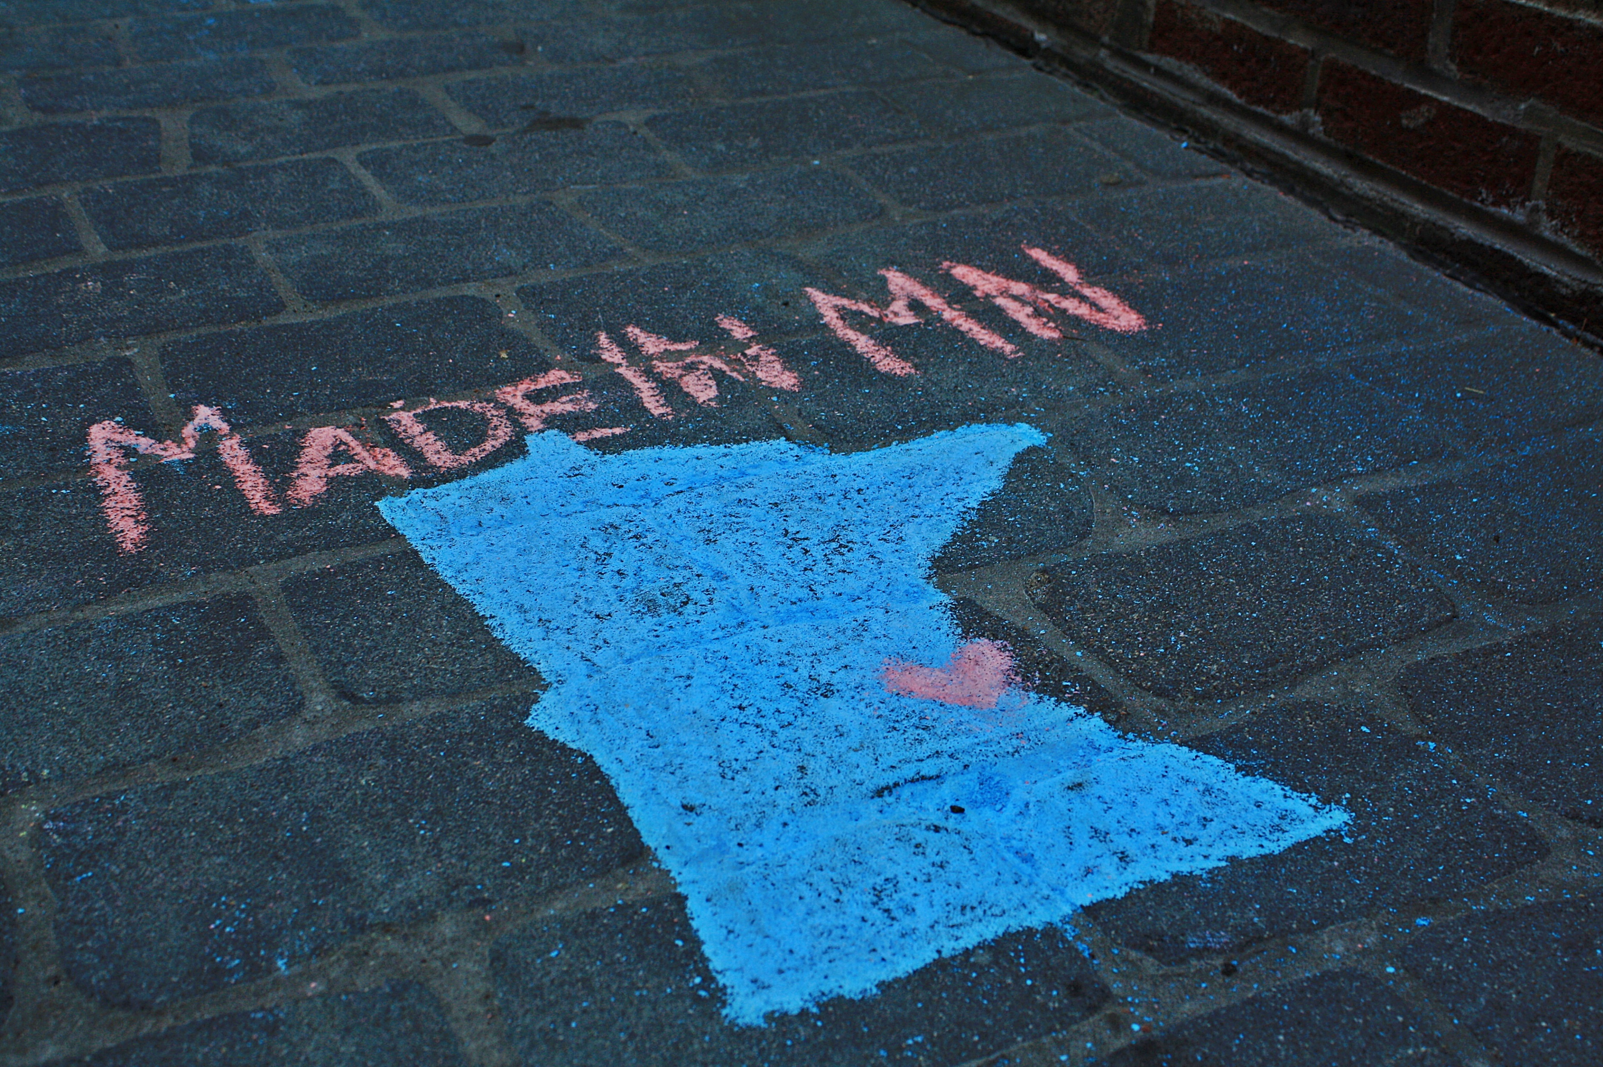
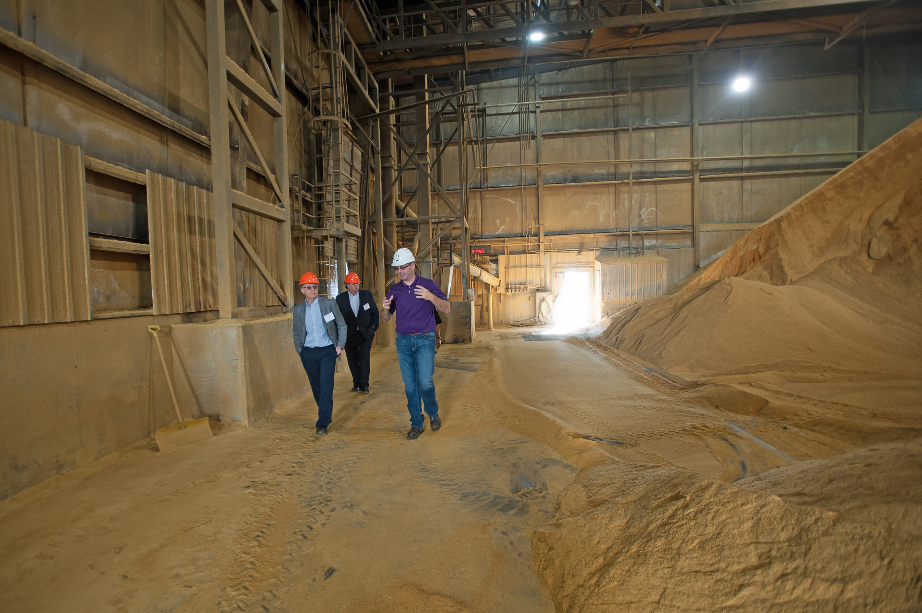
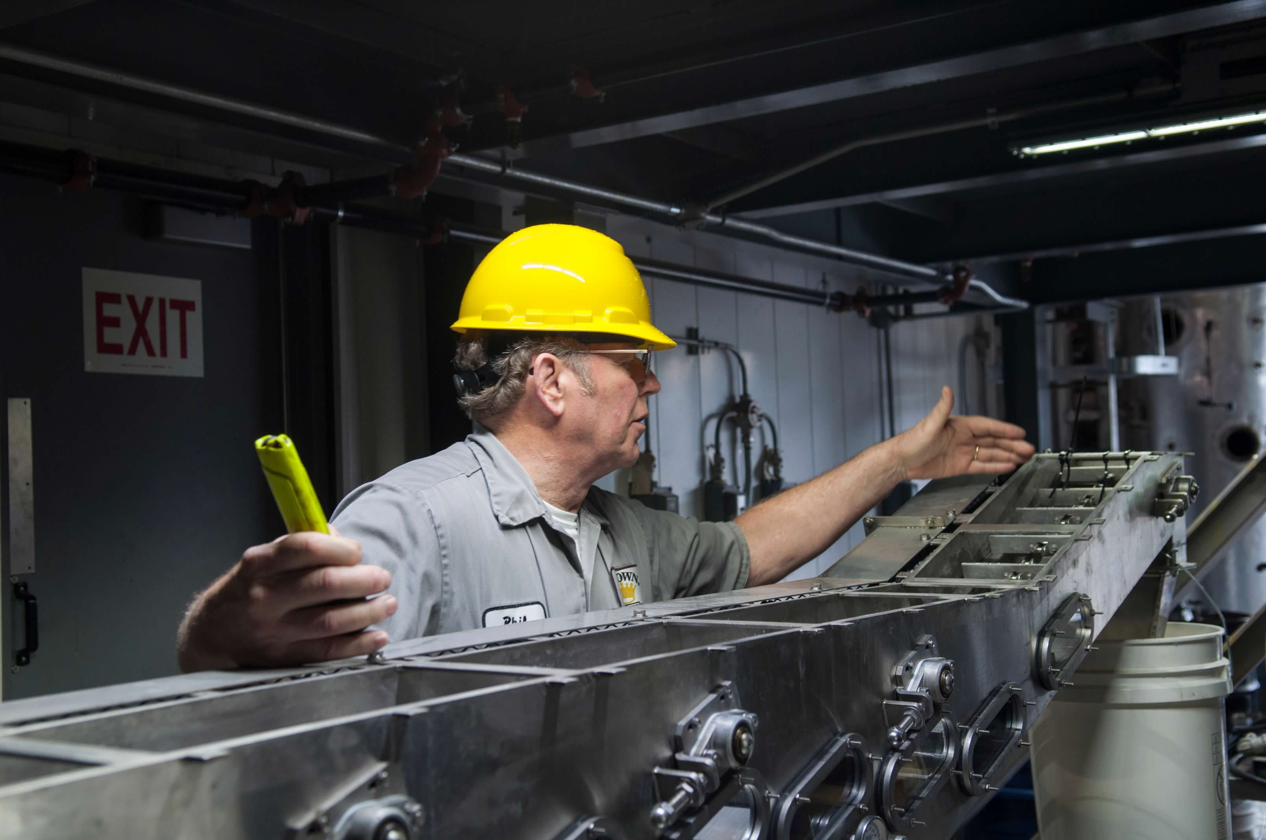
A Robust and Diverse Economy
#3
(*Minneapolis)
Notes:
Best Economic opportunity rankings: U.S. News and World Report: https://www.usnews.com/news/best-states/rankings/opportunity/economic-opportunity
Fortune 500 rankings: Correspondence with Fortune 500. Estimates by DEED.
Infrastructure: CNBC Best State for Businesses, 2023: https://www.cnbc.com/2023/07/11/americas-top-states-for-business-2023-the-full-rankings.html
Best Overall State in America: https://www.cnbc.com/2023/07/11/americas-top-states-for-business-2023-the-full-rankings.html

Slide 6
Our Business Climate Continually Outperforms the Nation
1st in 5-Year Business Survival (BLS, 2018-2023)
A top 10 state for business 14 times (CNBC, 2007-2023)
5th Best State in the Nation (US News & World Reports, 2023)
Notes:
Minnesota’s robust business climate is reflected in how we routinely rank among the top states across a broad swath of measures.

Slide 7
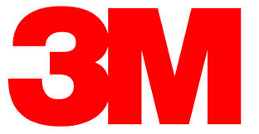
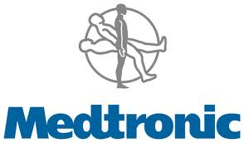
Global Giants
Notes:
Success attracts success. So it’s no surprise that some of the world’s most recognized and respected companies call Minnesota home. And many more have major operations in the state.

Slide 8
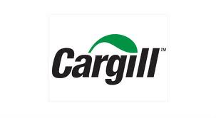
Global Giants
15 Fortune 500 Companies (2023)
5th in most Fortune 500 companies per capita (2023)
8th in Forbes largest private companies per capita (2022)
Cargill, the largest private company in the United States is based here
Notes:
This also illustrates the point that businesses find Minnesota a great place to locate.
END OF SPEAKER NOTES
SOURCES:
Fortune 500s: Fortune, 2023
Per capita: DEED analysis of Fortune rankings
Private companies: Forbes, 2022
Cargill: Forbes, 2022

Slide 9
Dynamic Innovation Ecosystem
Investing in hometown talent is the right (and smart) thing to do

Slide 10
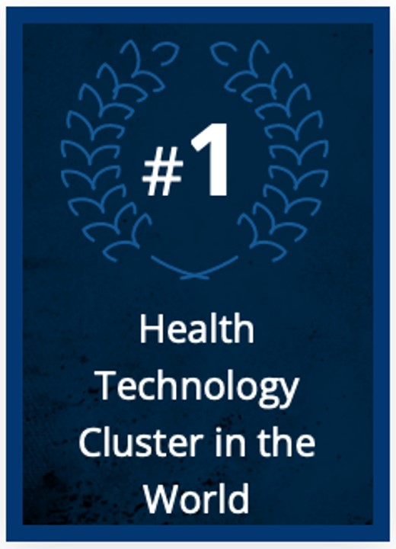
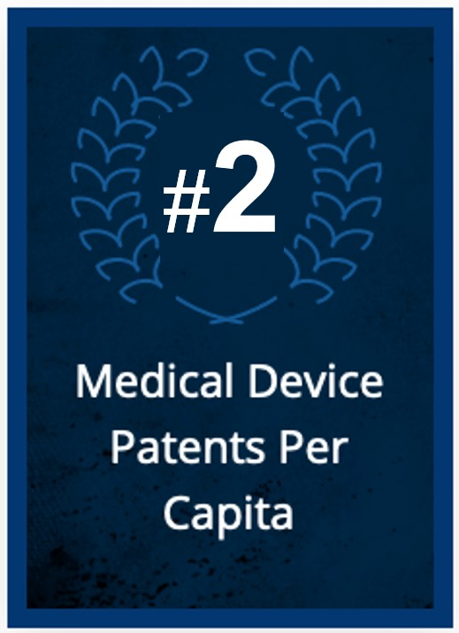
Dynamic Innovation Ecosystem
#2
#6
Notes:
SOURCES:
U.S. Patent and Trademark Office. Calculations by DEED.
Medical Alley: https://medicalalley.org/wp-content/uploads/2018/06/Medical-Alley.pdf
U.S. Patent and Trademark Office. Calculations by DEED.
U.S. Patent and Trademark Office. Calculations by DEED.

Slide 11
World-Class Infrastructure
We already did the heavy lifting, so you don't have to
Notes:
Infrastructure is another key ingredient to business success. Whether you need to move products or people, Minnesota’s top-notch transportation networks will make it efficient.

Slide 12
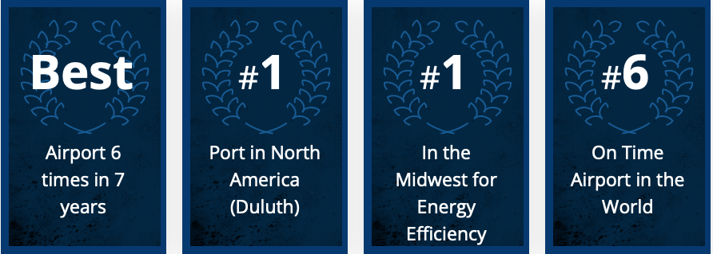
World-class Infrastructure
Port in the Great Lakes
Notes:
SOURCES:
Best Airport: ACI: https://aci.aero/programs-and-services/asq/asq-awards-and-recognition/. Star Tribune: https://bit.ly/3JjKUCy
#1 Port: Water Port Rankings. U.S. Army Corp of Engineers: https://usace.contentdm.oclc.org/digital/collection/p16021coll2/id/12781
Energy Efficiency: ACEEE: The State Energy Efficiency Scorecard: https://www.aceee.org/state-policy/scorecard
On Time Airport Rankings: Simply Fly: https://bit.ly/40lU07l

Slide 13
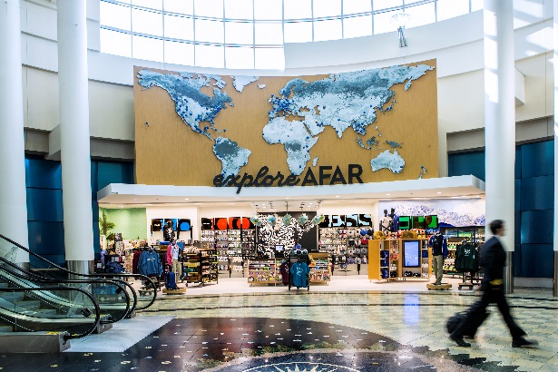
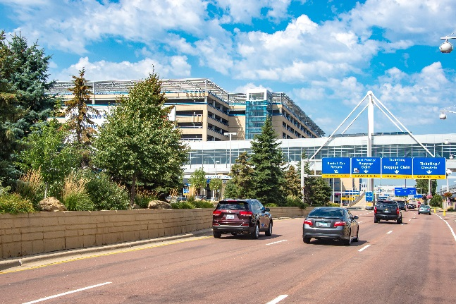
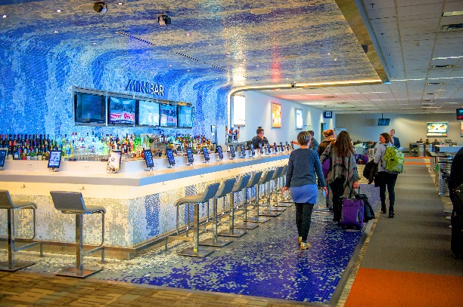
Minneapolis St. Paul International Airport
Best Airport in North America of its size 6 times in 7 years (2016-2022)
Best Airport in 2022
Moved over 32 million passengers in 2022, a 24% increase from 2021
Offers 156 non-stop flights
127 domestic destinations
29 international destinations
Notes:
Minneapolis-St. Paul International Airport – MSP – is a tremendous asset. It’s been ranked for four consecutive years – 2016, 2017, 2018, 2019 – as the best airport in North America in its size category (25 to 44 million passengers a year) by the Airports Council International. In 2021, the Minneapolis-St. Paul International Airport was ranked third best in North America by J.D. Power.
The Minneapolis-St. Paul International served 167 nonstop destinations before the pandemic, including 137 domestic and 30 international markets. International destinations included Amsterdam, Paris, Frankfurt, London and Tokyo – as well as Seoul, Dublin and Mexico City. We are confident that direct flights will resume in the coming year.
END OF SPEAKER NOTES
SOURCES:
1) Best Airport in North America, 25-40 million passengers per year category (Airports Council International, 2016, 2017, 2018, 2019, 2020, 2021, 2022).
2) 2022 North America Airport Satisfaction Study (2022 North America Airport Satisfaction Study | J.D. Power (jdpower.com))
3) Non-stop flights: Minneapolis-St. Paul International Airport, list from Brian Peters with Metropolitan Airports Commission, June 2023.
4) MSP passengers and cargo: Airports Council (https://airportscouncil.org/intelligence/north-american-airport-traffic-reports/, accessed October 2021).
5) MSP monthly passenger data: Minneapolis Saint Paul Metropolitan Airports Commission MSP Passenger and Operations Reports | Metropolitan Airports Commission (metroairports.org) (2022)

Slide 14
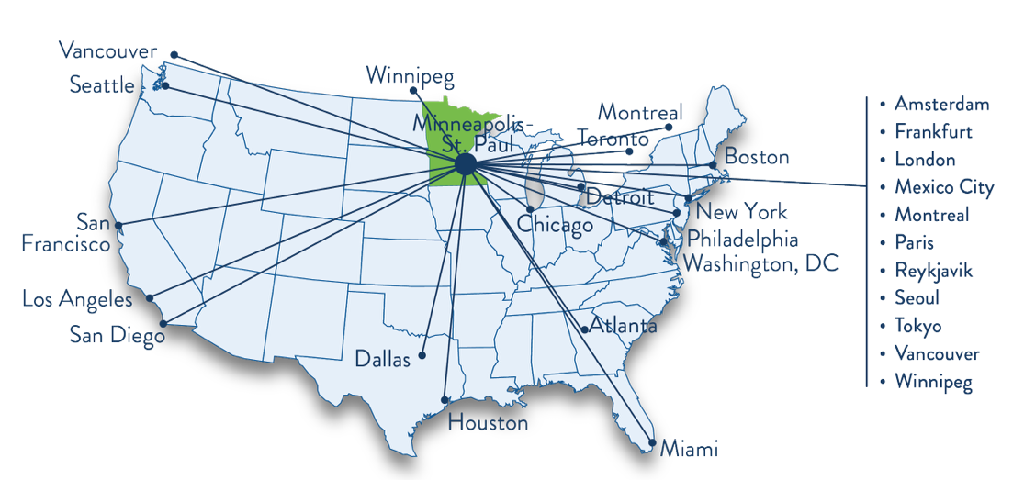
A Sampling of the 156 Nonstop Flights from MSP
Notes:
Located in the heart of the U.S., Minnesota is just a short flight away from any of North America’s major financial or commercial centers. New York is less than three hours away; Los Angeles less than four.
With direct flights to key cities across the globe, MSP can put you face-to-face with your headquarters, customers, distributors, partners and suppliers at a moment’s notice.
END OF SPEAKER NOTES
SOURCE:
Minneapolis-St. Paul International Airport, list from Brian Peters with Metropolitan Airports Commission, June 2023.

Slide 15
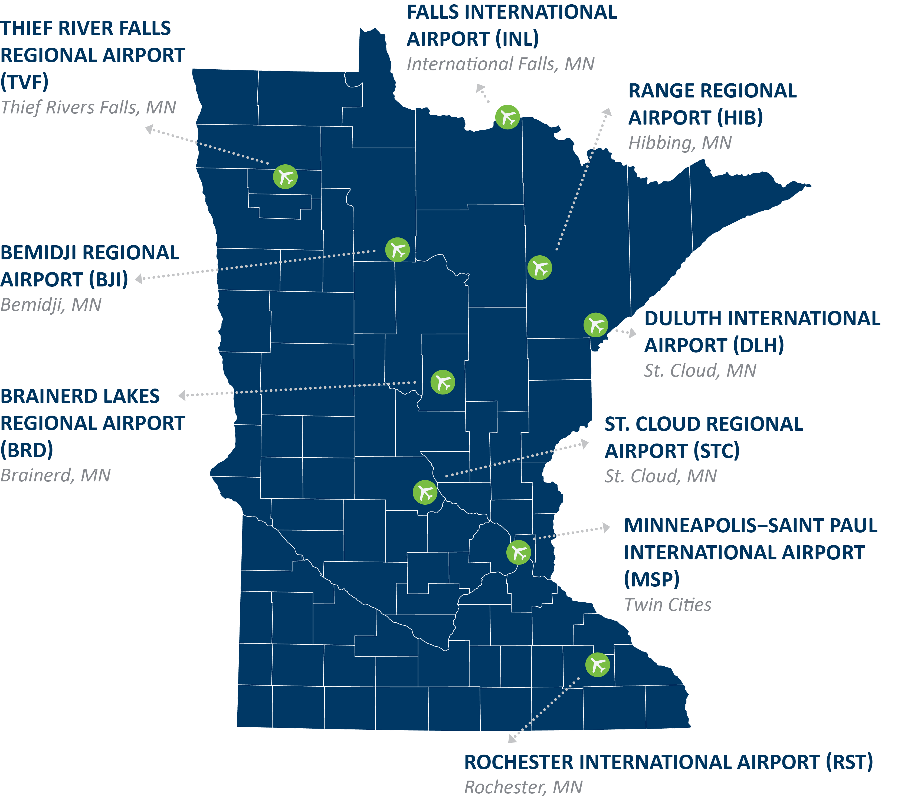
Air Infrastructure
Statewide system of regional, reliever and general aviation airports
9 airports around the state
Notes:
Air service for passengers and cargo extends throughout the state with international and regional airports in key regional hub cities.
We have commercial air service in the Twin Cities, Duluth, Rochester and six other cities across the state.
There’s also commercial air service in adjacent border cities which serve the southwest, southeast and west central regions of Minnesota – specifically, La Crosse, Sioux Falls, Fargo and Grand Forks. These airports are key assets for our communities.
END OF SPEAKER NOTES
SOURCES:
Nine airports around the state with commercial passenger airports are: Minneapolis/St. Paul; Duluth; Rochester; Bemidji; Brainerd; Hibbing; International Falls; St. Cloud and Thief River Falls Aviation: Minnesota Department of Transportation (state.mn.us)

Slide 16
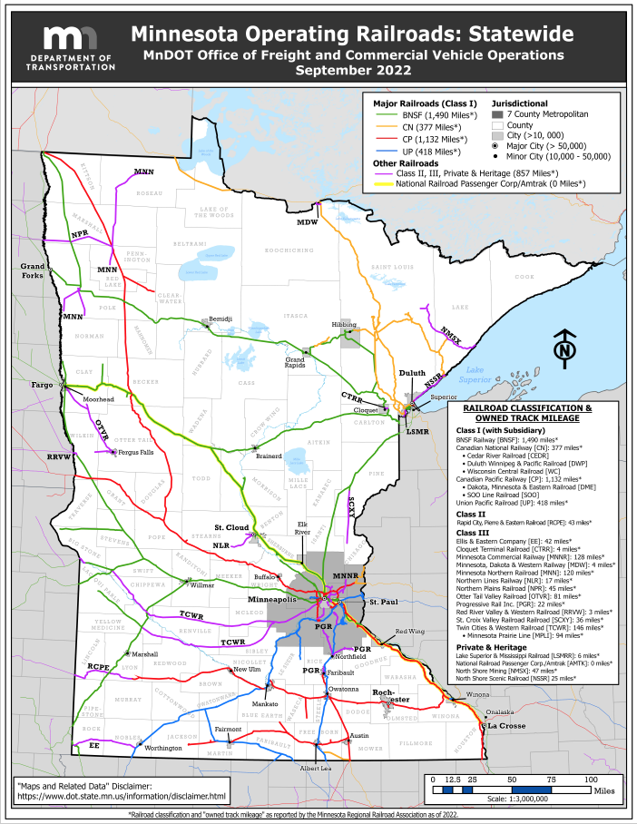
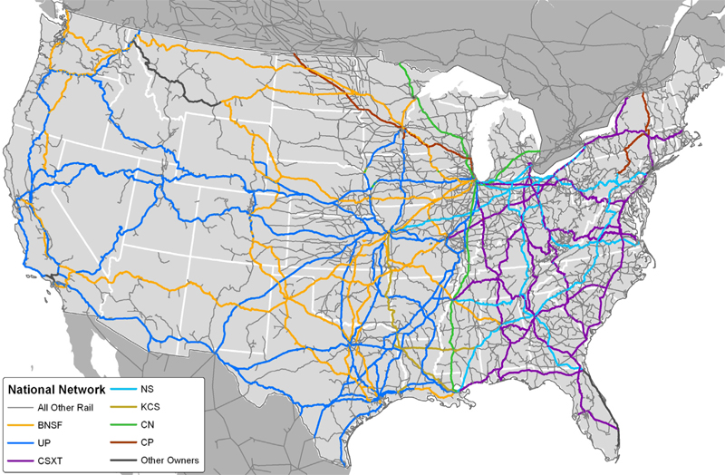
Major Railroads
Notes:
Our extensive freight rail system provides an efficient and cost-effective way to move goods to market. According to latest available statistics, rail accounts for one-quarter of all freight moved in Minnesota. The total volume is expected to be 1.8 billion tons by 2040.
END OF SPEAKER NOTES
SOURCE:
Map: Minnesota Department of Transportation, Office of Freight and Commercial Vehicle Operations, map dated September 2022.
Statistic in Notes: (rail accounting for one-quarter of all freight). http://www.dot.state.mn.us/planning/freightplan/pdf/statewidefreightplanrevised2018.pdf, Minnesota Department of Transportation, Minnesota Statewide Freight System Plan, January 2018. accessed June 2023). Landing page with updates: Statewide Freight System and Investment Plan - MnDOT

Slide 17
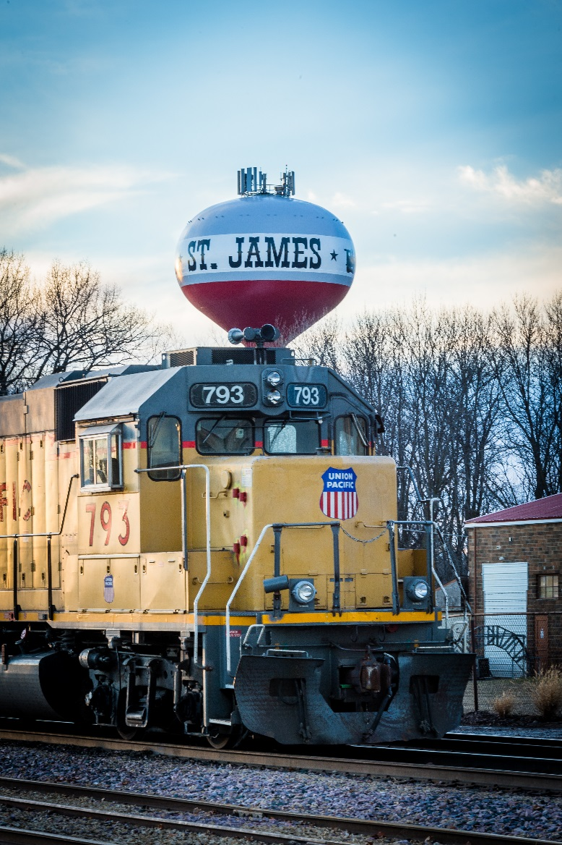
Rail Infrastructure
Minnesota has 4,444 route miles of freight railroad, operated by 21 rail companies
Four Class 1 freight rail lines are integrated with the U.S. and Canadian rail systems, including Burlington Northern Santa Fe, Canadian National, Canadian Pacific and Union Pacific
Commuter rail and light transit lines serve the Minneapolis-St. Paul metro area
Notes:
Whether moving materials to factory, goods to market, or people to destinations, we’ve got the rails for the job.
END OF SPEAKER NOTES
SOURCES:
Minnesota Department of Transportation About Railroads in Minnesota - MnDOT (state.mn.us) accessed June 2023
Minnesota Department of Transportation Railroad Companies Serving Minnesota - MnDOT (state.mn.us) accessed June 2023. Data source Minnesota Regional Railroads Association, 2021-2022.

Slide 18
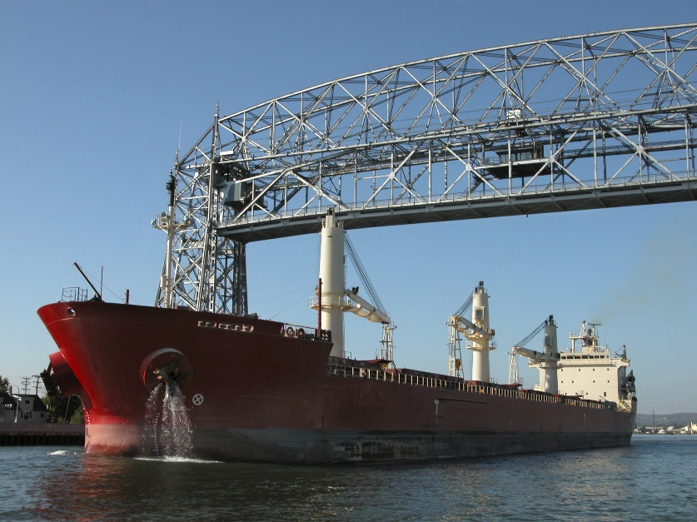
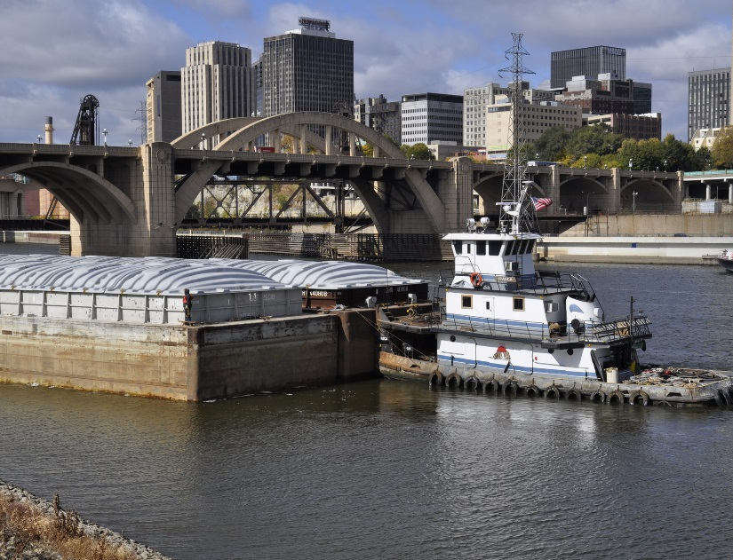
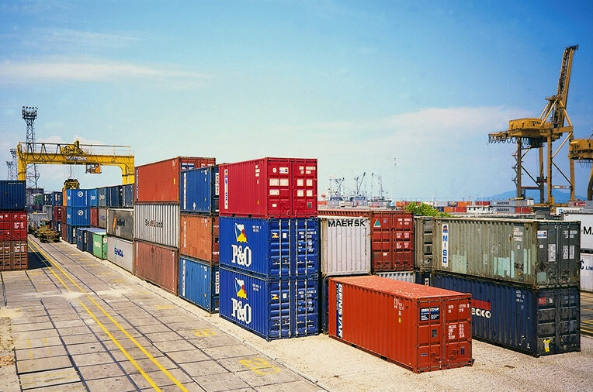
Ports and Waterways
Minnesota’s 3 ports on Lake Superior (Duluth, Two Harbors, and Silver Bay) move over 50 million net tons of freight each year
The Mississippi River system in Minnesota spans 195 miles and has four ports (Twin Cities, Savage, Red Wing and Winona) that move over 11 million freight tons each year
Notes:
Located in the middle of the country, Minnesota appears landlocked. But, we’ve got excellent access to the Atlantic Ocean and the Gulf of Mexico through some of the best and busiest commercial ports and waterways in the nation.
They are the Lake Superior/Great Lakes/St. Lawrence Seaway system and the Mississippi River, both internationally recognized U.S. landmarks.
END OF SPEAKER NOTES
SOURCES:
1) Minnesota Department of Transportation, Ports and Waterways Commercial Waterways in Minnesota - MnDOT (state.mn.us) accessed July 2023; 2019 was most recent data

Slide 19
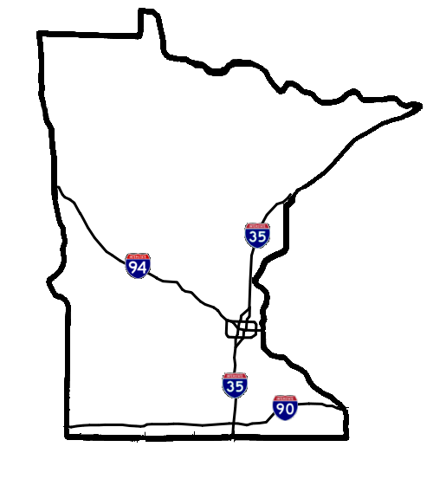
Highways
Three major interstate highways
4th largest road system in the nation
Nearly $370 million of total shipments from Minnesota estimated for 2023
3rd in the nation for transportation infrastructure (CNBC, 2023)
Notes:
Highways are the primary mode of transportation in Minnesota. Our network of roads is massive, and our highways routinely rank among the nation’s best.
END OF SPEAKER NOTES
SOURCES:
Highways: no source needed
Size of system: Road Miles by State: This runs through 2020: State Transportation Infrastructure | Bureau of Transportation Statistics (bts.gov) (accessed July 2023).
U.S. Department of Transportation, Bureau of Transportation Statistics: https://data.bts.gov/stories/s/Moving-Goods-in-the-United-States/bcyt-rqmu#shipments-by-state (“Percent of shipments within a state” table. Accessed July 2023)
Infrastructure: CNBC, 2023 rankings: https://www.cnbc.com/2023/07/11/americas-top-states-for-business-2023-the-full-rankings.html (accessed July 2023).

Slide 20
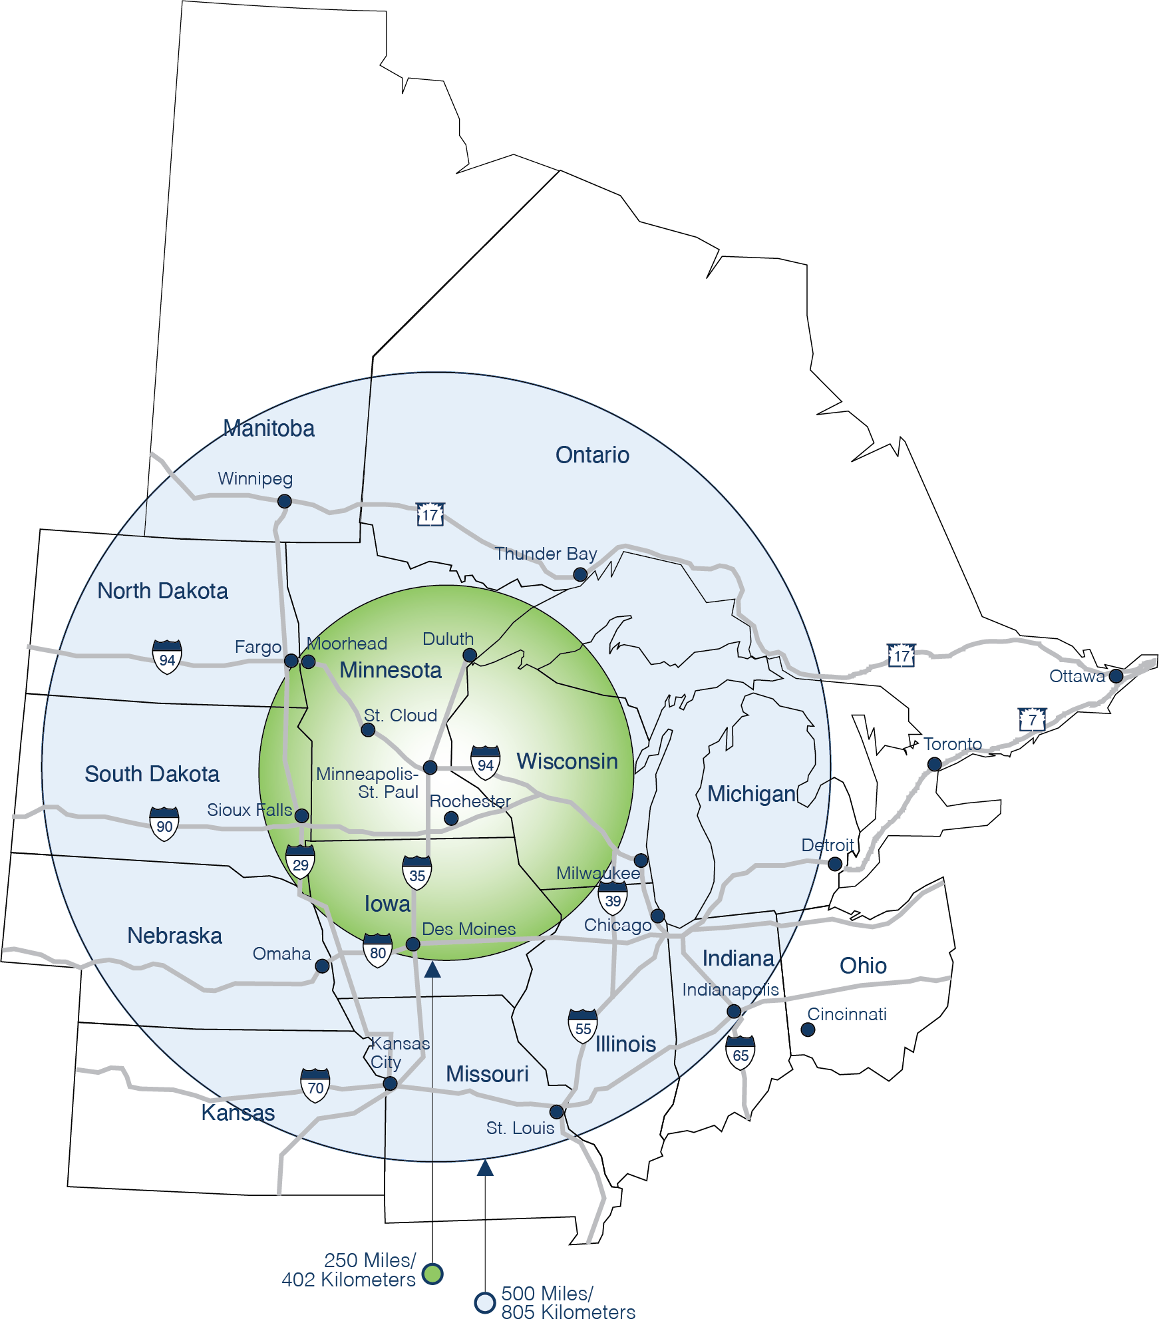
Reach Millions of Customers in Just a Day
Notes:
With a population of over 33 million within 500 miles of Minneapolis-St. Paul you are sure to find the customers your company needs to succeed. These are the 10 states with America's best infrastructure in 2022 (cnbc.com) accessed July 2023.

Slide 21
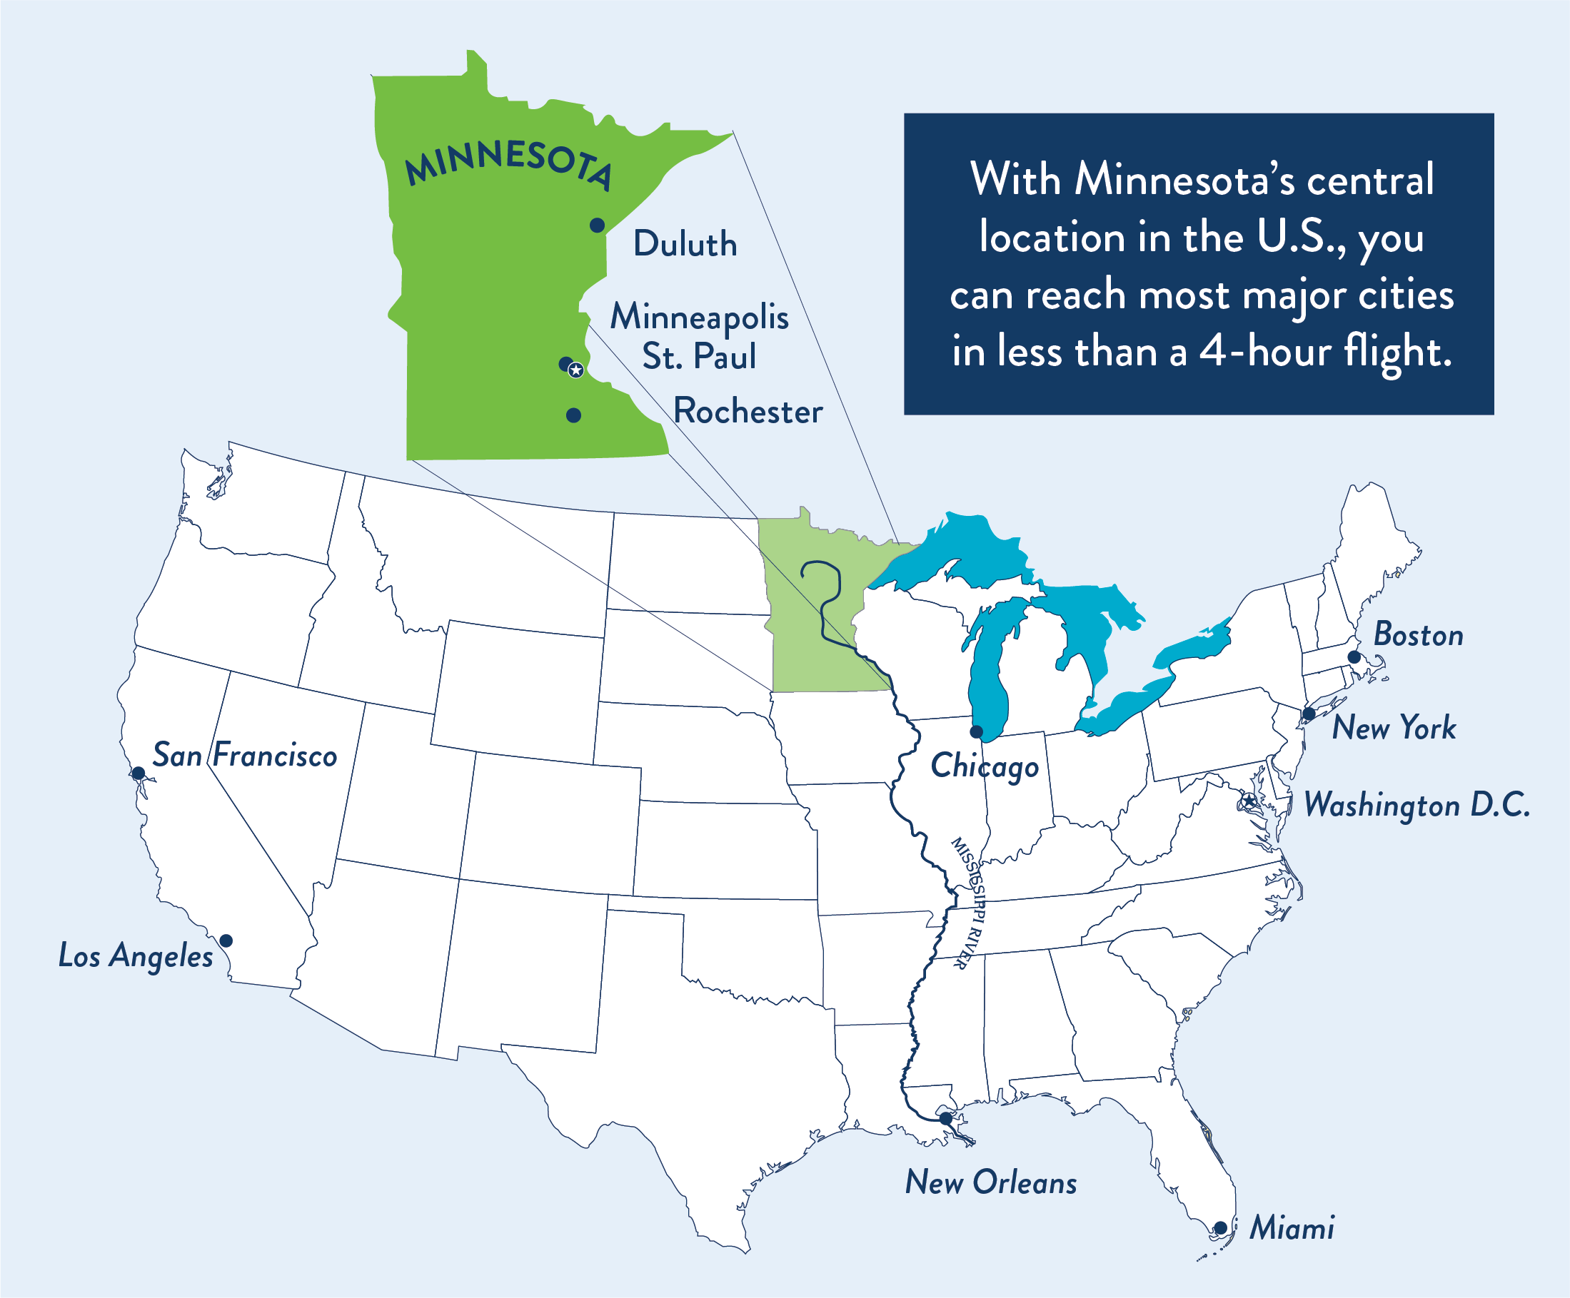
Central Location

Slide 22
Global Talent Market
Our talented workforce is ready to work and wants to make a difference.
Notes:
Let’s start with our most important asset: Our people

Slide 23
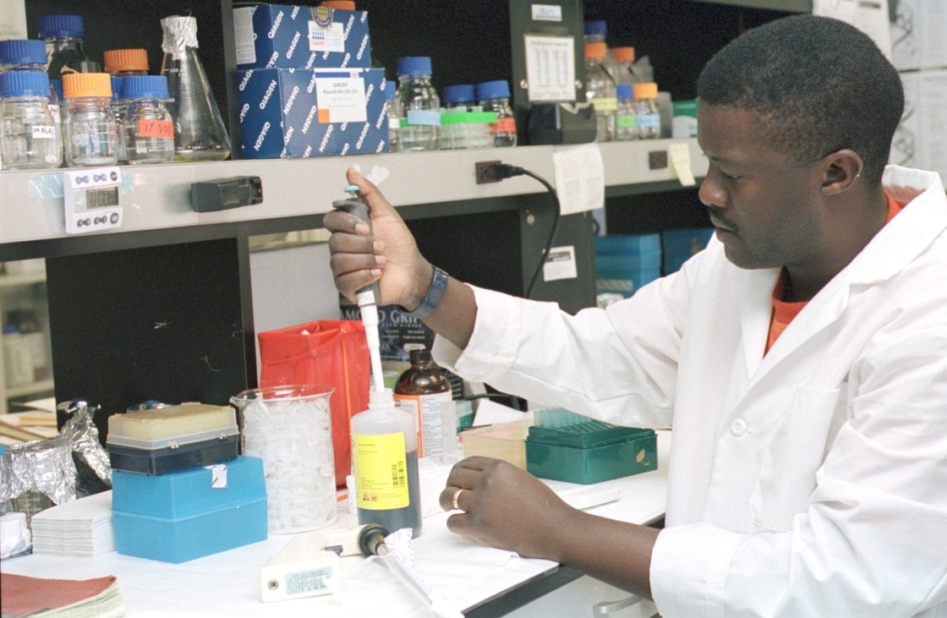
A Top-Ranked Workforce
#3
#8
#4
Labor Force Participation Rate for Women
Labor Force Participation Rate
Percent with High School Diploma
Notes:
Our workforce is a key competitive advantage for companies of all kinds. We are known nationwide for high skill, high productivity, high motivation and low absenteeism.
Our work ethic is legendary. And that’s no exaggeration. You can see it reflected in our labor force participation rate.
END OF SPEAKER NOTES
SOURCES:
Labor Force Participation: Bureau of Labor Statistics, 2022 Expanded State Employment Status Demographic Data : U.S. Bureau of Labor Statistics (bls.gov) accessed July 2023
Percent with high school diploma S1501: EDUCATIONAL ATTAINMENT - Census Bureau Table 2023 (accessed September 2023)

Slide 24
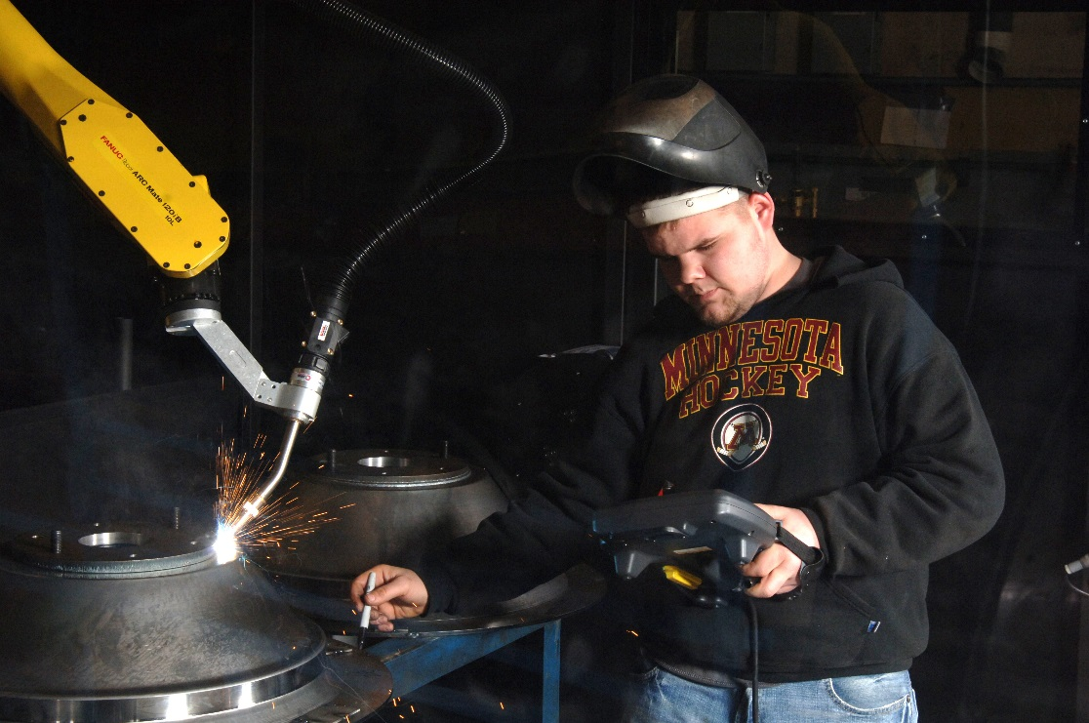
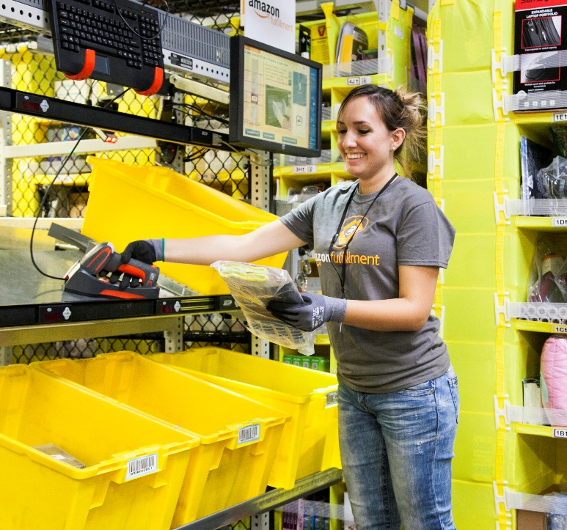
Abundant Pool of Reliable Talent
Labor force of over 3.1 million workers
4th in technology and innovation (CNBC, 2023)
Notes:
Minnesota is a magnet for talent and companies have access to a large, reliable pool of workers, from scientific and high-tech professionals, to high-level management expertise, to well-trained trades and production workers.
END OF SPEAKER NOTES
SOURCES:
Labor force size: 3.1 million; Bureau of Labor Statistics – (https://www.bls.gov/eag/eag.mn.htm, accessed July 2023).
Tech & Innovation: (https://www.cnbc.com/2023/07/11/americas-top-states-for-business-2023-the-full-rankings.html, accessed July 2023).

Slide 25
Exceptional Education System
A high-quality workforce comes from a high-quality education system
Notes:
Of course, a high-quality workforce can only come from an equally high-quality educational system.
The people of Minnesota are among the most educated in the nation, and our educational system is among the most admired.

Slide 26
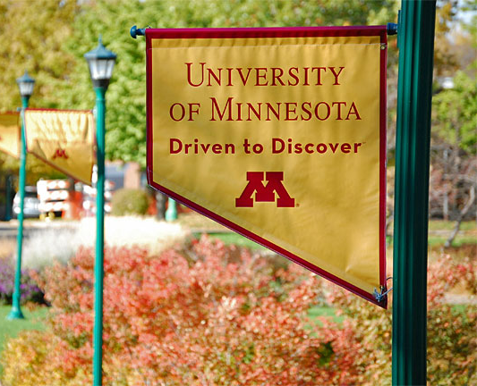
Always at the Top of the Class
#5
#5
#9
Chance for Success
Best Community College Systems
Most Educated States
Notes:
As a top-ranked place for people with a bachelor’s degree or higher, we’ve got more diplomas hanging on the wall than most other states.
The foundation of Minnesota’s success is a statewide network of over 100 public and private universities, colleges and technical schools.
Some of the nation’s most admired and respected institutions are among them.
END OF SPEAKER NOTES
SOURCES:
Chance for Success https://epe.brightspotcdn.com/53/49/8bbe12b94d1dac483739761844f9/quality-counts-2021-chance-for-success-table.pdf
Best Community College Systems https://wallethub.com/edu/e/states-with-best-worst-community-college-systems/15073
Most Educated States https://wallethub.com/edu/e/most-educated-states/31075

Slide 27
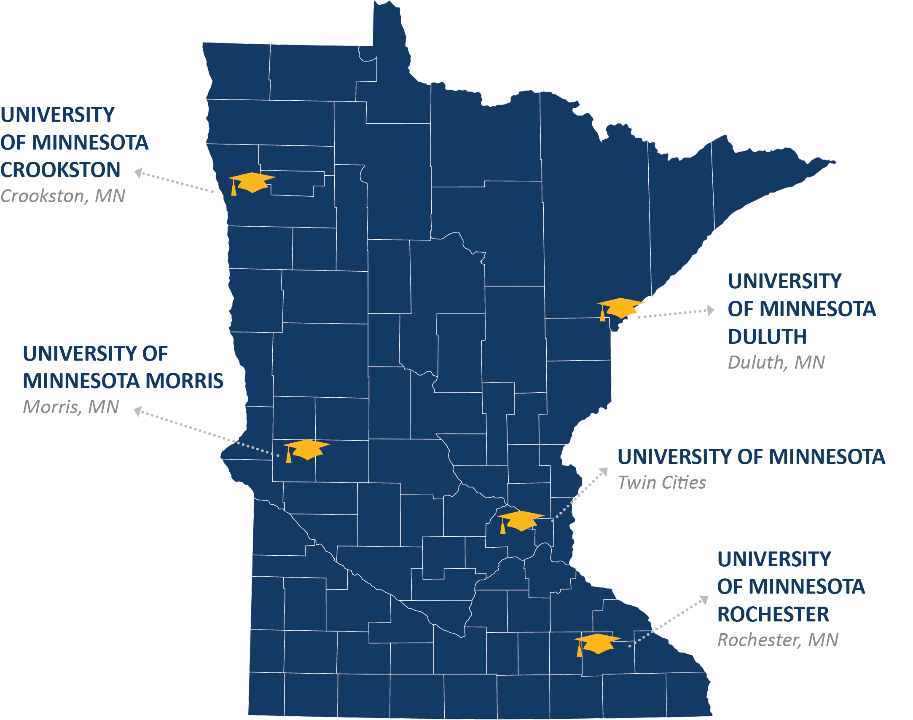
University of Minnesota
Serves over 68,500 students on five campuses
Offers 150 undergraduate majors and more than 130 research-based graduate programs
Over $1.07 Billion in R&D expenditures in FY2021
Notes:
The U of M serves over 68,500 students on five campuses, including the Twin Cities, Crookston, Duluth, Morris and Rochester.
END OF SPEAKER NOTES
SOURCES:
Number of students: University of Minnesota website, Academic Year 2022-2023 enrollment data: (https://idr.umn.edu/reports-by-topic-enrollment/enrollments, accessed July 2023).
Number of programs: University of Minnesota (https://admissions.tc.umn.edu/academics/academics-overview; accessed July 2023).
National Science Foundation, HERD Survey 2021 Table 37 (https://ncses.nsf.gov/surveys/higher-education-research-development/2021, accessed July 2023).

Slide 28
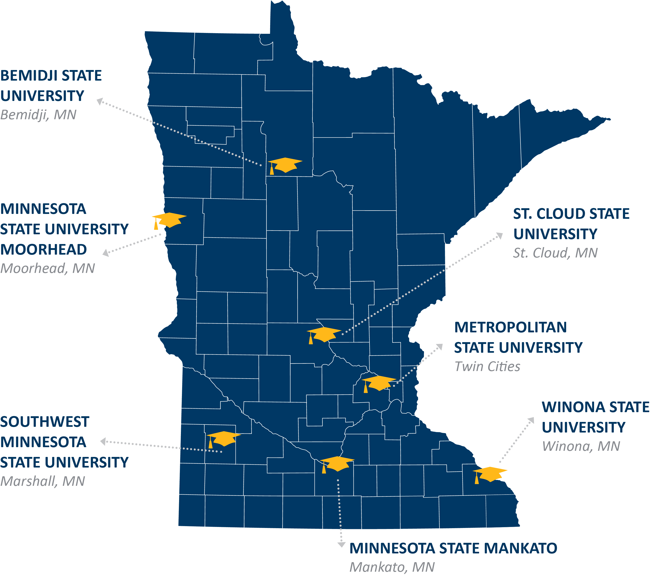
State Colleges and Universities
As the 4th largest system of state colleges and universities in the U.S., Minnesota state includes:
7 state universities
26 colleges
54 campuses
300,000 students served annually
More than 9,950 specialized training, occupational, and professional classes
Notes:
Minnesota State, a system of 33 colleges and universities, is the single-largest provider of higher education in the state – and is the fourth largest system of state colleges and universities in the country. It is a public higher education system that is separate from the University of Minnesota.
There are seven state universities in the system – in Bemidji, Marshall, Moorhead, Mankato, Winona, St. Cloud and St. Paul.
END OF SPEAKER NOTES
SOURCES:
All statistics from Minnesota State website (https://minnstate.edu/system/index.html, accessed July 2023).

Slide 29
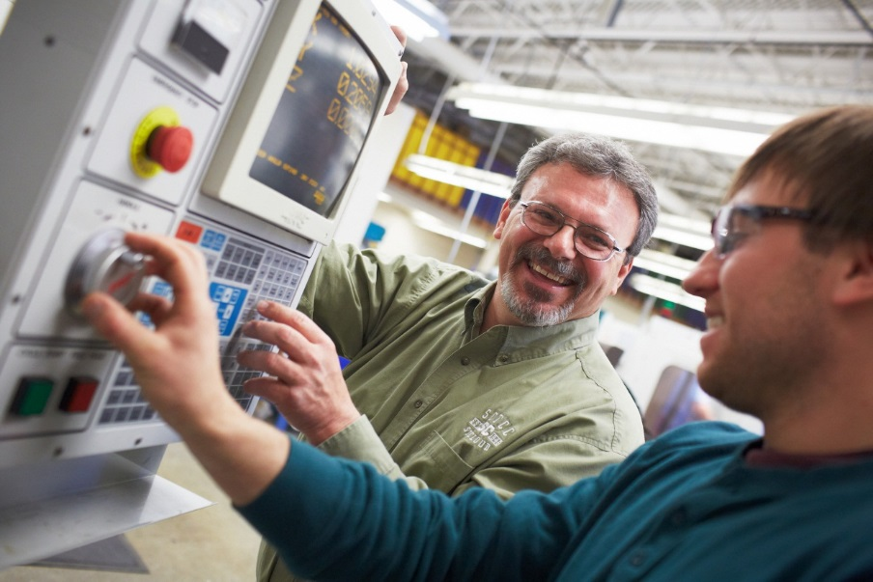
Intersection of Education and Technology
Minnesota State provides training to over 2,700 businesses and over 130,000 individuals every year
The University of Minnesota provides training, consulting, technology, research facilities, product development and testing – all catering to individual business needs
Notes:
The interlacing of education and industry is a Minnesota strong suit. Our responsiveness to – and collaboration with – business and industry is unrivaled.
From training to research and product commercialization, our colleges and universities work side-by-side with thousands of companies.
They range from small businesses to Fortune 500 companies like 3M and Land O’Lakes and bioscience powerhouses like Boston Scientific.
END OF SPEAKER NOTES
SOURCES:
Customized training: Minnesota State (https://www.minnstate.edu/ws/index.html, accessed July 2023).
U of M: Industry and Partnership (https://research.umn.edu/industry-partnership/corporations-industry, accessed July 2023).

Slide 30
Amazing Quality of Life
Welcome home, we think you're gonna like it here

Slide 31
Quality of Life
Minnesota is a Top-10 State in every category
Happiest
Healthiest
Safest
Best States for Millennials
Best States to Live In
Best States to Retire
Notes:
Quality of life is important in attracting and retaining employees. But what do we mean by it? It’s an admittedly broad category that gets measured in many different ways….
But, however you measure it, Minnesota routinely ranks at the top for overall quality of life….
https://wallethub.com/edu/happiest-states/6959
https://assets.americashealthrankings.org/app/uploads/ahr_2022annualreport.pdf
https://wallethub.com/edu/safest-states-to-live-in/4566
https://wallethub.com/edu/best-states-for-millennials/33371
https://wallethub.com/edu/best-states-to-live-in/62617
https://wallethub.com/edu/best-and-worst-states-to-retire/18592

Slide 32
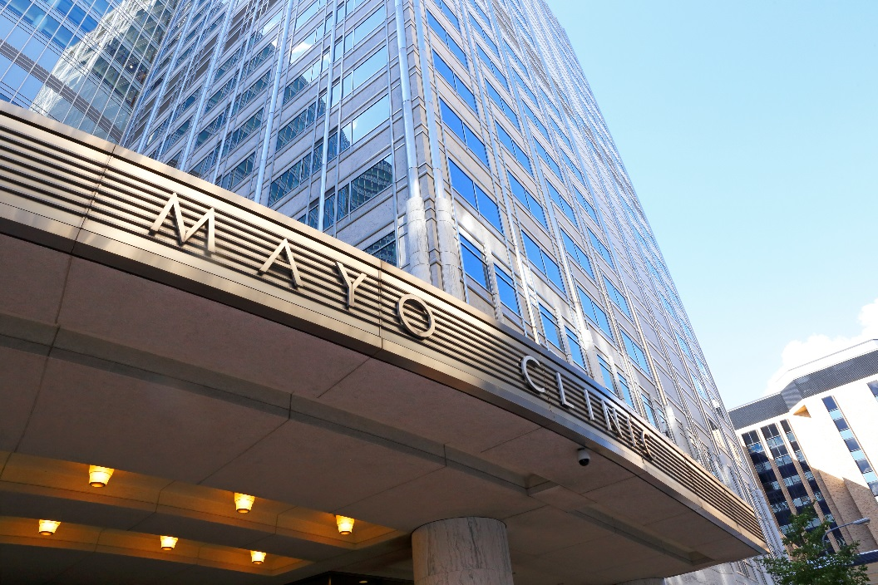
Top-Ranked Health Care
Best state for healthcare in the country (Forbes, 2023)
The Mayo Clinic rated best hospital in the U.S.: 2016 - 2023
Notes:
The high quality of our health care across the state is remarkable. Mayo Clinic, one of the world’s most renowned medical institutions, calls Minnesota home. For seven consecutive years, it has been named the best hospital in the country.
END OF SPEAKER NOTES
SOURCES:
The Worst (And Best) States For Healthcare, Ranked. https://www.forbes.com/advisor/health-insurance/best-worst-states-for-healthcare/, accessed October 2023.
Best Hospitals report, U.S. News & World Report, 2016-2017, 2017-2018, 2018-2019, 2019-2020, 2020-2021, 2021-2022, 2022-2023

Slide 33
A Top State for Kids
#2
#5
Best State to Raise a Family
Overall Child Well-Being
Notes:
As you can see, Minnesota is one of the very best places in the nation to grow up.
END OF SPEAKER NOTES
SOURCES:
Best State to Raise a Family: WalletHub, 2023: https://wallethub.com/edu/best-states-to-raise-a-family/31065
Overall: Annie E. Casey Foundation, 2023 Kids Count Databook: https://www.aecf.org/resources/2023-kids-count-data-book

Slide 34
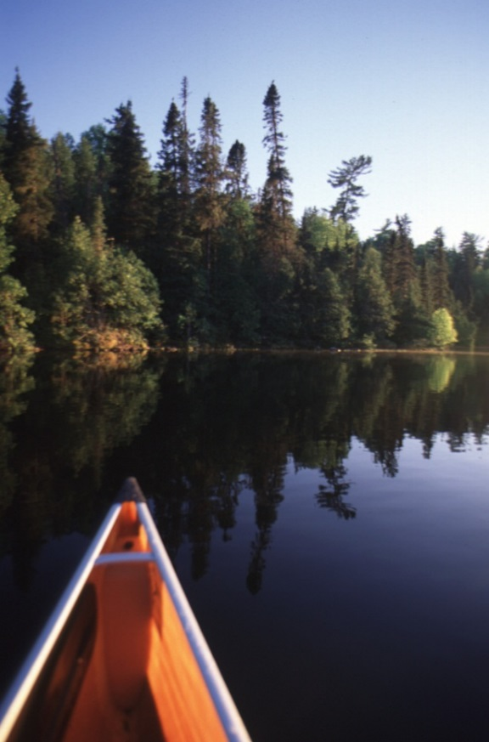
We Thrive Outside
Nearly 12,000 lakes
More shoreline that California, Florida and Hawaii combined
More than 400 golf courses
75 state parks and recreation areas
Over 1,300 miles of state trails
Camping, boating, skiing, water-skiing, canoeing, kayaking, snowmobiling and more
Notes:
Minnesotans are fun people – and we know how to have a good time.
We love our arts and culture, sports and recreation. And there’s a lot to love.
Minnesotans are irresistibly drawn to every corner of our beautiful outdoors and abundant public waters and lands. Nearly 8 million people visit our state parks every year.
END OF SPEAKER NOTES
SOURCES:
Minnesota Department of Natural Resources (DNR) (based on lakes of 10 acres or more)
More shoreline statistic: https://www.chrisfinke.com/2013/12/30/does-minnesota-really-have-more-shoreline-than-california/
Golf courses: Minnesota Department of Tourism, accessed July 2023. https://www.exploreminnesota.com/travel-ideas/golf-in-minnesota-fact-sheet/
State parks: DNR, accessed July 2023. https://www.dnr.state.mn.us/state_parks/index.html
State trails: DNR, accessed July 2023. https://www.dnr.state.mn.us/state_trails/index.html

Slide 35
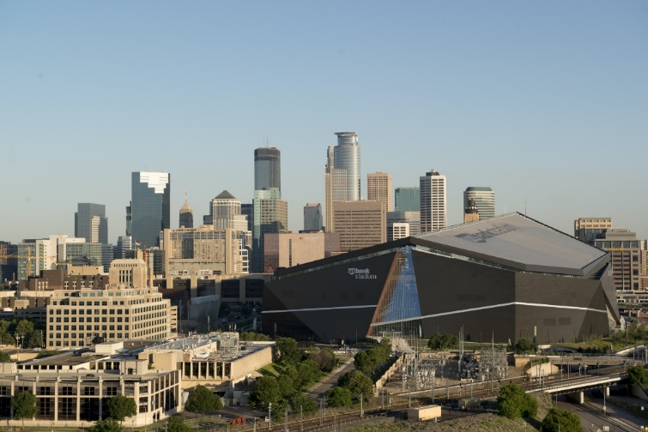
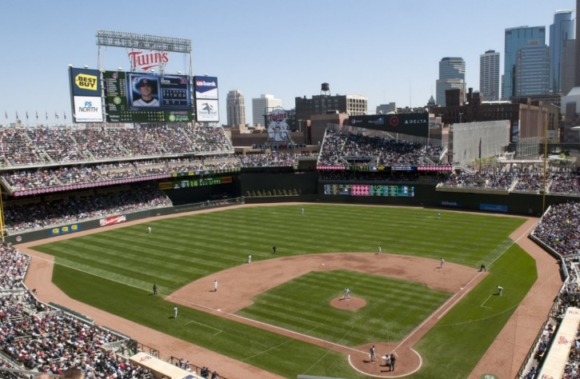
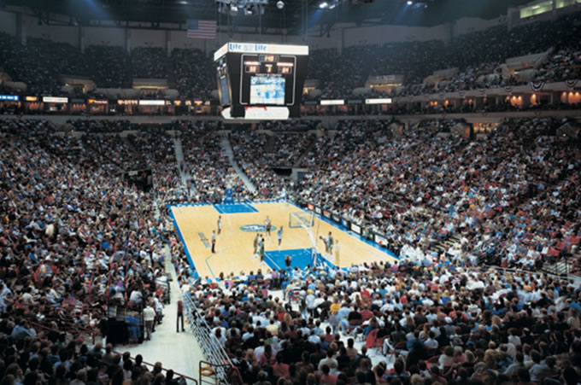
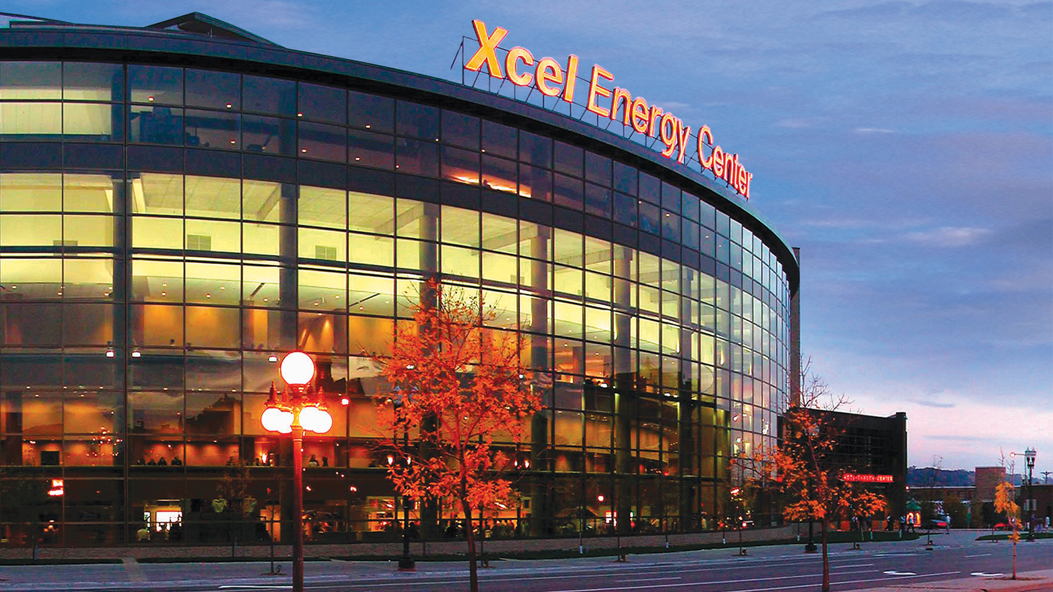
We’re Big on Sports
Professional baseball, football, basketball, hockey and soccer teams.
Notes:
We’re big on sports. If there’s a ball or puck involved, we bounce it, shoot it, pass it, throw it, smack it, and slap-shot the daylights out of it.
Minnesota’s US Bank Stadium hosted Super Bowl 52 in 2018 and the Final Four in 2019.
Minnesota United has joined Major League Soccer. Its new Allianz Field soccer stadium opened in 2019.

Slide 36
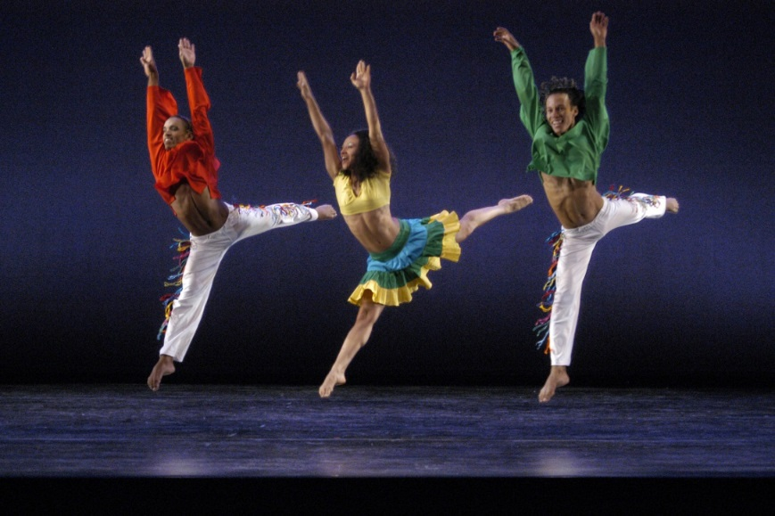
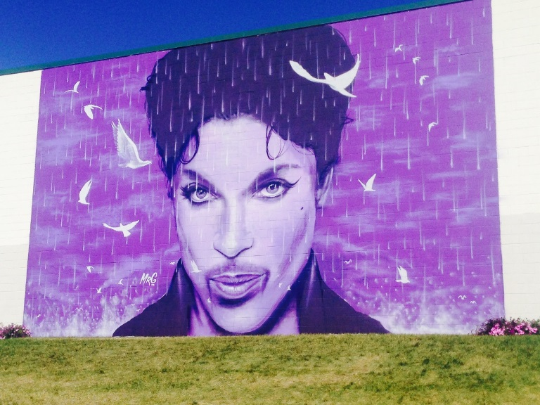
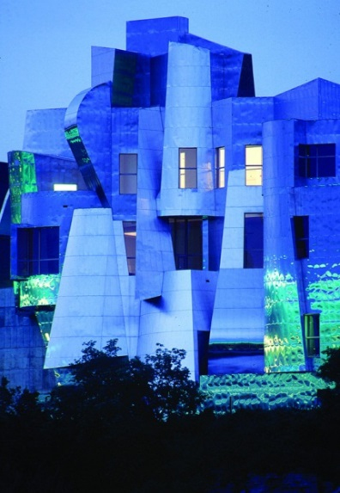
Arts and Culture
Renowned orchestras – including the Minnesota Orchestra and the St. Paul Chamber Orchestra – and a rich theater scene with performance centers like the Guthrie Theater
Several world-class museums, including the Minneapolis Institute of Arts, Walker Art Center and Sculpture Garden and the Weisman Art Museum, among others
Multiple venues that host national and international entertainers, including First Avenue nightclub and the Dakota Jazz Club
Notes:
However, you take your culture, you’ll find that it’s being painted, sculpted, sung, danced, played, recited and performed in Minnesota.

Slide 37
Key Industries
Our diverse economy makes Minnesota stand out

Slide 38
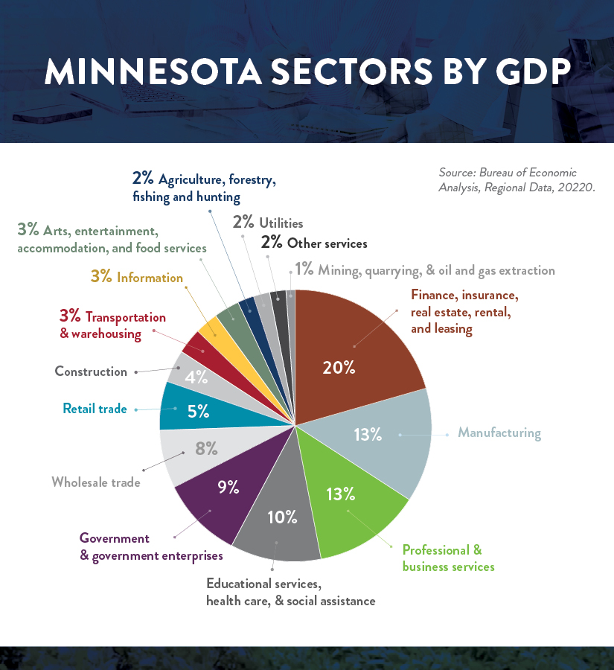
Key Industries
Advanced Manufacturing
Leading Life Sciences
Clean Tech and Renewable Energy
Food and Agriculture
Technology and Innovation
World Class Retail
Finance & Insurance Ecosystem
Support Services
Notes:
Minnesota's strength is economic diversity, matched with our innate collaboration that drives a diverse ecosystem of businesses that support our Fortune 500 companies and fuel the next generation of innovation makes your growth potential here unstoppable.
Sources
8 Key Industries https://joinusmn.com/key-industries/index.jsp
Pie chart of Minnesota sectors by GDP https://www.bea.gov/itable/, GDP in current dollars, Table SAGDP2N

Slide 39
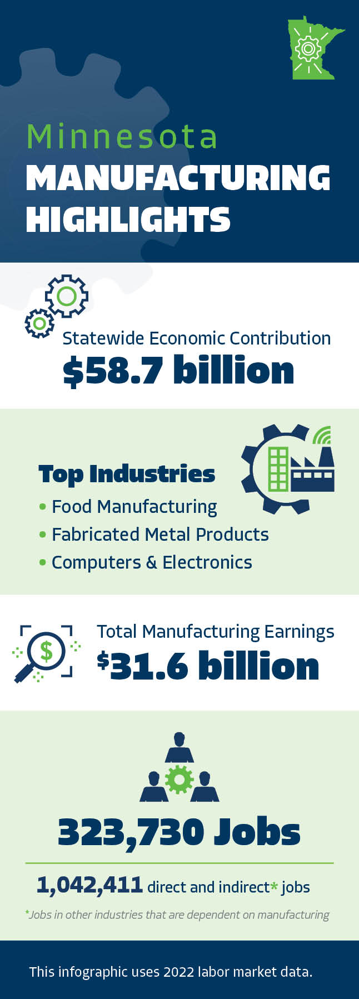
Advanced Manufacturing
More than 8,500 companies, making a wide range of products
Exported $24 billion worth of goods in 2022 (a 12% increase from 2021)
Accounts for 11% of statewide employment
Represents 13% of our state's gross domestic product by industry
Notes:
Minnesota's manufacturing sector is the backbone of the state's economy. Our history of innovation, along with our highly skilled workforce, makes the state a hotbed of manufacturing.
Sources
Number of companies: LMI QCEW (Establishments tab)
Exports: Thu-Mai
Percentage of statewide employment: LMI QCEW
Percentage of GDP: BEA
Infographic
Contribution: BEA
Top Industries: LMI QCEW (Employment tab)
Payroll: LMI QCEW (Employment tab – wages)
Direct and Indirect jobs: Neal (QCEW, LMI, MN DEED. REMI for indirect.)

Slide 40
Advanced Manufacturing
Half of Minnesota's Fortune 500 companies are involved in manufacturing, including 3M, CHS, General Mills, Land O'Lakes, Ecolab, Hormel Foods, Polaris.
Cargill, the largest private company in the country, is Minnesota's largest manufacturer.
Other manufacturing companies headquartered or with large operations in the state include Medtronic, Andersen Windows, H.B. Fuller, and Toro, just to name a few.
Notes:
Minnesota's diverse, technology-driven advanced manufacturing sector is strong in high-tech manufacturing, including computers and electronics, medical devices, vehicles and more.

Slide 41
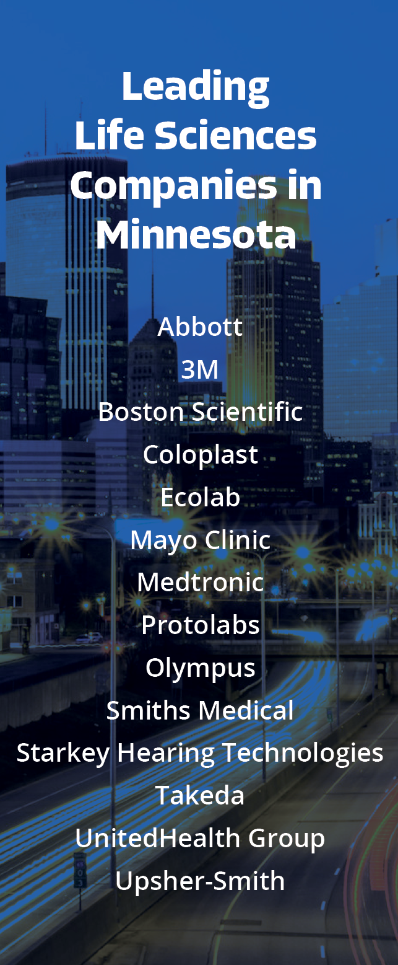
Leading Life Sciences
The state ranks:
2nd in medical device patents per capita
3rd in total medical device patents, and
9th in biotechnology patents per capita
Notes:
Minnesota is committed to developing, building and promoting health and life science technologies across a broad swath of industries – including medical devices, health care, pharma & biotech, health IT, animal science, biomaterials/biofuels and more. That's why we have a robust health and life sciences ecosystem. Businesses looking to start, expand or relocate in Minnesota will find a supportive community of like-minded partners in the public, private and nonprofit sectors who are passionate about their work and its potential to save and improve lives across the globe.
Source:
U.S. Patent and Trademark Office. Patents by Keyword. Calculations by DEED.
https://mn.gov/deed/data/economic-analysis/patents/

Slide 42
Clean Tech and Renewable Energy
1st in the West-North-Central Region and 5th in the nation in sustainability
8th most environmentally friendly state
10th for overall energy efficiency programs (highest in the Midwest)
Produce over 6,000 MW of electricity from clean energy, ranking 10th nationwide
Minnesota's clean energy can power 2 million homes in the state.
First state to mandate use of biodiesel, establishing B2 mandate in 2005 and first state to mandate use of ethanol in gasoline in 1995.
Notes:
SOURCES:
1) https://siteselection.com/issues/2021/jul/2021-sustainability-rankings-cover.cfm (2021)
2) https://wallethub.com/edu/greenest-states/11987 (2023)
3) https://www.aceee.org/state-policy/scorecard (2022)
4) https://cleanpower.org/facts/state-fact-sheets/ (February 2023)
5) https://cleanpower.org/facts/state-fact-sheets/ (February 2023)
6) https://mn.gov/deed/joinusmn/key-industries/clean-tech-renewable-energy/ (accessed July 2023)

Slide 43
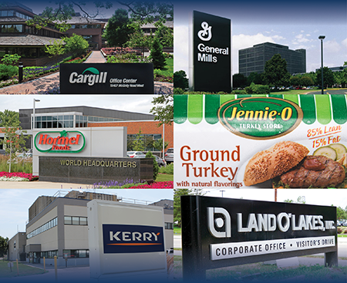
A Food Production Powerhouse
Agricultural production and processing industries generate over $106 billion annually in economic impact
Support more than 388,000 jobs
Generated about $21.3 billion in agricultural cash receipts in 2022
The largest private food company in the country—Cargill—is headquartered in Minnesota
Notes:
Minnesota is one of the top producers of food in the country. Three of the top 13 food companies in the U.S. by food sales are based here: General Mills, Cargill and Hormel. Source: Food Processing's Top 100 – 2022.
Headquarters for Fortune 500 food giants General Mills, Land O'Lakes and Hormel
Cargill and Rosen's Diversified are among the largest private food sector firms based here
Foreign-owned food companies with significant operations in Minnesota include Kerry, Ornua, and Agropur
Sources
https://www.mda.state.mn.us/business-dev-loans-grants/economic-analysis-market-research (Accessed July 2023)
https://www.mda.state.mn.us/business-dev-loans-grants/economic-analysis-market-research (Accessed July 2023)
https://www.mda.state.mn.us/business-dev-loans-grants/economic-analysis-market-research (Accessed July 2023)
https://www.forbes.com/lists/largest-private-companies/?sh=45b7cb44bac4 (2022)

Slide 44
Technology and Innovation
2nd in Medical Device manufacturing (Lightcast, 2022)
3rd in Navigational, Measuring, Electromedical, and Control Instruments Manufacturing (Lightcast, 2022)
3rd in Computer Storage Device Manufacturing (Lightcast, 2022)
4th in Technology and Innovation (CNBC, 2023)
4th in Computer Terminal and Other Computer Peripheral Equipment Manufacturing (Lightcast, 2022)
Notes:
Sources
1) Lightcast, 2022. By number of jobs.
2) Lightcast, 2022. By number of jobs.
3) Lightcast, 2022. By number of jobs.
4) America’s Top States for Business 2023, CNBC
5) Lightcast, 2022. By number of jobs.

Slide 45
Technology and Innovation
6th in Overall Computer and Electronic Product Manufacturing (Lightcast, 2022)
7th in Human Capital Investment and Technology and Science Workforce (Milken Institute, 2022)
11th in Semiconductor and Other Electronic Component Manufacturing (Lightcast, 2022)
11th Most Innovative State in the country (Bloomberg, 2020)
Notes:
Sources
1) Lightcast, 2022. By number of jobs.
2) State Technology and Science Index 2022 https://milkeninstitute.org/report/state-technology-and-science-index-2022
3) Lightcast, 2022. By number of jobs.
4) https://www.bloomberg.com/news/articles/2020-06-22/california-massachusetts-rank-as-most-innovative-u-s-states

Slide 46
Services Supporting our Ecosystem
Employs 192,000 people
Software Developers: 13,200 jobs
Management Analysts: 10,700 jobs
Accountants and auditors: 9,300 jobs
Lawyers: 8,760 jobs
General Managers and Operators: 7,215
Notes:
Sources
Employs 192,000 people; Pie Chart (Lightcast, Industry Table, NAICS 541, Minnesota, 2022 Jobs)
See notes attachment for updated numbers for pie chart for 2022
Number of jobs (Lightcast, Industry > Staffing Patterns > Harvard Cluster: Business Services, Employed in Industry Group, 2022)

Slide 47
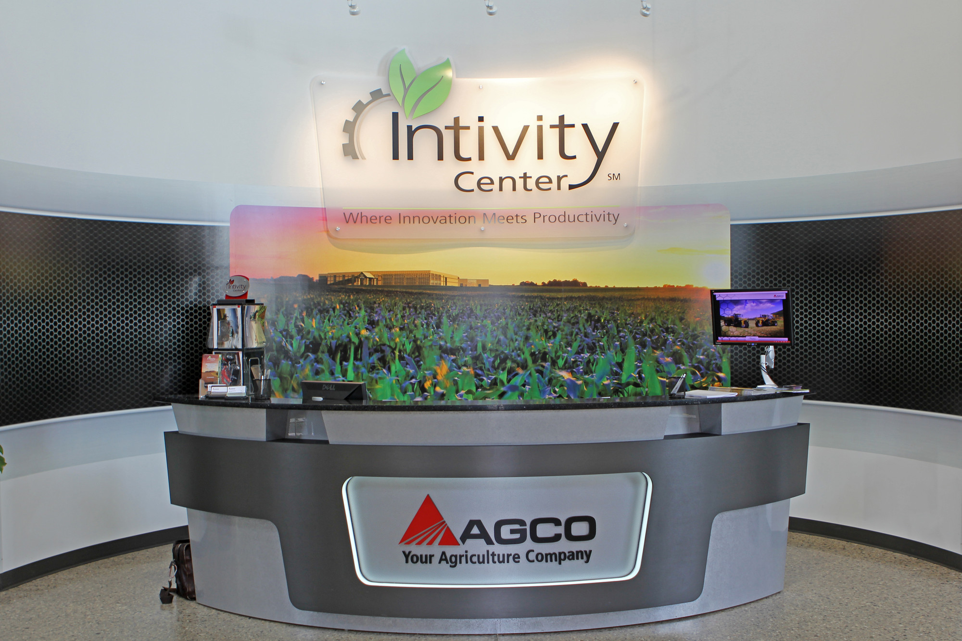
Innovation and Technology Patent Powerhouse
Minnesota's professional business services companies are beacons of technology registering patents (2000-2022) in cutting-edge fields:
IBM (computer design): 9,772 patents
3M (industry, healthcare, consumer goods): 9,554 patents
Medtronic (medical devices): 5,629 patents
Notes:
SOURCE: U.S, Patent and Trademark Office. Analysis by DEED.
(https://mn.gov/deed/data/economic-analysis/patents/, Patents by Top Minnesota Organizations) Accessed July 2023.
The number of patents 2000-2022

Slide 48
World Class Retail
Twelve of Fortune’s “World’s Most Admired Companies” are headquartered in Minnesota, including Target and 3M in the Top 30.
Minnesota Retail Innovations
1912 Handled Grocery bag
1919 Pop-Up Toaster
1922 Water Skis
1923 Milky Way Candy Bar
1925 Masking Tape
1947 Tonka Trucks
1947 Packaged Cake Mix
1950 Bundt Pan
1951 Snow Blower
1952 Indoor Shopping Mall
1964 Twister
1969 Nerf Ball
1980 Rollerblades
1987 Breath Right Nasal Strip
1987 Sleep Number Bed
1992 Mall of America – Largest shopping complex in the US
Notes:
While some hear retail and think shopping, in Minnesota, we mean so much more. Shopping means big business in Minnesota. We're home to dozens of leading large retailers. Our innovation and technology sectors contribute to the retail ecosystem in the state, helping our retailing giants ex
Most admired companies: https://fortune.com/ranking/worlds-most-admired-companies/2023/

Slide 49
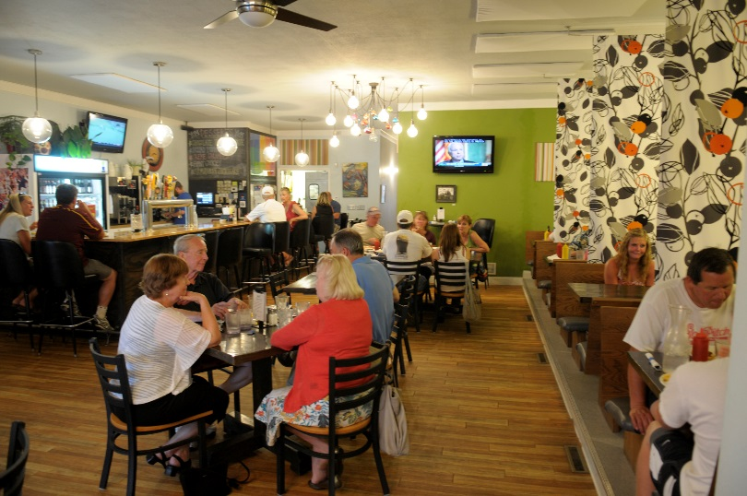
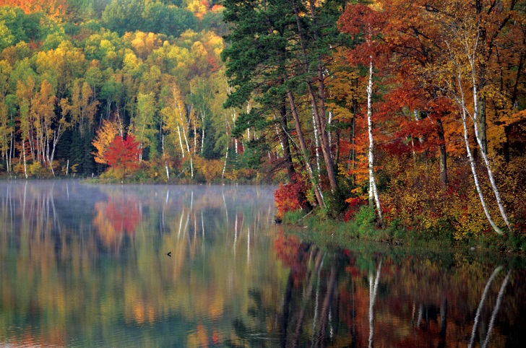
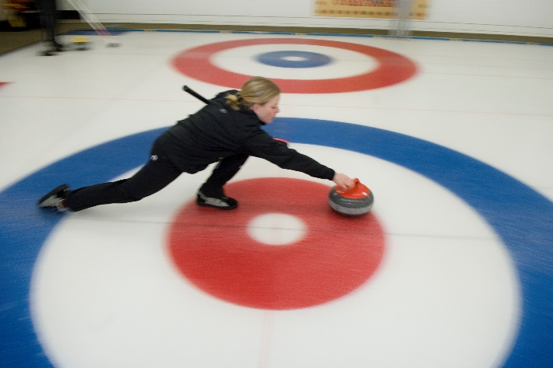
Thank You!

